Slide 1
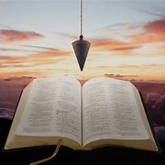
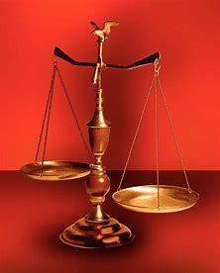
Fellowship Church, Oct 9, 2024 B. Heath
Straight and Balanced
(Luke 3:4-6)
Biblical characters (Hebrews 11:1-3, 6, 39-40)
#1 – Abel’s Faith & Innocent Blood (Heb 11:4, Gen 4)
#2 – Walking with God & with Enoch (Heb 11:5-6, Gen 5)
#3 – Secure on the Ark with Noah (Heb 11:7, Gen 6-11)
#4a – Faith with Abraham (Heb 11:8-19, Gen 12-23)
#4b – Faith with Sarah (Heb 11:11-12, 1 Peter 3:6)
#4c – OT & NT Strangers & Pilgrims (Heb 11:13-16, 1 Pe 2:11)
#5 – Faith & Laughter with Isaac (Heb 11:17-19, Gen 18-24)
#6 – Faith with Jacob/Israel (Heb 11:20-21, Gen 25-36)
#7 – Faith with Joseph beyond Death (Heb 11:22, Gen 37- 50)
#8 – Faith with Moses the Deliverer (Heb 11:23-29, Exo-Deu)
#9 – Faith with Joshua (Heb 11:30, Joshua)
#10 – Faith with Rahab (Heb 11:31, Joshua 6)
#11 – Faith with the Judges (Heb 11:32, Judges)
#12 – Faith with David (Heb 11:32, 2 Samuel, 1 Chr)
#13 – Faith with Samuel (Heb 11:32, 1 Samuel)
#14 – Faith with the Prophets (Heb 11:32-38, Is-Malachi)
#15 – Faith for All (Heb 11:39-40, Old Testament saints)
OT: Ps 5:8, Pr 4:25-27
Amos 7:7-8, Is 28:13, 17
NT: Mt 3:3, Acts 9:11
Hebrews 12:13, Jude 3
1 Cor 15:1-4, 2 Tim 3:10
John 7:16
OT: Deut 25:13-16
Pr 20:10, Dan 5:25-28
NT: Hebrews12:1
1 Cor 3:11-15,
Philippians 4:5,
James 3:17

Slide 2
By Faith with Moses the Deliverer (Hebrews 11:23-29)
Text: 11:23 By faith Moses, when he was born, was hid three months of his parents, because they saw [he was] a proper child; and they were not afraid of the king's commandment. /Acts 7:20-22, Moses’ birth in Egypt to three months/
24 By faith Moses, when he was come to years, refused to be called the son of Pharaoh's daughter; 25 Choosing rather to suffer affliction with the people of God, than to enjoy the pleasures of sin for a season; 26 Esteeming the reproach of Christ greater riches than the treasures in Egypt: for he had respect unto the recompense of the reward.
/Acts 7:23-25, 26-28, Moses in Egypt from 3 months to 40 years old/
27 By faith he forsook Egypt, not fearing the wrath of the king: for he endured, as seeing Him who is invisible. /Acts 7:29-34, Moses in the desert of Madian from 40 to 80 years old/
28 Through faith he kept the passover, and the sprinkling of blood, lest He that destroyed the firstborn should touch them. /Acts 7:35-36a, Moses in Egypt as the deliverer from slavery/
29 By faith they passed through the Red sea as by dry [land]: which the Egyptians assaying to do were drowned. /Acts 7:36b. Acts 7:37-44, Moses in the desert from 80 to 120 years old/

Slide 3
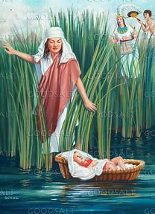
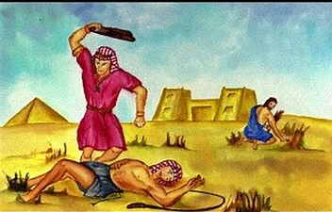
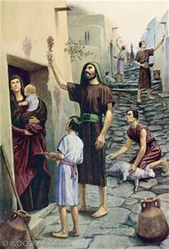
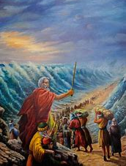
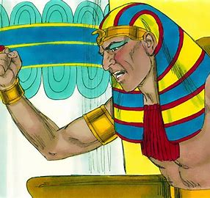
Faith with Moses the Deliverer (Hebrews 11:23-29) “Moses is a type of Jesus my deliverer”
(1)
Hebrews
11:23
Exodus
1:1-2:10
Luke
1:78-80
Acts
7:20-22
(2)
Hebrews
11:24-26
Exodus
2:11-12
Matthew
26:52
Acts
7:23-25
NO MENTION – WHY?
Exodus 2:16-10
Ten plagues, Israel’s complaints
Exodus 15:22 to Deuteronomy 34
Ten commandments, law of Moses, in the wilderness (1 Corinthians 10:1-13)
(3)
Hebrews
11:27
Exodus
2:13-15
Matthew
10:28
(4)
Hebrews 11:28
Exodus
11-12
1 Corinthians
5:6-8
(5)
Hebrews 11:29
Exodus
14:31-15:21
Acts
7:35-36

