Slide 1
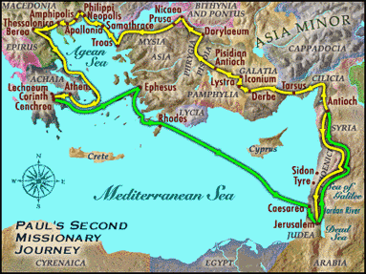
9:55 Countdown
Fellowship Church – Adult Sunday School – August 22, 2021
Title: Readiness for the Rapture of the Church (ekklesia)
Text: 1& 2 Thessalonians
Doctrine: Tier 2
Background: Acts 17:1-9
Sub-titles:
1 Thessalonians
12 Preparations for
the Rapture
2 Thessalonians
Trainings for
the Rapture

Slide 2
1 Thessalonians 1
Our salvation and the gospel are repeated three timeS
1
1:3. Remembering without ceasing your
(1) work of faith, and /salvation – past/
(2) labor of love, and /sanctification - present/
(3) patience of hope in our Lord Jesus Christ /return - future/
1:5. For our gospel came not to you in word only, but also
(1) in power, and /salvation - past/
(2) in the Holy Spirit, and /sanctification - present/
(3) in much assurance; /return - future/
1:9-10. (1) ye turned to God from idols /salvation – past/
(2) to serve the living and true God; And /sanctification - present/
(3) to wait for his Son from heaven, /return - future/
[even] Jesus, which delivered us from the wrath to come. /return - future/
2
3

Slide 3
Outline
1 Thessalonians
1. 1:1-10 Salvation (after Introduction 1:1)
2:1-3:9 Sanctification of pastors & teachers
3:10-4:12 Sanctification of believers – in general (2 sins)
4:13-5:11 Rapture of the Church
5:12-5:28 Sanctification of believers - specifics
2 Thessalonians
1:1-6 Sanctification of believers – in general (Intro 1:1-2)
1:7-2:12 Post Rapture wrath
2:13-3:18 Sanctification of believers – specifics (1 sin)
9. 1 & 2 Thes. Assess our readiness for the rapture

Slide 4
2 Thessalonians 1:7-2:12 Post Rapture Wrath 22 Aug 2021
1:7-10 Return of Jesus 1:11-12 Sanctification of Believers
2:1-3a Rapture of Church 2:3b-12 Post Rapture Wrath
Legend
S1-Salvation (one day, individuals, 1 Thes 1:1-10)
S2-Sanctification (daily, individuals & local church) * R2 – bride of Christ
R1-Prerapture (times & season, the church, global)
R2-Rapture (one day, the church, 1 Thes 4:13-5:11)
_________________________________________________________________________
R3-Post rapture (7 years of deception then wrath, global, Jerusalem, 2 Th 1:7-2:12)
* R3 – Judgment Seat of Christ then Marriage Supper
R4-Return (one day, Jesus to Jerusalem, global)
R5-Reign (1000 years, Christ in Jerusalem, global)
R6-Eternity (R6a - in Hell, R6b - in Heaven, New Jerusalem)
Next Sunday. 2 Thessalonians 2:13-3:18 Sanctification of Believers-Specifics

