Slide 1
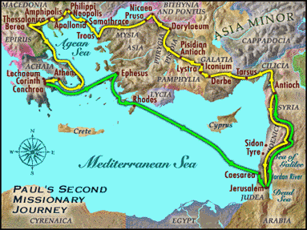
9:55 Countdown
Fellowship Church – Adult Sunday School – August 29, 2021
Title: Readiness for the Rapture of the Church
Text: 1& 2 Thessalonians
Doctrine: Tier 2
Background: Acts 17:1-9
Sub-titles:
1 Thessalonians
12 Preparations for
the Rapture
2 Thessalonians
Trainings for
the Rapture

Slide 2
1 Thessalonians 1
Our salvation and the gospel are repeated three timeS
1
3. Remembering without ceasing your
(1) work of faith, and /salvation – past/
(2) labor of love, and /sanctification - present/
(3) patience of hope in our Lord Jesus Christ /return - future/
5. For our gospel came not to you in word only, but also
(1) in power, and /salvation - past/
(2) in the Holy Spirit, and /sanctification - present/
(3) in much assurance; /return - future/
9-10. (1) ye turned to God from idols /salvation – past/
(2) to serve the living and true God; And /sanctification - present/
(3) to wait for his Son from heaven, /return - future/
[even] Jesus, which delivered us from the wrath to come. /return - future/
2
3

Slide 3
Outline
1 Thessalonians
1:1-10 Salvation
2:1-3:9 Sanctification of pastors & deacons
3:10-4:12 Sanctification & 2 sins
4:13-5:11 Rapture of Church; wrath & pre-rapture
5:12-5:28 Sanctification specifics
2 Thessalonians
1:1-6 Sanctification in general
1:7-2:12 Return of Jesus; rapture & wrath
2:13-3:18 Sanctification & 1 sin
9. 1 & 2 Thes. Assess my/our readiness for the rapture

Slide 4
2 Thessalonians 2:13-3:18 Sanctification & One Sin 29 Aug 2021
FIRST: 2:13-17 The Called are Established in Every Good Word and Work
- Chosen > Salvation > Spirit > Truth > Called > Glory (golden chain)
- Traditions > Taught > Establish > Every Good Word & Work
SECOND: 3:1-5 The Pastors Prayer Request & Encouragement
- Word Run & be Glorified
- Faithful > Establish > Keep from Evil > Love > Waiting
THIRD: 3:6-16 The Sin of Unemployment
- Behave Disorderly > Follow our Ensample > No Work – No Eat
- Obey not > Note > No Company > Ashamed > Admonish > Peace
FOURTH: 3:17-18 Ending: Grace Shall I continue in sin that grace may abound? God forbid!
Next Sunday. 1 & 2 Thessalonians Rapture Readiness Self-Assessment

