Slide 1
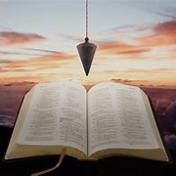
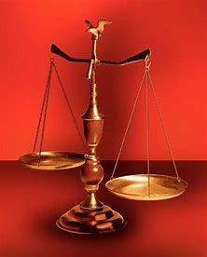
Fellowship Church, Mar 1, 2026 2 Peter 3:18 Sunday School Bill Heath
Music: Parables in Blues
Straight & Balanced
(Luke 3:4-6)
Jesus Teaches in Parables
11. The Prodigal Steward (Luke 16:1-13)
12. The Wedding Supper (Luke 14:7-24)
13. The Rich Man and Lazarus (Luke 16:19-31)
14. The Widow’s Persistent Prayers (Luke 18:1- 8)
15. The Pharisee & the Publican (Luke 18:9-14)
16. Ten Pounds to Ten Servants (Luke 19:11-27)
17. Words then Actions of Two Sons (Mt 21:28-32)
18. The Workers in the Vineyard (Mt 21:33-46)
19.
20.
21.
22.
23. Mysteries Revealed in the Parables of Jesus
OT: 2 Kings 21:13, Ps 5:8 Pr 4:25-27, Amos 7:7-8 Isaiah 28:13, 17
NT: Mt 3:3, Acts 9:11
Hebrews 12:13, Jude 3
1 Corinthians 15:1-4
2 Timothy 3:10, John 7:16
OT: Deut 25:13-16
Proverbs 20:10
Daniel 5:25-28
NT: Hebrews 12:1
1 Cor 3:11-15
Philippians 4:5
James 3:17

Slide 2
Today
Next 2 Sundays
Then, 3 more parables on the Mount of Olives (Matthew 24:1-26:2)
A parable is a temporary earthly story with an eternal heavenly truth.

Slide 3
Parable: Words then Actions of Two Sons, MT 21:28-32
 | No fruit on the fig tree 21:18-22 Jesus’ authority is challenged 21:23-27 ^{Go work today in My vineyard} The first son: “I will not,” then goes 21:28-29 The second son: “I will,” then goes not 21:30 Which son does the will of his father? 21:31 The way of righteousness – believed 21:32 Application: How am I working in His vineyard?

Slide 4
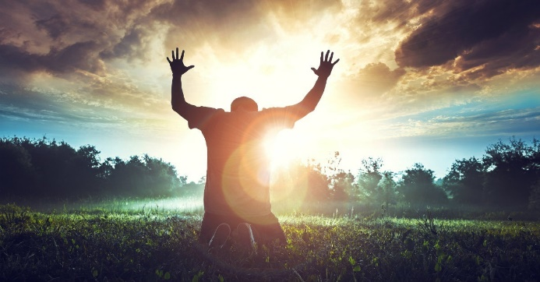
Sunday School Through the Bible (2019 - 2026)
Grow in grace, and in the knowledge of our Lord and Savior Jesus Christ
2 Peter 3:18
COMPLETED books of the Bible
Old Testament: Genesis (4), Exodus (4), Leviticus (2), Numbers (3), Deuteronomy (5),
1-2 Kings (12), Ruth, Esther, Psalms (4), Psalm 68 (3), Asaph (12), Proverbs, Ecclesiastes, Daniel (12), Hosea (9), Amos, Obadiah, Malachi
New Testament: Mark, Parables (24), Colossians, 1-2 Thessalonians (10), Ephesians, Philemon, Hebrews, James, 2 Peter (4), 1 John (13), 2 John, 3 John, Jude, Revelation (22)
Wednesdays: Judges (15), Song of Songs (15),
Topics: Prayer (15), Hebrews 11/prophets-Jonah, Micah,
Isaiah, Nahum, Habakkuk, Zephaniah, Jeremiah, Ezekiel,
(36), various (40)
Invitation to Fellowship Church 2026 daily schedule for Bible and prayer
2 Corinthians – Feb 28 to April 3, 2026 (44-day daily word & prayer)

Slide 5
Parable: Words and Actions of Two Sons, Matthew 21:28-32
 | No fruit on the fig tree, withered (3 different times, Lu 13:6-9, Mt 24:32-35) 21:18-22 who-Israel, when? Fig-tree represents the national position of Israel. Mt 3:2-10, ax laid at the root of the trees. Repent and be baptized, - faith to remove “this mountain & cast into the sea” (same-Mk 11:22-23, earlier-Mt 17:20, cast out demons, fast & pray) Jesus’ authority is challenged (same Mk 11:23-27, Lu 20:1-8) 21:23-27 who today, all nations? Movie: Time Changer Wisdom w/ the enemy. A Question answered with a question, then no response. different than the earlier parable in Luke 15 of 2 sons (repentance & joy), later 2 sons of Adam or thieves on crosses on each side of Jesus - day of atonement, 1 goat sacrificed and 1 set free (Lu 23:43) GO work today in My vineyard (the vine represents Israels blessings in Christ, Jn 15) The first son: “I will not,” then goes 21:28-29 “certain man” is the Lord Jesus Christ go work today in My vineyard (Mt 20:1-16, time. Next, Mt 21:33-46) (then goes - repentance) The second son: “I will,” then goes not 21:30 (then goes not – Hebrews 5x, not my 18-yr old experience) self-righteous, only with their mouth & words confession – witness yesterday. Which son does the will of his father? 21:31 (1st son, natural reasoning. Publicans & harlots go into the kingdom of God before you. John 3:3-8, born of water-infant baptism, not mother. The way of righteousness – believed 21:32 repented not. (John the Baptist and Jesus, Mt 3Mt 11:32, none born of women greater, least in the kingdom of heaven is greater) Ro 11:32, Jn 14:6 Application: How am I working in His vineyard?

