Slide 1
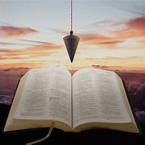
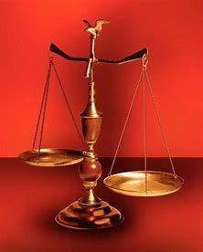
Fellowship Church, September 28, 2025 B. Heath
Straight & Balanced
(Luke 3:4-6)
Psalm 82 judge of the earth, in the Blues
Matthew quotes Asaph the prophet in Psalm 87:2 with things kept secret from the foundation of the world
(Matthew 13:35)
Psalm 50, God Judges His People Israel
(to bless or curse)
1 John 3:1-3
Psalm 73, When I am Weak, I am Strong
(look up, not around)
2 Corinthians 12:10
Psalm 74, God Chastises Israel
(sin allows the enemy in)
Hebrews 12
Psalm 75, God shall Judge the Wicked
(look at self first)
John 5:18-24
Psalm 76, God’s Wrath is Coming
(Jesus’ 2nd coming)
Hebrews 10:26-31
Psalm 77, Remember: Whom God Redeems,
He Leads
(in trials)
2 Corinthians 12:10
Psalm 78, Sin Limits the Holy One of Israel
(sin)
1 Corinthians 10:1-13
Psalm 79, National Prophetic Prayer for Israel
(Godly sorrow)
2 Corinthians 7:10
Psalm 80, National Prophetic Prayer for Israel
(Sanctification)
Romans 6-8
Psalm 81, National Prophetic Rejection by God
(Rejection by Israel)
Romans 11:1-10
Psalm 82, National Prophetic Judgment by God
(Judgment of Israel)
Romans 11:11-32
Psalm 83, All Nations Prophetic Judgment by God
(Enemies of Israel)
Romans 11:33-36
Asaph’s Parable
God’s Prophet, Psalmist, and Musician at the Ark
(Psalm 50, 73-83)
OT: 2 Kings 21:13, Ps 5:8 Pr 4:25-27, Amos 7:7-8 Isaiah 28:13, 17
NT: Mt 3:3, Acts 9:11
Hebrews 12:13, Jude 3
1 Corinthians 15:1-4
2 Timothy 3:10, John 7:16
OT: Deut 25:13-16
Proverbs 20:10
Daniel 5:25-28
NT: Hebrews 12:1
1 Cor 3:11-15
Philippians 4:5
James 3:17

Slide 3
ASAPH the prophet, the psalmist, and the musician
Old Testament
Asaph is “collector” in Hebrew
2. Asaph led music at the ark in Jerusalem (1 Chronicles 16: 4-7, 16:37)
3. David appointed Asaph the * seer to prophesy with instruments
(1 Chronicles 25:1-2); then God appointed Asaph (1 Chronicles 25:8-9a, 24 shifts)
4. Asaph wrote 12 psalms: 50, 73-83 (around 50 years with David and Solomon)
New Testament
Matthew 13:35 quotes Asaph in Psalm 78:2 (Asaph is the prophet quoted after Jesus’ 1st four parables about the kingdom of heaven)
* seer is prophet , 1 Samuel 9:9, 2 Chronicles 29:30 updated 22 Sep 2025 (WH)

Slide 4
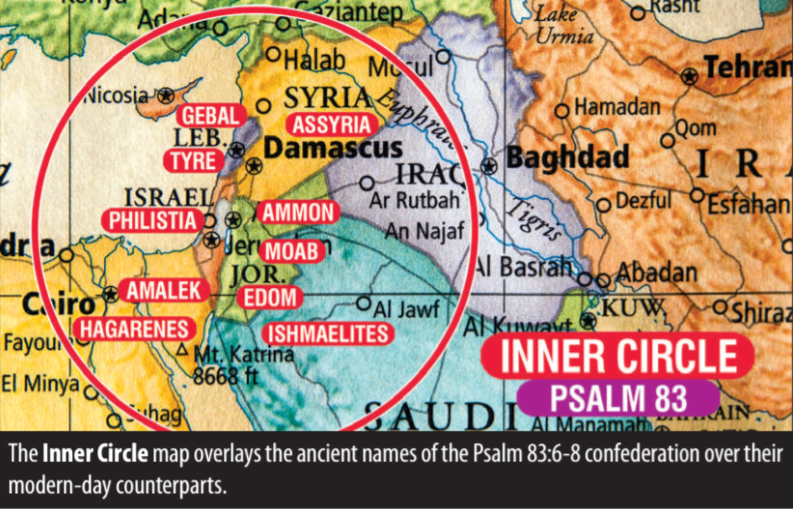
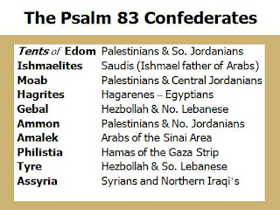
Generally, we can say the nations surrounding Israel, where the national boundaries and names change, but not the Biblical history and land surrounding Israel
The land, people, and language of Israel remains the same as written in the 66 books of the Bible. 2 Timothy 2:15 and 2 Peter 1:20-21.
Notes:
(

Slide 5
Psalm 83 | All Nations Prophetic Judgment by God (Romans 11:33-36)
(-) 1-8 | Enemies of God (1-2, 5-8) and Israel (3-4, Noah’s Ark, Col 3:3, Is 26:20)
(-) 9-12 | Israel’s Past Victories over their Enemies (Judges 4-5, 6-8)
(-) 13-17 | Prayer for Vengeance on God’s and Israel’s Enemies (Revelation 17-18)
(+) 18 | Heaven on Earth with Christ Reigning (Revelation 19-20)
Key words | Asaph,-0x: Psalm 81-82-83. God, Psalm 81-29x, 82-5x, 83-18x. Enemy, Psalm 81-2x, 82-0x, 83-40x. Israel, Psalm 81-40x, 82-18x, 83- 5x. Asaph’s singing prayer. God- 18x: God-4x. LORD-1x. Jehovah-1x. Most High-1x. Thee, Thou, Thy/Thine. God’s character: silent-peace-still Enemy-40x: Enemies-1x. they, them, their. us, ourselves. 83:2-8: Edom. Ishmaelites. Moab. Hagarenes. Gebal. Ammon. Amalek. Philistines. Tyre. Assur. Children of Lot. 83:9-12: Midianites. Sisera. Jabin (brook of Kison/Endor). Oreb. Zeeb. Zebah. Zalmunna. Enemy’s character: make a tumult, lift up head, hate, crafty counsel, consult against, one consent, confederate, take. Confounded, troubled forever, shame-2x in God’s time. Israel-5x in 83:3-4: people-1x. hidden ones-1x. them-1x. nation-1x. Israel-1x. Israel’s character:
Decision | I become a living sacrifice and not high-minded. Trust in God’s vengeance. (Romans 12:1-3) (judgment and justice, Romans 12:19)
Notes:
(

Slide 6

Sunday School Through the Bible (2023 - 2025)
Grow in grace, and in the knowledge of our Lord and Savior Jesus Christ
2 Peter 3:18
COMPLETED books of the Bible
Old Testament: Genesis (4), Exodus (4), Leviticus (2), Numbers (3), Deuteronomy (5), Ruth, Esther, Psalms (4), Psalm 68, Asaph (11), Proverbs, Ecclesiastes, Amos, Obadiah, Malachi
New Testament: Mark, Colossians, 1-2 Thessalonians (10), Ephesians, Philemon, James,
2 Peter (4), 2 John, Jude
Invitation to Fellowship Church 2025 daily schedule for Bible and prayer
Sep 22-28: 2 Chronicles 17-19 (Mon-Sat), Psalm 91 (Sun)

