Slide 1
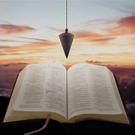
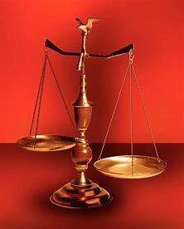
Straight and Balanced
(Luke 3:4-6)
The Faith, a noun, G3982, pis’-tis, 244x, Hebrews 11-11x (11:1-3, 6, 38-40, 12:1-4; Romans 15:23, Jude 1:3)
Fellowship Church, Dec 17, 2025 B. Heath
Old Testament: True Prophets of the Faith
#13 – Samuel: Lifelong Shining Faith (Heb 11:32f, 1 Sam)
#14 – Nathan & Gad: The Comforter’s Faith (Heb 11:32g)
#15 – Man of God & Old Prophet: Weak Prophets of the Faith
#16 – Azariah & Hanani: Two Prophets and Two Effects of Truth
#17 – Jehu, a Prophet, & Micaiah: Little-Known Prophets
#18 – Elijah: The Past, Present, and Future Prophet of the Faith (Heb 11:35)
#19 – Elisha: Prophet of Power and Water (Heb 11:35)
#20 – Jonah & Nahum: God’s Mercy & Judgment on Nineveh
#21 – Hosea, Joel, & Amos: Future Judgments and Blessings
#22 – Obadiah, Jonah, & Micah: Fight with Hate, Anger, & Darkness
#23 – Isaiah: Prophet of Majesty and Royalty (Heb 11:37)
#24 – Nahum, Habakkuk, & Zephaniah: God the Loving-Holy Judge
#25 – Huldah: Prophetess of Anomaly & Conformity of the Faith
#26 – Jeremiah & Lamentations: Speak, Weep, and Turn unto the LORD
#27 – Ezekiel:
#28 – Daniel:
#29 – Haggai, Zechariah, & Malachi:
#30 – Old Testament False Prophets
#31 – New Testament Prophets
OT: Ps 5:8, Pr 4:25-27
Amos 7:7-8, Is 28:13, 17
NT: Mt 3:3, Acts 9:11
Hebrews 12:13, Jude 3
1 Cor 15:1-4, 2 Tim 3:10
John 7:16
OT: Deut 25:13-16
Pr 20:10, Dan 5:25-28
NT: Hebrews 12:1
1 Cor 3:11-15
Philippians 4:5
James 3:17

Slide 2
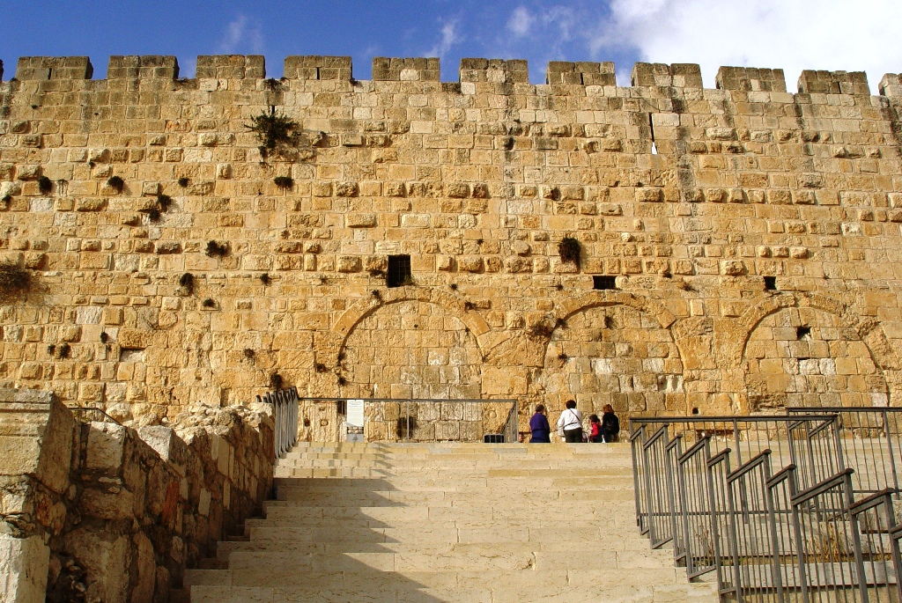
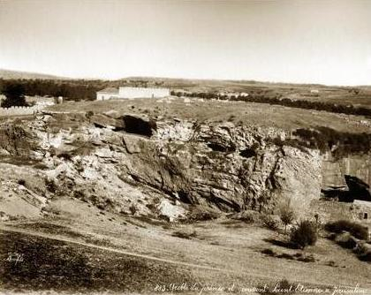
Lamentations: God’s Weeping Justice
Time: c. 586-580 BC. King Nebuchadnezzar of Babylon
Background: Jeremiah is past the midnight hour of the destruction of Jerusalem
and the temple. The people do not turn from their sin, nor respond favorably to Jeremiah’s words
and weeping. Jesus wept three times: for Lazarus, for Jerusalem, and in Gethsemane.
Key Words: Weeping, weep or tears 21x in Jeremiah, 5x in Lamentations 1:2, 16, 2:11, 18
I foresee and prepare for the fall of a nation, knowing Scripture
Solitude and emptiness replace greatness and fullness 1:1
(My king and kingdom are not of this world)
2a) to remember in humility the LORD’s mercy and compassion 3:20-26
(Jeremiah is: I, me, my – 8x, his walk with the LORD, new every morning)
2b) the chastised quietly wait for the LORD’s salvation 3:27-32
(Israel is: he, him, his – 9x, reveals how to turn to God after chastisement)
3) Our earthly inheritance and houses are lost to the enemy 5:2
4) Our place of worship is desolate, and the little foxes ruined us 5:18 (Song of Songs 2:15)
Others may not listen as I choose to trust and obey God’s will for my life (OT-nation, NT-individual, 1 Cor 9:27)
Application today; as God never leaves Israel, He never leaves me (Col 1:27)
Gold standard for Bible study
1st What it says then.
2nd What it says about God.
3rd Application for me today.
Jeremiah’s Grotto
Cave to the left of Golgotha

Slide 3
OT True Prophets chart in respect to
Hebrews
11:1-3, 11:6,
11:32-40, 12:1
# | Name/ Scripture | Suffer-Persecute /Scripture | King (Saul to Zedekiah) | Public/ Private | Prophecy - Near/Far or None | Nation | Bless/ Curse | Vision/ Dream | Miracle Prophet or God | Notes | Heb 11
1 | Samuel | No /1 Sam 1-28 | Saul | Private | Near/for Saul | Israel | B/C | 0 | 0 | after death | 32c
2 | Gad | No/1 Sam 22:25 | David | Public | Near/for David | Israel | B/C | 0 | 0 | Book | 32d
3 | Nathan | No/2 Sam 7. 12. | David - | Private | Near/Far-seed of David | Israel | B/C/B | 0 | 0 | Solomon | 32d
4 | Asaph | No/Psalms 50, 73-83 | David | Public | Far/Tribulation and 1000-year reign | Israel | C/B | 0 | 0 | Revelation 6-20
5 | Ahijah | No/1 Ki 11:29-39 | Jeroboam - 1st | Private | Near/Jeroboam’s reign-son | N-Israel | B/C | 0 | 0 | 1 Ki 14:1-26 | 32d
6 | Shemaiah | No/1 Ki 12:22-24 | Rehoboam - 1st | Private | Near/for Rehoboam | S-Judah | B | 0 | 0 | Book 931 BC | 32d
7 | Iddo | No/2 Chr 9:29 | Jeroboam - 1 ^{st} | Private | Seer for Jeroboam | N-Israel | C | 1 Vision | 0 | Records 931 BC | 32d
8 | man of God | No/1 Kings 13 | Jeroboam – 1st | Private | Far/King Josiah by name, c. 300 yrs., 13:2 | N-Israel | C | 0 | Heal hand | Judah, 2 Ki 23:15 | 32d
9 | old prophet | No/1 Kings 13 | Jeroboam – 1st | Private | Near/for man of God, lion and donkey | N-Israel | C | 0 | 0 | Liar-like Lot | 32d
10 | Azariah | No/2 Chr 15:1-7 | Asa – 3rd | Public | None | S-Judah | B | 0 | 0 | war w/Ethiopia
11 | Hanani | No/2 Chr 16:7-10 | Asa – 3rd | Private | Near/ | S-Judah | C | 0 | 0 | war w/Israel-Syria
12 | Jehu | No/1 Ki 16:1-13, | Baasha-3rd | Private | Near/2 Chr 19:1-4 | N-Israel | C/B | 0 | 0 | Son of Hanani
13 | Prophet - | No/1 Ki 20:13-36 | Ahab-7th | Private | Near/Syria/man of God | N-Israel | B/B/C | 0 | Lion | Son of prophet
14 | Micaiah | Yes/1 Ki 22:1-28 | Ahab-death | Private | Near/400 to 1, 2 Chr 18:1-27 | N-Israel | C | 0 | 0 | Lying spirit | 33a
15 | Elijah | Yes/1 Ki 17-2 Ki 2 | Omri, Ahab – 7th | Public | Near/3 ½ years draught, 450 to 1 | N-Israel | B5/C3 | 0 | 8 | Gentile widow | 35
16 | Elisha | No/2 Ki 3-13 | Joram, Jehu – 8th, | Public | None/gentile general, Lu 4:27 | N-Israel | B11/C5 | 0 | 16 | Jezebel-death | 35
17 | Eliezer | No/2 Chronicles 20:37 | Jehosophat -4th | Private | Near/alliance with Ahaziah | S-Israel | C | 0 | 0 | Fleet destroyed
18 | Joel | No/2 Kings 11-15 | Joash -11th | ? | Far/ | S-Israel | C-B | 0 | 0
19 | Jonah | No/Jonah 1-4 | Jehoash - 11th | Public | Near/40 days – repent | Nineveh | B | 0 | 9 by God | Angry-carnal
20 | Amos | No/2 Kings 14-15 | Jeroboam II – 13th | Public | Near/c 45 yrs | N-Israel | C/B | 5 Visions | 0 | Exile Assyria 722
21 | Hosea | No/2 Kings 15-18 | Jeroboam II – 13th | Public | Near/c 40 yrs, Far/2700+ yrs (7x) | N-Israel | C-B | 0 | 0 | Gomer/3 children
 | Oded | No/2 Chr 28:6-15 | Ahaz-12th | Public | Near/ | S-Judah | B | 0 | 0 | War victory
22 | Micah | Yes/rejection | Jotham-Hezekiah | Public | Near Assyria & Babylon, Far Jesus 1st 5:2 | N-S Israel | C-B | Visions | 0 | that day 25%, hear
23 | Isaiah | Yes/sawn in half | Uzziah-Hezekiah | Public | Near and Far/more than other prophets | S-Judah | C-B | Visions | 3/time-185 | Majesty, Royalty | 34
24 | Nahum | No/Nahum 1-3 | Hezekiah-13th | Personal | Near/30 -50 years | Nineveh | C | 1 vision | 0 | Israel, 722 BC | 33a
25 | Habakkuk | No/ | Zedekiah-20th | Personal | Near/ Babylon-Nebuchadnezzar | S-Judah | C-B | Vision | 0 | Trial to Triumph
26 | Zephaniah | No/ | Josiah-16th | Personal | Near-Babylon/Far 2nd coming of Jesus | S-Judah | C-B | 0 | 0 | Trib & 1000
27 | Huldah | No/2 Kings 22:11-20 | Josiah-16th | Private | Near/13 years, Josiah’s grave 2 Ki 23:27 | S-Judah | C-B | 0 | 0 | 2 Chr 34:18-28
28 | Jeremiah | Yes/no wife, pit, etc | Josiah-Zedekiah | Public | Near-Babylon/70-year captivity | S-Judah | C-B | Visions | 0 | Exile Babylon 586 | 36
29 | Daniel | Yes/ | ? – Babylon | Public |  | S-Judah
30 | Ezekiel |  | ? – Babylon | Public |  | S-Judah
31 | Obadiah | No/ | Zedekiah-20th |  |  | Edom
32 | Haggai | No/ | Zerubbabel-Gov |  |  | Israel
33 | Zechariah | Yes/ | Zerubbabel |  |  | Israel
34 | Malachi |  | Zerubbabel |  |  | Israel
Before Samuel
Enoch
Genesis 5:24
Jude 1:14
Moses
Exodus 7:1 Deut 34:10
Acts 3:22,
7:37
Miriam
Exodus 15:20
Deborah
Judges 4:9
During & after Samuel
1 Samuel
19:18-24
2 Ki 4:38-41
Sons of the prophets-9x
Updated: 17 Nov 2025
W.H.

