Slide 1
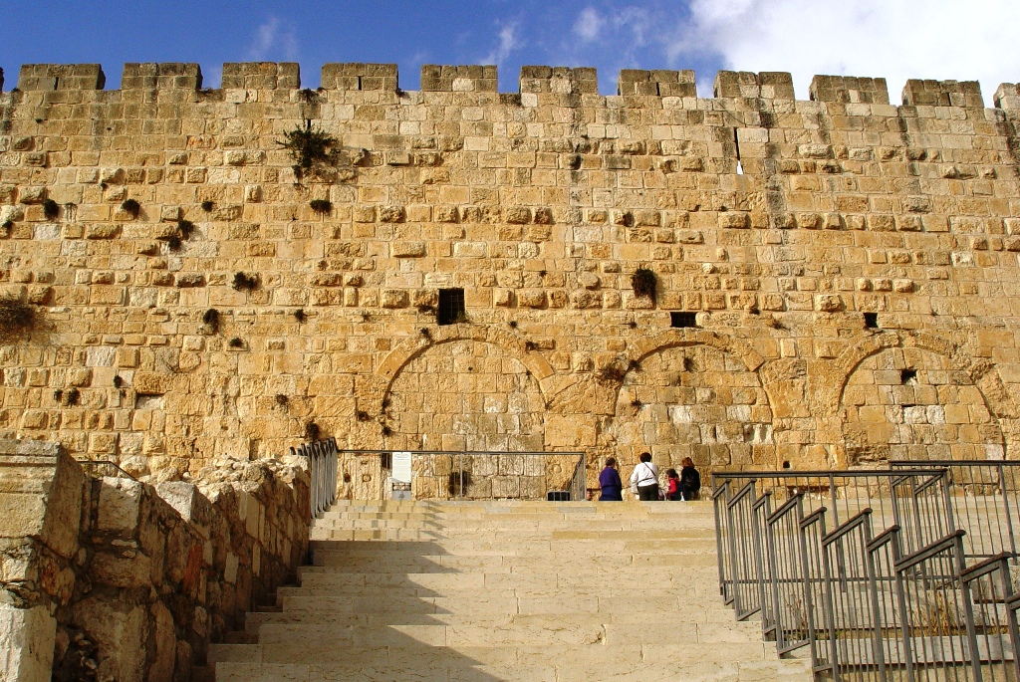
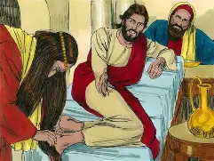
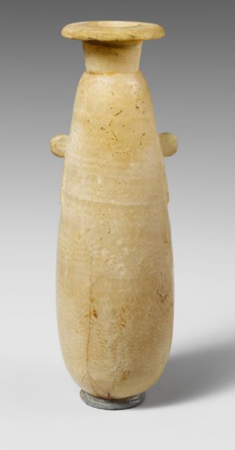
More Tears and Ointment for Jesus in 2026, Luke 7:36-50
Time: c. 32 AD, 2 ½ years into the public ministry of Jesus
Place: Galilee, at a meal in a Pharisee’s home
People: Jesus, disciples, public, Simon the Pharisee, and a sinner
Content: 7:36, 37-38, 39, 40-42 (parable), 43, 44-47, 48, 49, 50 (peace)
Context: After speaking with John the Baptist’s disciples, 7:18-35
How can I bring Jesus more tears and ointment in 2026?
Time: spend daily time in the Scripture and prayer
Friends: wisdom to speak the gospel truth with others
Jesus: commit to follow Jesus day by day and hour by hour
2026 Daily Bible & Prayer in 1 Corinthians for Jan-Feb 2026

