Slide 1


Fellowship Church, May 10, 2026 2 Peter 3:18 Sunday School Bill Heath
Straight & Balanced
(Luke 3:4-6)
Jesus Teaches in Parables
11. The Prodigal Steward (Luke 16:1-13)
12. The Wedding Supper (Luke 14:7-24)
13. The Rich Man and Lazarus (Luke 16:19-31)
14. The Widow’s Persistent Prayers (Luke 18:1- 8)
15. The Pharisee & the Publican (Luke 18:9-14)
16. Ten Pounds to Ten Servants (Luke 19:11-27)
17. Words then Actions of Two Sons (Mt 21:28-32)
18. Servants in God’s Vineyard (Mt 21:33-46)
19. The King’s Wedding Feast (Matthew 22:1-14)
20. The Withered Fig Tree (Matthew 24:32-35)
21. Ten Virgins & Five Talents (Matthew 25:1-30)
22. I AM the Door f the Sheep (John 10:1-10)
23. The 26 Mysteries Revealed in the NT
OT: 2 Kings 21:13, Ps 5:8 Pr 4:25-27, Amos 7:7-8 Isaiah 28:13, 17
NT: Mt 3:3, Acts 9:11
Hebrews 12:13, Jude 3
1 Corinthians 15:1-4
2 Timothy 3:10, John 7:16
OT: Deut 25:13-16
Proverbs 20:10
Daniel 5:25-28
NT: Hebrews 12:1
1 Cor 3:11-15
Philippians 4:5
James 3:17

Slide 2
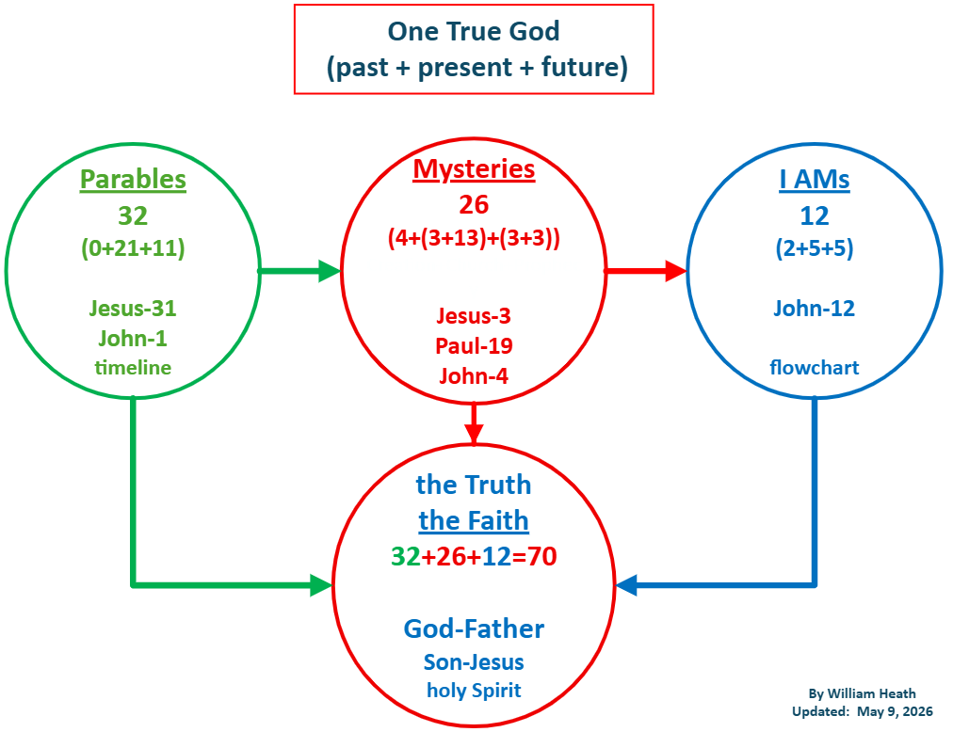
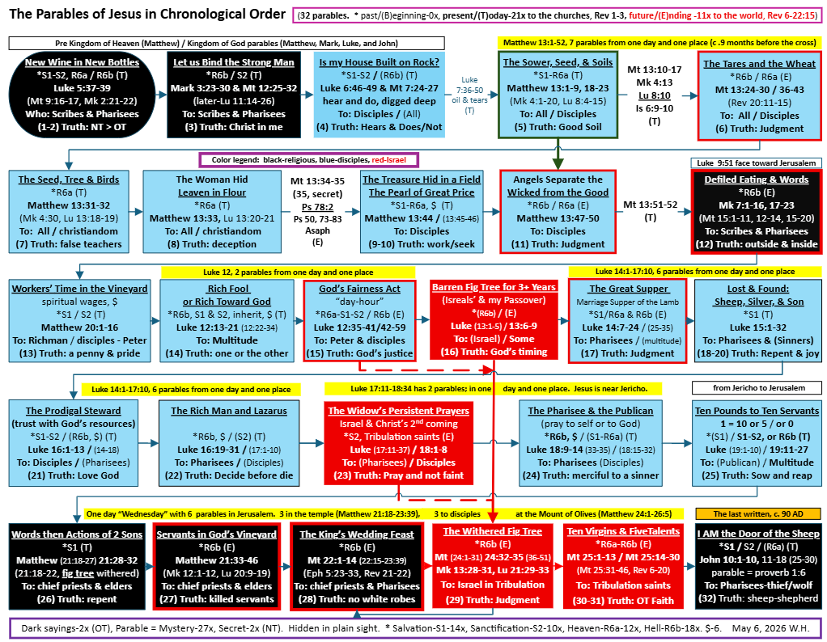

Slide 3
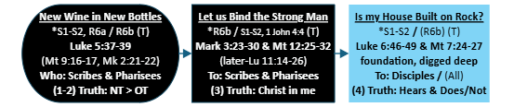
The Churches’ Parables Reveal Sanctification (part 1)
 | 1-2) Luke 5:37-39. Wine. Bottle. Perished. Preserved. 3) Mark 3:23-30. Blaspheme against the Holy Ghost. 4) Luke 6:46-49. Rock or Sand. Hear & Do. Dig Deep. Next Sunday: The Churches’ Parables Reveal Sanctification (part 2)

Slide 4

Sunday School Through the Bible (2019 - 2026)
Grow in grace, and in the knowledge of our Lord and Savior Jesus Christ
2 Peter 3:18
COMPLETED books of the Bible (Sundays and Wednesdays)
Old Testament: Genesis (4), Exodus (4), Leviticus (2), Numbers (3), Deuteronomy (5),
Judges (15), 1-2 Kings (12), Ruth, Esther, Psalms (4), Psalm 68 (3), Asaph (12), Proverbs, Ecclesiastes, Song of Songs (15), Ezekiel (36), Daniel (12), Hosea (9), Joel, Amos, Nahum, Habakkuk, Obadiah, Zephaniah, Haggai, Zechariah, Malachi
New Testament: Mark, Parables (30), Colossians, 1-2 Thessalonians (10), Ephesians, Philemon, Hebrews (12), James, 2 Peter (4), 1 John (13), 2 John, 3 John, Jude, Revelation (22)
Topics: Prayer (15), mysteries (7), various (40)
Invitation to Fellowship Church 2026 daily schedule for Bible and prayer
Zechariah–April 10 to May 15, 2026 (Psalm 119-March 29 to August 23)

