Slide 1
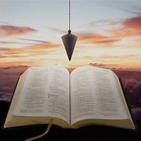
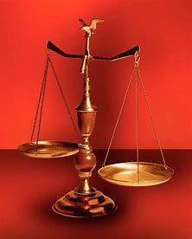
Fellowship Church, Oct 2, 2024 B. Heath
Straight and Balanced
(Luke 3:4-6)
Biblical characters (Hebrews 11:1-3, 6, 39-40)
#1 – Abel’s Faith & Innocent Blood (Heb 11:4, Gen 4)
#2 – Walking with God & with Enoch (Heb 11:5-6, Gen 5)
#3 – Secure on the Ark with Noah (Heb 11:7, Gen 6-11)
#4a – Faith with Abraham (Heb 11:8-19, Gen 12-23)
#4b – Faith with Sarah (Heb 11:11-12, 1 Peter 3:6)
#4c – OT & NT Strangers & Pilgrims (Heb 11:13-16, 1 Pe 2:11)
#5 – Faith & Laughter with Isaac (Heb 11:17-19, Gen 18-24)
#6 – Your Faith with Jacob/Israel (Heb 11:20-21, Gen 25-36)
#7 – Faith with Joseph beyond Death (Heb 11:22, Gen 37- 50)
#8 – Faith with Moses (Heb 11:23-29, Exodus-Deut)
#9 – Faith with Joshua (Heb 11:30, Joshua)
#10 – Faith with Rahab (Heb 11:31, Joshua 6)
#11 – Faith with the Judges (Heb 11:32, Judges)
#12 – Faith with David (Heb 11:32, 2 Samuel, 1 Chr)
#13 – Faith with Samuel (Heb 11:32, 1 Samuel)
#14 – Faith with the Prophets (Heb 11:32-38, Is-Malachi)
#15 – Faith for All (Heb 11:39-40, Old Testament saints)
OT: Ps 5:8, Pr 4:25-27
Amos 7:7-8, Is 28:13, 17
NT: Mt 3:3, Acts 9:11
Hebrews 12:13, Jude 3
1 Cor 15:1-4, 2 Tim 3:10
John 7:16
OT: Deut 25:13-16
Pr 20:10, Dan 5:25-28
NT: Hebrews12:1
1 Cor 3:11-15,
Philippians 4:5,
James 3:17

Slide 2
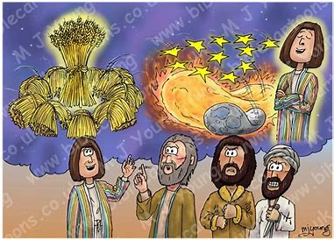
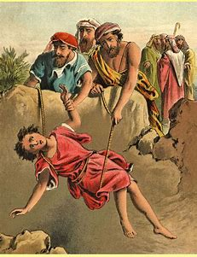
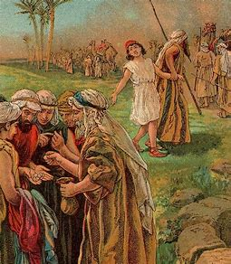
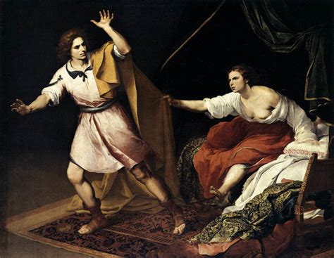
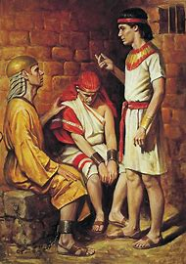
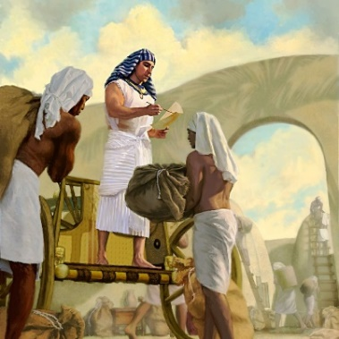
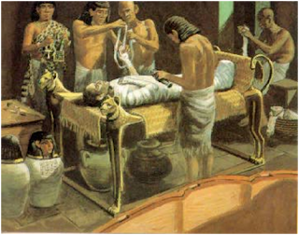
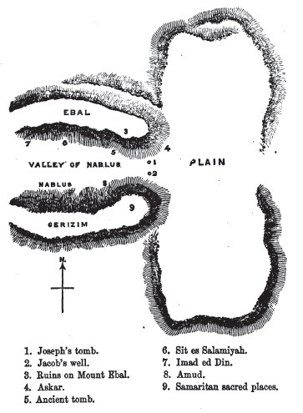
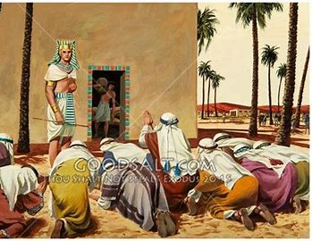
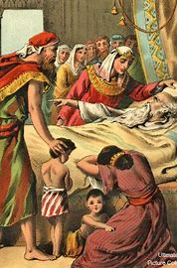
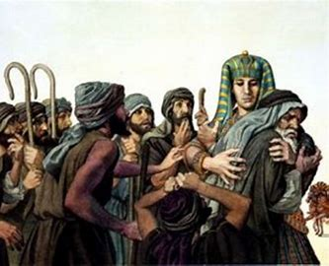
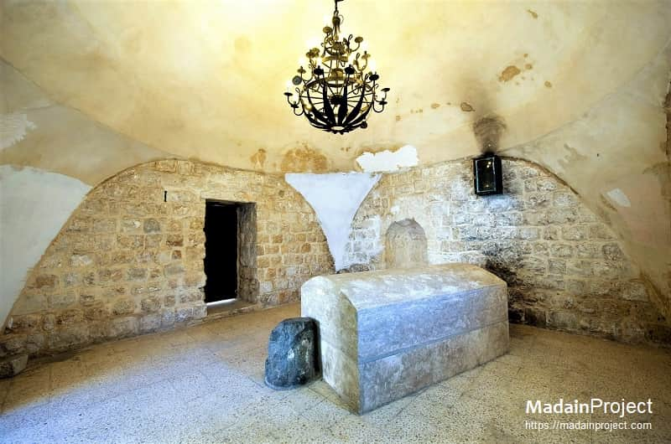
By Faith with Joseph beyond Death (Genesis 50:24-25, in the context of Genesis 37-50)
Genesis 37:7-9, two dreams
Genesis 37:11-36, pit & sold
Gen 39-40, Potiphar’s wife & prison (butler & baker)
Gen 41, Pharoah’s 2 dreams of 7’s & famine (cows & corn)
Genesis
48-49,
Jacob blesses Joseph’s 2 sons and Joseph’s 11 brothers
Genesis
50:24-26
Joseph’s
Last words of faith for deliver-ance and bones
repeated
in Hebrews
11:22
Genesis 42-47, 11 brothers
bow and father Jacob’s reunion

Slide 3
By Faith with Joseph beyond Death (Hebrews 11:22)
Text: Heb 11:22 By faith Joseph, when he died, made mention of the departing
of the children of Israel; and gave commandment concerning his bones.
Old Testament: Genesis 15:13-16 (400 years later, the Ammonites), 50:24-26, Joshua 24:32
(bones buried at Shechem btwn Mt Gerizim-bless and Mt Ebal-curse, the valley of decision)
Ezekiel 1:14, 20 (Noah, Daniel, and Job), Matthew 11:11 (John the baptizer)
New Testament: Hebrews 11:10, 1 Cor 15, Paul: End strong, Appointed unto man, I buffet my body. 1 Peter 2:5, 2 Peter 1: 13-14, John in Revelation 22: 20-21, Jude 24-25, James:
Straight and balanced truth: Israel is in the valley of decision where they laid the bones of Joseph, as we are today in the New Testament with better promises.
Application: Christ-followers learn from Joseph’s knowing the best this world offers is strangely dim to the glory prepared for the children of God. In death, I look forward to the promised land of New Jerusalem, as Joseph looks forward to Christ’s reign on earth from Jerusalem.

