Slide 1
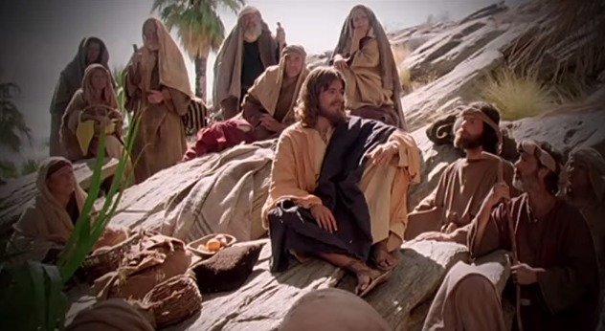
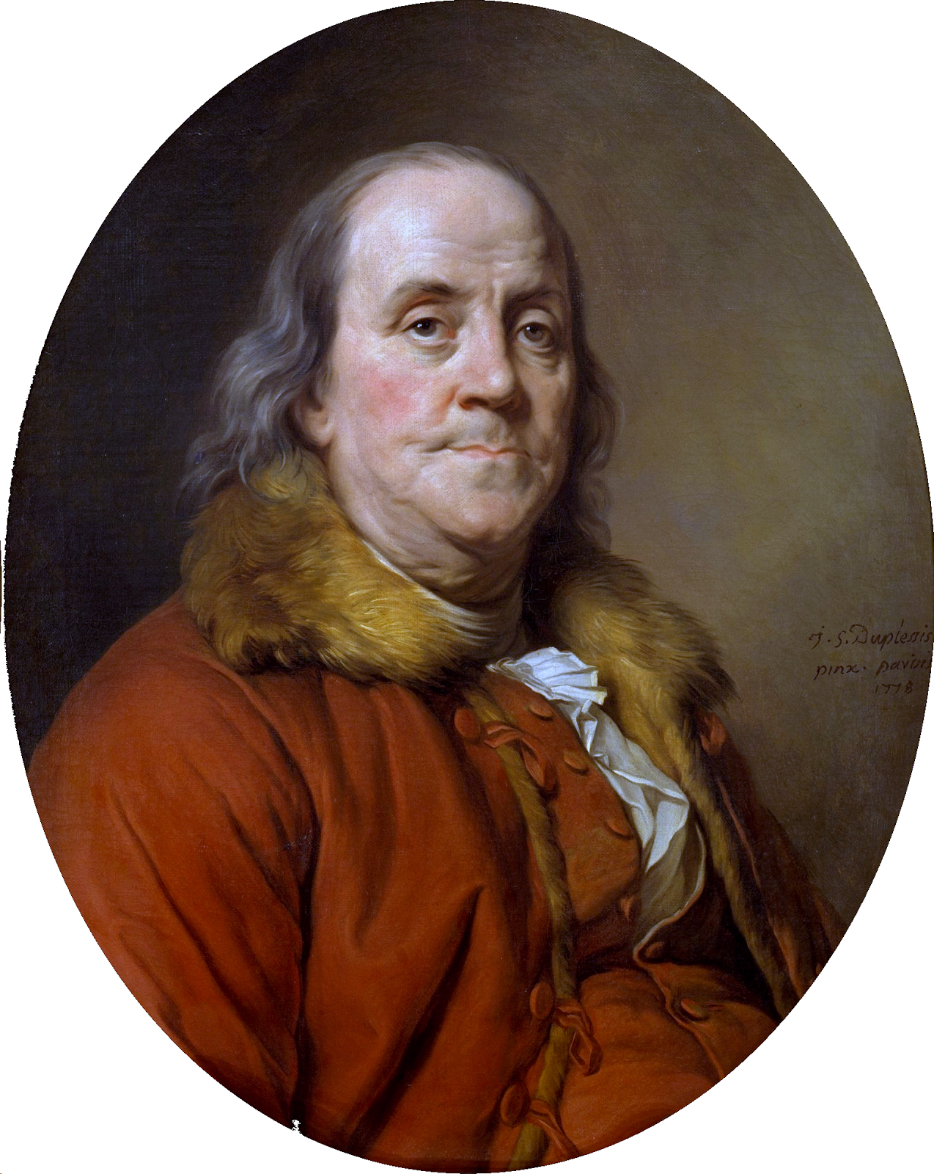
Fellowship Church - Wednesday 7pm service - January 13, 2021
Title: Sound Doctrine
Text: 2 Timothy 3:10 (KJVish)
But you have fully known my doctrine, manner of
life, purpose, faith, longsuffering, charity, patience,
Quotes from Benjamin Franklin for 2021
"By failing to prepare, you are preparing to fail."
“Tell me and I forget. Teach me and I remember. Involve me and I learn."
"We must, indeed, all hang together or, most assuredly,
we shall all hang separately.“
“Guests, like fish, begin to smell after three days."

Slide 2
Sound Doctrine (teachings from the Holy Scriptures and the laws of God)
By Pastor, Shepherd, Overseer, Elder, Deacon, Teacher
(others: minister, reverend, bishop, prophet, rabbi, father, priest, cardinal, pope, etc)
I Timothy 2 Timothy Titus Disciples
1. Sound doctrine 1:10 4:3 1:9, 2:1 1 Corinthians 11:1
2. Sound mind 1:7 Romans 12:1-2, Phil 4:8
3. Sound words 1:13 James
4. Sound speech 2:8 James
Sound faith 1:13, 2:2 Hebrews 11, 2 Peter 1
a. Knowledge is Science. b. Knowledge of the spiritual laws of God our creator. Proverbs 1:7 The fear of the LORD [is] the beginning of knowledge: [but] fools despise wisdom and instruction.

Slide 3
3 Walls (Believers)
Three Tiers of Sound Doctrine
Tier (bottom-up) Severity Consequence Scripture
1-Salvation Most Important Eternal Life or death John 1:12-13, 3:16-17
2-Sanctification Very Important Eternal Reward 1 Thes 5:23, 1 Cor 3:11-15
3-Solid Rock Important Sound Doctrine Parable in Luke 6:47-49 Moses - 1 Cor 10:4 (10:1-6) Jesus - Matthew 16:13-20
Sinking Sand Unimportant Parable in Matthew 7:21-26 (philosophy, psychology, traditions, superstitions, myths, fables, wives tales)
Questions:
Jan 27, Wednesday Service: Seasons of Prayer (preparing for the rest of 2021)
2 Foundation (Apostles & Prophets –OT)
1 Chief Cornerstone (Jesus Christ)

