Slide 1

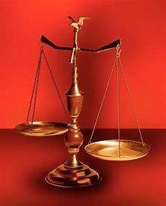
Straight and Balanced
(Luke 3:4-6)
The Faith, a noun, G3982, pis’-tis, 244x, Hebrews 11-11x (11:1-3, 6, 38-40, 12:1-4; Romans 15:23, Jude 1:3)
Fellowship Church, Jan 14, 2026 B. Heath
Old Testament: True Prophets of the Faith
#13 – Samuel: Lifelong Shining Faith (Heb 11:32f, 1 Sam)
#14 – Nathan & Gad: The Comforter’s Faith (Heb 11:32g)
#15 – Man of God & Old Prophet: Weak Prophets of the Faith
#16 – Azariah & Hanani: Two Prophets and Two Effects of Truth
#17 – Jehu, a Prophet, & Micaiah: Little-Known Prophets
#18 – Elijah: The Past, Present, and Future Prophet of the Faith (Heb 11:35)
#19 – Elisha: Prophet of Power and Water (Heb 11:35)
#20 – Jonah & Nahum: God’s Mercy & Judgment on Nineveh
#21 – Hosea, Joel, & Amos: Future Judgments and Blessings
#22 – Obadiah, Jonah, & Micah: Fight with Hate, Anger, & Darkness
#23 – Isaiah: Prophet of Majesty and Royalty (Heb 11:37)
#24 – Nahum, Habakkuk, & Zephaniah: God the Loving-Holy Judge
#25 – Huldah: Prophetess of Anomaly & Conformity of the Faith
#26 – Jeremiah & Lamentations: Speak, Weep, and Turn unto the LORD
#27 – Ezekiel: Watchman on a Short Leash
#28 – Daniel:
#29 – Haggai, Zechariah, & Malachi:
#30 – Old Testament False Prophets
#31 – New Testament Prophets
OT: Ps 5:8, Pr 4:25-27
Amos 7:7-8, Is 28:13, 17
NT: Mt 3:3, Acts 9:11
Hebrews 12:13, Jude 3
1 Cor 15:1-4, 2 Tim 3:10
John 7:16
OT: Deut 25:13-16
Pr 20:10, Dan 5:25-28
NT: Hebrews 12:1
1 Cor 3:11-15
Philippians 4:5
James 3:17

Slide 2
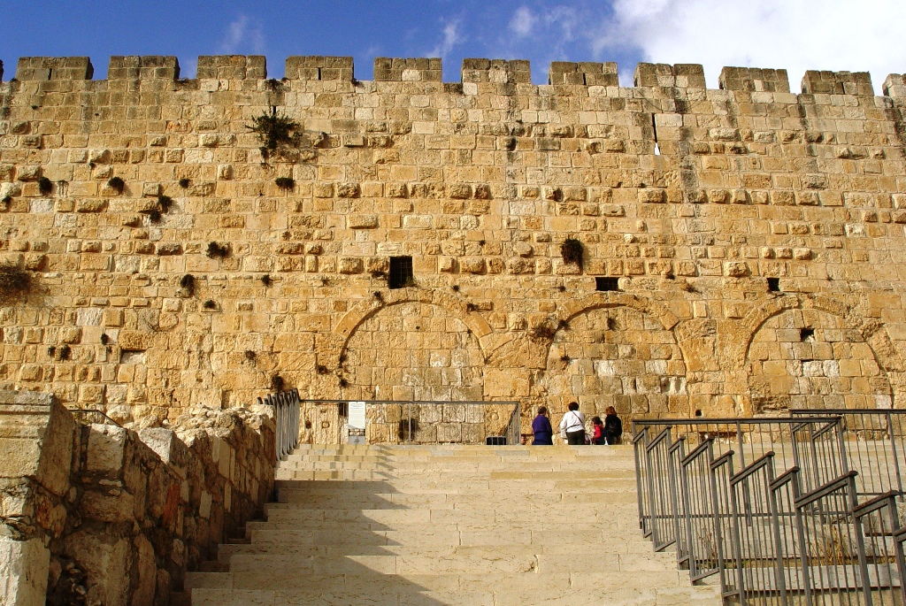
Ezekiel: Watchman on a Short Leash “God strengthens”
A watchman Scripture in Ezekiel
- Hears and warns (1 Cor 4:14, Acts 20:31) 3:17-21
- Is a little sanctuary (temple, 1 Cor 3:16) 11:16
- Is accountable for their own sin (1 Cor 3:1-4) 18:20
- Represents God in trials (1 Cor 4:8-10) 24:16-17
- Will reign with Christ (1 Cor 6:1-8) 40-48
Application for me today; Watch ye, 1 Cor 16:13-14
Day by day in 2026

Slide 3
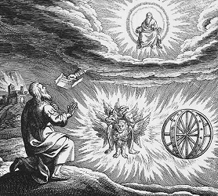
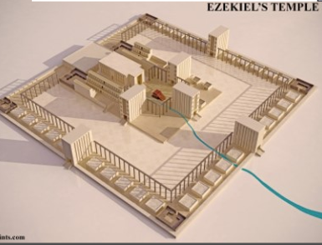
Ezekiel: Watchman on a Short Leash “God strengthens”
Time: 597-571 BC. 14 exact dates to the day. 593 BC priest to prophet, 1:1-2
Place: In exile, south of Babylon, alone as a street witness while Daniel served kings
A watchman will Scripture
1) Let the spirit enable them to stand on their feet and hear when God speaks 2:1-2
2) Hear the word of the Lord and warn the wicked and righteous (Acts 20:31) 3:17-21
3) Be a little sanctuary unto God wherever they are 11:16
4) Know when the glory of the LORD departs from a place, step by step 11:23
5) Be accountable for our own sin and righteousness, and not another’s (18) 18:20
6) Be a man that repairs the wall, & stands in the gap before God for others 22:30
7) Represent God when his life’s desire dies, without questioning or total trust 24:16-17
8) Warn others of coming judgment if the do not return to God 33:22
9) Warn of shepherds who feed themselves and not the flock (2 Peter 2) 34:2
10) Trust God to seek out His sheep and feed them in green pasture 34:11-16
11) Be cleansed from filthiness with water to have a new heart & new spirit 36:25-26
12) Know when the glory of the LORD returns to a place 43:5
Application for me today; Watch ye, 1 Cor 16:13-14. Day by day in 2026.
Gold standard for Bible study
1st What it says then.
2nd What it says about God.
3rd Application for me today.
Outline of Ezekiel
1-24, God curses Israel
8 parables, 16 signs, 6 visions
25-32, God curses Gentiles
28, Tyre is a type of Satan
29-32, Egypt is a way, a
truth, & an afterlife.
33-48, God blesses Israel
2 signs, 7 visions
37-39, present and future
40-48, future 1000-year (Rev 20)
Reign of Jesus Christ
Vision (1:3-28) Temple (40-48)

Slide 4
OT True Prophets chart in respect to
Hebrews
11:1-3, 11:6,
11:32-40, 12:1
# | Name/ Scripture | Suffer-Persecute /Scripture | King (Saul to Zedekiah) | Public/ Private | Prophecy - Near/Far or None | Nation | Bless/ Curse | Vision/ Dream | Miracle Prophet or God | Notes | Heb 11
1 | Samuel | No /1 Sam 1-28 | Saul | Private | Near/for Saul | Israel | B/C | 0 | 0 | after death | 32c
2 | Gad | No/1 Sam 22:25 | David | Public | Near/for David | Israel | B/C | 0 | 0 | Book | 32d
3 | Nathan | No/2 Sam 7. 12. | David - | Private | Near/Far-seed of David | Israel | B/C/B | 0 | 0 | Solomon | 32d
4 | Asaph | No/Psalms 50, 73-83 | David | Public | Far/Tribulation and 1000-year reign | Israel | C/B | 0 | 0 | Revelation 6-20
5 | Ahijah | No/1 Ki 11:29-39 | Jeroboam - 1st | Private | Near/Jeroboam’s reign-son | N-Israel | B/C | 0 | 0 | 1 Ki 14:1-26 | 32d
6 | Shemaiah | No/1 Ki 12:22-24 | Rehoboam - 1st | Private | Near/for Rehoboam | S-Judah | B | 0 | 0 | Book 931 BC | 32d
7 | Iddo | No/2 Chr 9:29 | Jeroboam - 1 ^{st} | Private | Seer for Jeroboam | N-Israel | C | 1 Vision | 0 | Records 931 BC | 32d
8 | man of God | No/1 Kings 13 | Jeroboam – 1st | Private | Far/King Josiah by name, c. 300 yrs., 13:2 | N-Israel | C | 0 | Heal hand | Judah, 2 Ki 23:15 | 32d
9 | old prophet | No/1 Kings 13 | Jeroboam – 1st | Private | Near/for man of God, lion and donkey | N-Israel | C | 0 | 0 | Liar-like Lot | 32d
10 | Azariah | No/2 Chr 15:1-7 | Asa – 3rd | Public | None | S-Judah | B | 0 | 0 | war w/Ethiopia
11 | Hanani | No/2 Chr 16:7-10 | Asa – 3rd | Private | Near/ | S-Judah | C | 0 | 0 | war w/Israel-Syria
12 | Jehu | No/1 Ki 16:1-13, | Baasha-3rd | Private | Near/2 Chr 19:1-4 | N-Israel | C/B | 0 | 0 | Son of Hanani
13 | Prophet - | No/1 Ki 20:13-36 | Ahab-7th | Private | Near/Syria/man of God | N-Israel | B/B/C | 0 | Lion | Son of prophet
14 | Micaiah | Yes/1 Ki 22:1-28 | Ahab-death | Private | Near/400 to 1, 2 Chr 18:1-27 | N-Israel | C | 0 | 0 | Lying spirit | 33a
15 | Elijah | Yes/1 Ki 17-2 Ki 2 | Omri, Ahab – 7th | Public | Near/3 ½ years draught, 450 to 1 | N-Israel | B5/C3 | 0 | 8 | Gentile widow | 35
16 | Elisha | No/2 Ki 3-13 | Joram, Jehu – 8th, | Public | None/gentile general, Lu 4:27 | N-Israel | B11/C5 | 0 | 16 | Jezebel-death | 35
17 | Eliezer | No/2 Chronicles 20:37 | Jehosophat -4th | Private | Near/alliance with Ahaziah | S-Israel | C | 0 | 0 | Fleet destroyed
18 | Joel | No/2 Kings 11-15 | Joash -11th | ? | Far/ | S-Israel | C-B | 0 | 0
19 | Jonah | No/Jonah 1-4 | Jehoash - 11th | Public | Near/40 days – repent | Nineveh | B | 0 | 9 by God | Angry-carnal
20 | Amos | No/2 Kings 14-15 | Jeroboam II – 13th | Public | Near/c 45 yrs | N-Israel | C/B | 5 Visions | 0 | Exile Assyria 722
21 | Hosea | No/2 Kings 15-18 | Jeroboam II – 13th | Public | Near/c 40 yrs, Far/2700+ yrs (7x) | N-Israel | C-B | 0 | 0 | Gomer/3 children
 | Oded | No/2 Chr 28:6-15 | Ahaz-12th | Public | Near/ | S-Judah | B | 0 | 0 | War victory
22 | Micah | Yes/rejection | Jotham-Hezekiah | Public | Near Assyria & Babylon, Far Jesus 1st 5:2 | N-S Israel | C-B | Visions | 0 | that day 25%, hear
23 | Isaiah | Yes/sawn in half | Uzziah-Hezekiah | Public | Near and Far/more than other prophets | S-Judah | C-B | Visions | 3/time-185 | Majesty, Royalty | 34
24 | Nahum | No/Nahum 1-3 | Hezekiah-13th | Personal | Near/30 -50 years | Nineveh | C | 1 vision | 0 | Israel, 722 BC | 33a
25 | Habakkuk | No/ | Zedekiah-20th | Personal | Near/ Babylon-Nebuchadnezzar | S-Judah | C-B | Vision | 0 | Trial to Triumph
26 | Zephaniah | No/ | Josiah-16th | Personal | Near-Babylon/Far 2nd coming of Jesus | S-Judah | C-B | 0 | 0 | Trib & 1000
27 | Huldah | No/2 Kings 22:11-20 | Josiah-16th | Private | Near/13 years, Josiah’s grave 2 Ki 23:27 | S-Judah | C-B | 0 | 0 | 2 Chr 34:18-28
28 | Jeremiah | Yes/no wife, pit, etc | Josiah-Zedekiah | Public | Near-Babylon, 586 BC/70-year captivity | S-Judah | C-B | Visions | 0 | Exile Babylon 586 | 36
30 | Ezekiel | No/not from people | Nebu – Babylon | Public | Near, 586 BC/Far , 37-39 ,40-48 1000 yr | S-Judah | C-B | 13 vision | 0 | 18 signs, 8 parables
29 | Daniel | Yes/ | Nebu – Babylon | Public | Near/Far, 2nd coming | S-Judah |  |  |  |  | 29
31 | Obadiah | No/ | Zedekiah-20th |  |  | Edom
32 | Haggai | No/ | Zerubbabel-Gov |  |  | Israel
33 | Zechariah | Yes/ | Zerubbabel |  |  | Israel
34 | Malachi |  | Zerubbabel |  |  | Israel
Before Samuel
Enoch
Genesis 5:24
Jude 1:14
Moses
Exodus 7:1 Deut 34:10
Acts 3:22,
7:37
Miriam
Exodus 15:20
Deborah
Judges 4:9
During & after Samuel
1 Samuel
19:18-24
2 Ki 4:38-41
Sons of the prophets-9x
Updated: 1 4 Jan 2026
W.H.

