Slide 1
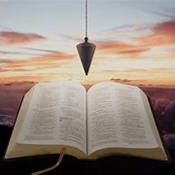
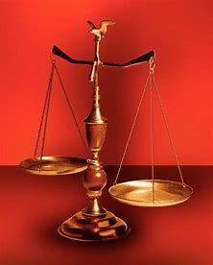
Fellowship Church, October 19, 2025 B. Heath
Straight & Balanced
(Luke 3:4-6)
Psalm 82 judge of the earth, in the Blues
Past 6 months: Beginning with the Victory Parade for the Ark of God in Psalm 68 (3), New Testament elect ladies (7), the Psalms of Asaph (12), and Matthew 13 (2).
Today: Asaph’s Prophecy of Israel’s future
Next Sunday: The Parables of Jesus
OT: 2 Kings 21:13, Ps 5:8 Pr 4:25-27, Amos 7:7-8 Isaiah 28:13, 17
NT: Mt 3:3, Acts 9:11
Hebrews 12:13, Jude 3
1 Corinthians 15:1-4
2 Timothy 3:10, John 7:16
OT: Deut 25:13-16
Proverbs 20:10
Daniel 5:25-28
NT: Hebrews 12:1
1 Cor 3:11-15
Philippians 4:5
James 3:17

Slide 2
Differ | Israel | Church
Origin | Abraham | Jesus
Purpose | Covenants | New Testament
Destiny | 1000 | New Jerusalem
Acts 1:8 2-28 | Nation Israel | Nations Earth
Acts 17:30 | temporary | eternal
Romans 15:4 | Hebrews | Romans
1 Cor 10:1-13 | Jew | Gentiles
Eph & Col | Physical | Spiritual
1-2 Thes | Return | Rapture
Revelation | 6-18, 19-20 | 1-5, 21-22
Asaph’s Secret Unleashed
Matthew links the Old Testament with the New Testament
2) Matthew 13 parables are key to the
Gospel of Matthew
3) Matthew 13:35 is key to knowing what
is concealed in the Old Testament is
revealed in the New Testament
Israel during the time of Jacob’s trouble:
Sin of mankind since the first Adam
Judgment by a just and holy God
Repentance of sin with Godly sorrow
Return to Christ for life
Reign of Christ yesterday, today, and
forever

Slide 4

Sunday School Through the Bible (2023 - 2025)
Grow in grace, and in the knowledge of our Lord and Savior Jesus Christ
2 Peter 3:18
COMPLETED books of the Bible
Old Testament: Genesis (4), Exodus (4), Leviticus (2), Numbers (3), Deuteronomy (5), Ruth, Esther, Psalms (4), Psalm 68, Asaph (12), Proverbs, Ecclesiastes, Amos, Obadiah, Malachi
New Testament: Matthew 13 (2), Mark, Colossians, 1-2 Thessalonians (10), Ephesians, Philemon, James, 2 Peter (4), 2 John, Jude
Invitation to Fellowship Church 2025 daily schedule for Bible and prayer
Oct 20-25: 2 Chronicles 29:1-31:10 (Mon-Sat), Psalm 95 (Sun)

