Slide 1
Fellowship Church, Sept 29, 2024 B Heath
Straight and Balanced
(Luke 3:4-6)
It's all about you Jesus (9:55-9:59)
1 – 12 beginnings (origins) of life with Adam, Genesis 1-2
2a – 12 beginnings (origins) of death with Adam, Genesis 3
2b – death with Cain & Noah, Genesis 4:1-9:17
2c – death with Nimrod & Babel, Genesis 9:18-11:32
3 – 12 beginnings of Israel with Abraham, Genesis 12-50
4a – exit from slavery in Egypt to the Red Sea, Exodus 1-12
4b – from the Red Sea to Mount Sinai, Exodus 13-18
4c – Mount Sinai (Law) 10 Commandments, Exodus 19-24
4d – Mount Sinai (Law) the Tabernacle, Exodus 25-40
5a – Mount Sinai (Law) approaching a holy God, Leviticus 1-17
5b – Mount Sinai (Law) living a holy life, Leviticus 18-27
6a – Mount Sinai (Law) prepare to depart, Numbers 1-10
OT: Ps 5:8, Pr 4:25-27
Amos 7:7-8
Isaiah 28:13, 17
NT: Mt 3:3, Acts 9:11
Hebrews 12:13, Jude 3
1 Corinthians 15:1-4
2 Timothy 3:10, John 7:16
OT: Deut 25:13-16
Proverbs 20:10
Daniel 5:25-28
NT: Hebrews12:1
1 Cor 3:11-15
Philippians 4:5
James 3:17

Slide 2
at Mount Sinai (Law) & Living a Holy Life, Leviticus 18-27
Leviticus
18-20 Civil laws
21-22 Ceremonial laws
23-24 Ceremonial laws
(also prophetic for the 1st coming of Jesus, the church, and the 2nd coming of the king of kings)
24-27 Civil laws
Note for Leviticus where Jesus is better and perfect:
Priests 4:14-7:28 (4:14) Jesus is the personal, permanent “Great” High Priest
Covenant 8:1-13 (8:6) Jesus is mediator of a “better” covenant & better promise
Tabernacle 9:1-28 (9:11) Jesus is a “greater and more perfect” tabernacle
Sacrifice 10:1-39 (10:14) Jesus’ eternal sacrifice is “superior” to the Old Covenant
Faith 11:1-40 (11:40) Jesus provides for a “better” faith where we may mature
The shadow of the ceremonial laws for approaching a holy God were fulfilled and substantiated when Jesus died as the lamb of God on the cross. (shadow Scripture - Colossians 2:17, Hebrews 8:5, 10:1, James 1:17)
Application: Today, do not return to, mix with, or substitute the ceremonial laws with following Jesus.

Slide 3
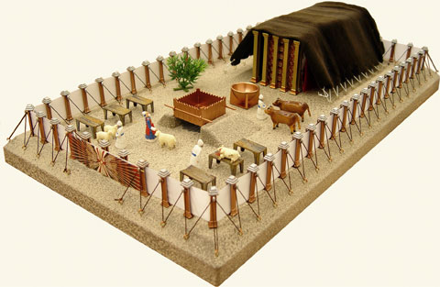
The Tabernacle
Exodus 25-40
Figure of Jesus
(Hebrews 9:9,
1 Peter 3:21)
Also the
body of Jesus
John 2:19-22
(21)
and the
Body of
believers
1 Cor 6:12-20
(19 )

Slide 4
Sunday School Schedule-2024
Mas de Cristo class
COMPLETED
Old Testament / Genesis (4), Exodus (4), Leviticus (2), Psalms (4), Proverbs, Ecclesiastes, Amos, Obadiah, Malachi
The purpose of the Old Testament: (1) Learn – Romans 15:4 (2) Admonish – 1 Corinthians 10:1-10
(3) Shadow – Col 2:17, Heb 8:5, 10:1 (4) Figure – Heb 9:9, 11:19, 1 Peter 3:21
(5) Type or antitype - specific people are like God or the Devil to help New Testament Christ-followers to
discern good from evil, obey God, follow Jesus, and be filled with the Holy Spirit.
New Testament / Mark, Colossians, Philemon, James, Jude
Invitation to the 2024 daily Bible reading schedule. Isaiah from May 9 to Oct 18. Copies on the back table.
Next Sunday is Numbers 1-10 – Departing Mount Sinai into wandering in the desert
Notes:
-

