Slide 1

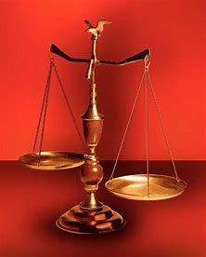
Straight and Balanced
(Luke 3:4-6)
The Faith, a noun, G3982, pis’-tis, 244x, Hebrews 11-11x (11:1-3, 6, 38-40, 12:1-4; Romans 15:23, Jude 1:3)
Fellowship Church, Feb 11,2026 B. Heath
Old Testament: True Prophets of the Faith
#13 – Samuel: Lifelong Shining Faith (Heb 11:32f, 1 Sam)
#14 – Nathan & Gad: The Comforter’s Faith (Heb 11:32g)
#15 – Man of God & Old Prophet: Weak Prophets of the Faith
#16 – Azariah & Hanani: Two Prophets and Two Effects of Truth
#17 – Jehu, a Prophet, & Micaiah: Little-Known Prophets
#18 – Elijah: The Past, Present, and Future Prophet of the Faith (Heb 11:35)
#19 – Elisha: Prophet of Power and Water (Heb 11:35)
#20 – Jonah & Nahum: God’s Mercy & Judgment on Nineveh
#21 – Hosea, Joel, & Amos: Future Judgments and Blessings
#22 – Obadiah, Jonah, & Micah: Fight with Hate, Anger, & Darkness
#23 – Isaiah: Prophet of Majesty and Royalty (Heb 11:37)
#24 – Nahum, Habakkuk, & Zephaniah: God the Loving-Holy Judge
#25 – Huldah: Prophetess of Anomaly & Conformity of the Faith
#26 – Jeremiah & Lamentations: Speak, Weep, and Turn unto the LORD
#27 – Ezekiel: Watchman on a Short Leash
#28 – Daniel: Prophet of Self-control and Godliness
#29 – Haggai, Zechariah, & Malachi:
#30 – Old Testament False Prophets
#31 – New Testament Prophets
OT: Ps 5:8, Pr 4:25-27
Amos 7:7-8, Is 28:13, 17
NT: Mt 3:3, Acts 9:11
Hebrews 12:13, Jude 3
1 Cor 15:1-4, 2 Tim 3:10
John 7:16
OT: Deut 25:13-16
Pr 20:10, Dan 5:25-28
NT: Hebrews 12:1
1 Cor 3:11-15
Philippians 4:5
James 3:17

Slide 2
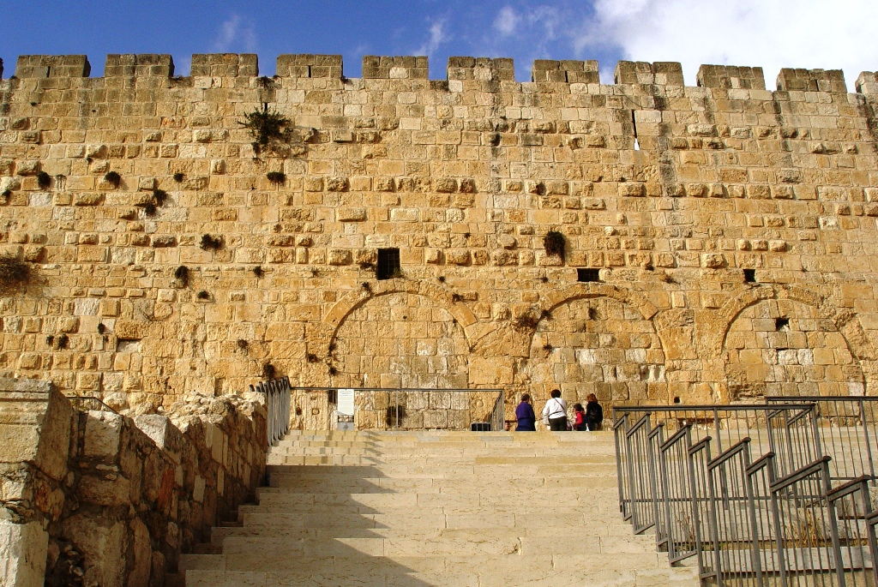
Daniel: Prophet of Self-control and Godliness “God is my judge”
Time: 605-536 BC Place: Babylon
Christians learn from Daniel Scripture
1. Control over their body (1:8) 1 Cor 7, 9:27
2. Character undefiled (3:17-18) Ezekiel 14:14, 18
3. Control by the Spirit of God (6:10) Romans 8:1-17a
4. Character of future things (10:2, secrets) 1 Thes 5:9-11
Application today: Stand fast in the faith, 1 Cor 16:13-14
Day by day, hour by hour, in 2026

Slide 3
Daniel: Prophet of Self-control & Godliness (2 Peter 1:5-7, brotherly kindness & charity)
Time: 605-536 BC Place: Babylon with 5 Kings, Neb-Cyrus (Nov-Feb 2022-2023)
12 weeks - 1 CEU, 8 hrs
Christians learn from Daniel (Romans 15:4) Scripture
Control over his body (Eunuch, Mt 19:10-12. Food & drink) Daniel 1, Cor 7, 9:27
Character undefiled (prayed 3x a day, Daniel 6:10-28) Ezekiel 14:14, 18
Like Joseph, Samuel, John the Baptist, Nathaniel, Peter, Paul, and ____________________
Ezekiel 14:14 (KJV) Though these three men, Noah (3 sons), Daniel (3 friends), and Job (3 friends) were in it, they should deliver [but] their own souls by their righteousness, saith the Lord GOD.
Law: 2-3 witnesses. Ecc 4:10-12 Two [are] better than one; because they have a good reward for their labour. ¹⁰ For if they fall, the one will lift up his fellow: but woe to him [that is] alone when he falleth; for [he hath] not another to help him up. ¹¹ Again, if two lie together, then they have heat: but how can one be warm [alone]? ¹² And if one prevails against him, two shall withstand him; and a threefold cord is not quickly broken.
3. Controlled by the Spirit of God Romans 8:1-17a
Character of future things (Dan 9:24-27, 10:2-3, times of the Gentiles) 1 Thes 5:8-11
Application today: Stand fast in the faith, 1 Cor 16:13-14 Day by day, hour by hour, in 2026

Slide 4
OT True Prophets chart in respect to
Hebrews
11:1-3, 11:6,
11:32-40, 12:1
# | Name/ Scripture | Suffer-Persecute /Scripture | King (Saul to Zedekiah) | Public/ Private | Prophecy - Near/Far or None | Nation | Bless/ Curse | Vision/ Dream | Miracle Prophet or God | Notes | Heb 11
1 | Samuel | No /1 Sam 1-28 | Saul | Private | Near/for Saul | Israel | B/C | 0 | 0 | after death | 32c
2 | Gad | No/1 Sam 22:25 | David | Public | Near/for David | Israel | B/C | 0 | 0 | Book | 32d
3 | Nathan | No/2 Sam 7. 12. | David - | Private | Near/Far-seed of David | Israel | B/C/B | 0 | 0 | Solomon | 32d
4 | Asaph | No/Psalms 50, 73-83 | David | Public | Far/Tribulation and 1000-year reign | Israel | C/B | 0 | 0 | Revelation 6-20
5 | Ahijah | No/1 Ki 11:29-39 | Jeroboam - 1st | Private | Near/Jeroboam’s reign-son | N-Israel | B/C | 0 | 0 | 1 Ki 14:1-26 | 32d
6 | Shemaiah | No/1 Ki 12:22-24 | Rehoboam - 1st | Private | Near/for Rehoboam | S-Judah | B | 0 | 0 | Book 931 BC | 32d
7 | Iddo | No/2 Chr 9:29 | Jeroboam - 1 ^{st} | Private | Seer for Jeroboam | N-Israel | C | 1 Vision | 0 | Records 931 BC | 32d
8 | man of God | No/1 Kings 13 | Jeroboam – 1st | Private | Far/King Josiah by name, c. 300 yrs., 13:2 | N-Israel | C | 0 | Heal hand | Judah, 2 Ki 23:15 | 32d
9 | old prophet | No/1 Kings 13 | Jeroboam – 1st | Private | Near/for man of God, lion and donkey | N-Israel | C | 0 | 0 | Liar-like Lot | 32d
10 | Azariah | No/2 Chr 15:1-7 | Asa – 3rd | Public | None | S-Judah | B | 0 | 0 | war w/Ethiopia
11 | Hanani | No/2 Chr 16:7-10 | Asa – 3rd | Private | Near/ | S-Judah | C | 0 | 0 | war w/Israel-Syria
12 | Jehu | No/1 Ki 16:1-13, | Baasha-3rd | Private | Near/2 Chr 19:1-4 | N-Israel | C/B | 0 | 0 | Son of Hanani
13 | Prophet - | No/1 Ki 20:13-36 | Ahab-7th | Private | Near/Syria/man of God | N-Israel | B/B/C | 0 | Lion | Son of prophet
14 | Micaiah | Yes/1 Ki 22:1-28 | Ahab-death | Private | Near/400 to 1, 2 Chr 18:1-27 | N-Israel | C | 0 | 0 | Lying spirit | 33a
15 | Elijah | Yes/1 Ki 17-2 Ki 2 | Omri, Ahab – 7th | Public | Near/3 ½ years draught, 450 to 1 | N-Israel | B5/C3 | 0 | 8 | Gentile widow | 35
16 | Elisha | No/2 Ki 3-13 | Joram, Jehu – 8th, | Public | None/gentile general, Lu 4:27 | N-Israel | B11/C5 | 0 | 16 | Jezebel-death | 35
17 | Eliezer | No/2 Chronicles 20:37 | Jehosophat -4th | Private | Near/alliance with Ahaziah | S-Israel | C | 0 | 0 | Fleet destroyed
18 | Joel | No/2 Kings 11-15 | Joash -11th | ? | Far/ | S-Israel | C-B | 0 | 0
19 | Jonah | No/Jonah 1-4 | Jehoash - 11th | Public | Near/40 days – repent | Nineveh | B | 0 | 9 by God | Angry-carnal
20 | Amos | No/2 Kings 14-15 | Jeroboam II – 13th | Public | Near/c 45 yrs | N-Israel | C/B | 5 Visions | 0 | Exile Assyria 722
21 | Hosea | No/2 Kings 15-18 | Jeroboam II – 13th | Public | Near/c 40 yrs, Far/2700+ yrs (7x) | N-Israel | C-B | 0 | 0 | Gomer/3 children
 | Oded | No/2 Chr 28:6-15 | Ahaz-12th | Public | Near/ | S-Judah | B | 0 | 0 | War victory
22 | Micah | Yes/rejection | Jotham-Hezekiah | Public | Near Assyria & Babylon, Far Jesus 1st 5:2 | N-S Israel | C-B | Visions | 0 | that day 25%, hear
23 | Isaiah | Yes/sawn in half | Uzziah-Hezekiah | Public | Near and Far/more than other prophets | S-Judah | C-B | Visions | 3/time-185 | Majesty, Royalty | 34
24 | Nahum | No/Nahum 1-3 | Hezekiah-13th | Personal | Near/30 -50 years | Nineveh | C | 1 vision | 0 | Israel, 722 BC | 33a
25 | Habakkuk | No/ | Zedekiah-20th | Personal | Near/ Babylon-Nebuchadnezzar | S-Judah | C-B | Vision | 0 | Trial to Triumph
26 | Zephaniah | No/ | Josiah-16th | Personal | Near-Babylon/Far 2nd coming of Jesus | S-Judah | C-B | 0 | 0 | Trib & 1000
27 | Huldah | No/2 Kings 22:11-20 | Josiah-16th | Private | Near/13 years, Josiah’s grave 2 Ki 23:27 | S-Judah | C-B | 0 | 0 | 2 Chr 34:18-28
28 | Jeremiah | Yes/no wife, pit, etc | Josiah-Zedekiah | Public | Near-Babylon, 586 BC/70-year captivity | S-Judah | C-B | Visions | 0 | Exile Babylon 586 | 36
30 | Ezekiel | No/not from people | Nebu – Babylon | Public | Near, 586 BC/Far , 37-39 ,40-48 1000 yr | S-Judah | C-B | 13 vision | 0 | 18 signs, 8 parables
29 | Daniel | Yes/furnace & lions | Nebu to Cyrus | Public | Near/Far, 1st and 2nd coming, Times of Gentiles | S-Judah | Prophecy | 2 D, 3 V | 4 | Control & Godliness | 33
31 | Obadiah | No/ | Zedekiah-20th |  |  | Edom
32 | Haggai | No/ | Zerubbabel-Gov |  |  | Israel
33 | Zechariah | Yes/ | Zerubbabel |  |  | Israel
34 | Malachi |  | Zerubbabel |  |  | Israel
Before Samuel
Enoch
Genesis 5:24
Jude 1:14
Moses
Exodus 7:1 Deut 34:10
Acts 3:22,
7:37
Miriam
Exodus 15:20
Deborah
Judges 4:9
During & after Samuel
1 Samuel
19:18-24
2 Ki 4:38-41
Sons of the prophets-9x
Updated: 1 4 Jan 2026
W.H.

Slide 5
Romans 15:4 (KJV) For whatsoever things were written aforetime were written for our learning, that we through patience and comfort of the scriptures might have hope. //Scriptures(s) 51x in the NT. 28 Jan WAMM, what we do when we are alone, defines us// something said sticks
1 Corinthians 7:5 (KJV) Defraud ye not one the other, except [it be] with consent for a time, that ye may give yourselves to fasting and prayer;
and come together again, that Satan tempt you not for your incontinency. /RAC 2, secondary, 5x Paul speaks by permission, not command//
Matthew 19:12 (KJV) For there are some eunuchs, which were so born from [their] mother's womb: and there are some eunuchs, which were made eunuchs of men: and there be eunuchs, which have made themselves eunuchs for the kingdom of heaven's sake. He that is able to receive [it], let him receive [it]. //Marytn Lles//
1 Corinthians 9:27 But I keep under my body, and bring [it] into subjection: lest that by any means, when I have preached to others, I myself should be a castaway. //8x, 4 in 1-2 Cor. disqualified or reprobate or reprobado. Salvation (2 Cor 13:5) or sanctification (1 Cor 3:9-15).//
Ezekiel 14:14 Though these three men, Noah (3 sons), Daniel (3 friends) and Job (3 friends) were in it, they should deliver [but] their own souls by their righteousness, saith the Lord GOD.
Romans 8:14 (KJV) For as many as are led by the Spirit of God, they are the sons of God. //Holy Spirit – 15x. // 7:1-6 law of Moses, 7:7-21 law of sin & death, 22-25 law of my mind, law of God, 8:1-17a law of the Spirt of life, 17b-27 Jesus is our hope and help, 28-39 Our Confidence to Continue in the Love of Christ
1 Thessalonians 5:8-11 But let us, who are of the day, be sober, putting on the breastplate of faith and love; and for an helmet, the hope of salvation. For God hath not appointed us to wrath, but to obtain salvation by our Lord Jesus Christ, Who died for us, that, whether we wake or sleep, we should live together with him. ¶ Wherefore comfort yourselves together, and edify one another, even as also ye do.
1 Corinthians 16:13-14 (5 parts)¶ Watch ye //Ezekiel: Watchman on a short lease//, stand fast in the faith //Daniel: prophet of control & character//. Haggai

