Slide 1
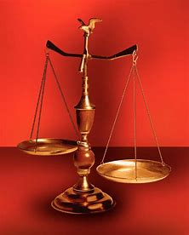
Fellowship Church, Oct 6, 2024 B Heath
Straight and Balanced
(Luke 3:4-6)
It's all about you Jesus (9:55-9:59)
The Law of Moses
1 – 12 beginnings (origins) of life with Adam, Genesis 1-2
2a – 12 beginnings (origins) of death with Adam, Genesis 3
2b – death with Cain & Noah, Genesis 4:1-9:17
2c – death with Nimrod & Babel, Genesis 9:18-11:32
3 – 12 beginnings of Israel with Abraham, Genesis 12-50
4a – exit from slavery in Egypt to the Red Sea, Exodus 1-12
4b – from the Red Sea to Mount Sinai, Exodus 13-18
4c – Mt Sinai (Law) 10 Commandments, Exodus 19-24
4d – Mt Sinai (Law) the Tabernacle, Exodus 25-40
5a – Mt Sinai (Law) approaching a holy God, Leviticus 1-17
5b – Mt Sinai (Law) living a holy life, Leviticus 18-27
6a – Mt Sinai (Law) Prepared to Obey God, Numbers 1:1-10:10
6b – The Wilderness of Disobedience, Numbers 10:11-25:18
6c – Prepare to Cross the Jordan & Warfare, Numbers 26-36
OT: Ps 5:8, Pr 4:25-27
Amos 7:7-8
Isaiah 28:13, 17
NT: Mt 3:3, Acts 9:11
Hebrews 12:13, Jude 3
1 Corinthians 15:1-4
2 Timothy 3:10, John 7:16
OT: Deut 25:13-16
Proverbs 20:10
Daniel 5:25-28
NT: Hebrews12:1
1 Cor 3:11-15
Philippians 4:5
James 3:17

Slide 2
Sunday School Schedule-2024
Mas de Cristo class
What is concealed in the Old Testament is revealed in the New Testament.
(1) Learn – Romans 15:4 (2) Admonish – 1 Corinthians 10:1-13
(3) Shadow – Col 2:17, Heb 8:5, 10:1 (4) Figure (model) – Heb 9:9, 11:19, 1 Peter 3:21
(5) Type or antitype - specific people are Godly or Ungodly
COMPLETED books of the Bible
Old Testament: Genesis (4), Exodus (4), Leviticus (2), Numbers (1), Psalms (4), Proverbs, Ecclesiastes, Amos, Obadiah, Malachi
New Testament: Mark, Colossians, Philemon, James, Jude
Invite to the 2024 daily Bible reading schedule. Isaiah from May 9 to Oct 18. Copies on the back table.
Notes:
-

Slide 3
at Mount Sinai (Law) Prepared to Obey God, Numbers 1-10
Numbers Preparation Law of Moses New Testament
1-2 1st ORDER Civil – warfare Ephesians 1-6, Rev 2
(age: 20 years and able, Levites exempt) Sit-Walk-Stand
3-4 2nd PRIESTS Ceremonial – priests & Levites 1 Peter 2:5, 9 (age: 30-50 years, 25-30 for training) Revelation 1:6, 5:10
5-6 3rd SEPARATION Civil – unclean & unfaithful (sin) 1 Corinthians 5-7
(the Nazarite vow is for anyone) Acts 21, Eph 5:18
7 4th FINANCES Civil - leadership (comm-time) 2 Corinthians 8-9
8 5th CONSECRATION Ceremonial - light & Levites Romans 6-8, 12:1-3
9:1-14 6th REMEMBER Ceremonial – Passover Mt 26:17-30, Rev 19:9
(unleavened bread & fruit of the vine) 1 Cor 11:17-34
9:15-10:10 7th COMMUNICATE daily - cloud & fire, silver trumpets 1 Corinthians 14-15
(God with us, leaders for/with us. 1st love as babies in Christ.) Hebrews 13:7
Application: God prepares us for a future of obedience in our 1st love. (Romans 15:4, 14)
Award: Numbers 10-25. Israel disobeys, and Moses prays ____ times? (1 Cor 10:1-13)

Slide 4
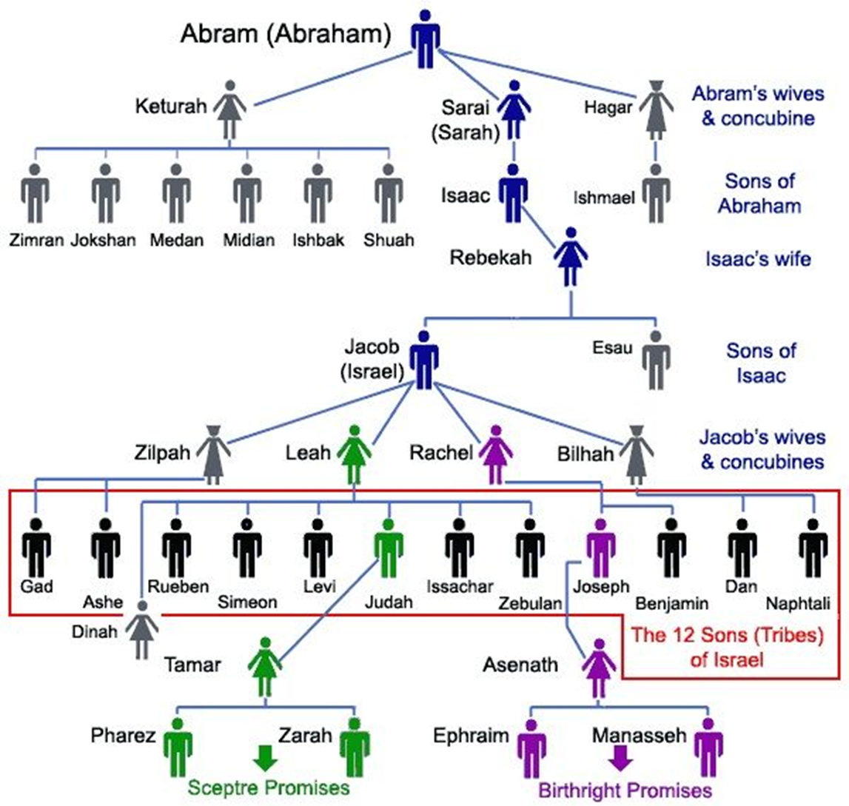
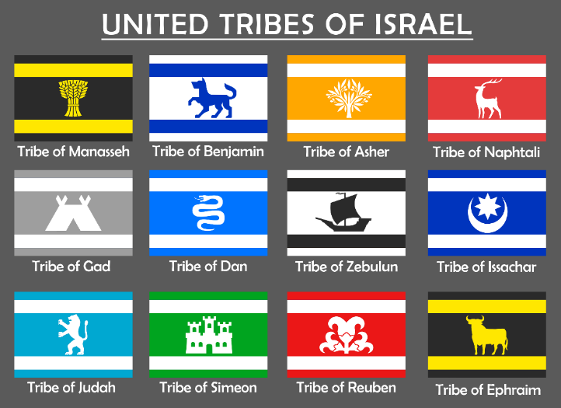
Old Testament:
12 tribes listed
19 times. 5 of 19
lists shown.
New Testament:
“12 tribes” noted in
Mt 19:28, Lu 22:30
Acts 26:7, James 1:1
Rev 21:12
Genesis 34
Genesis 38

Slide 5
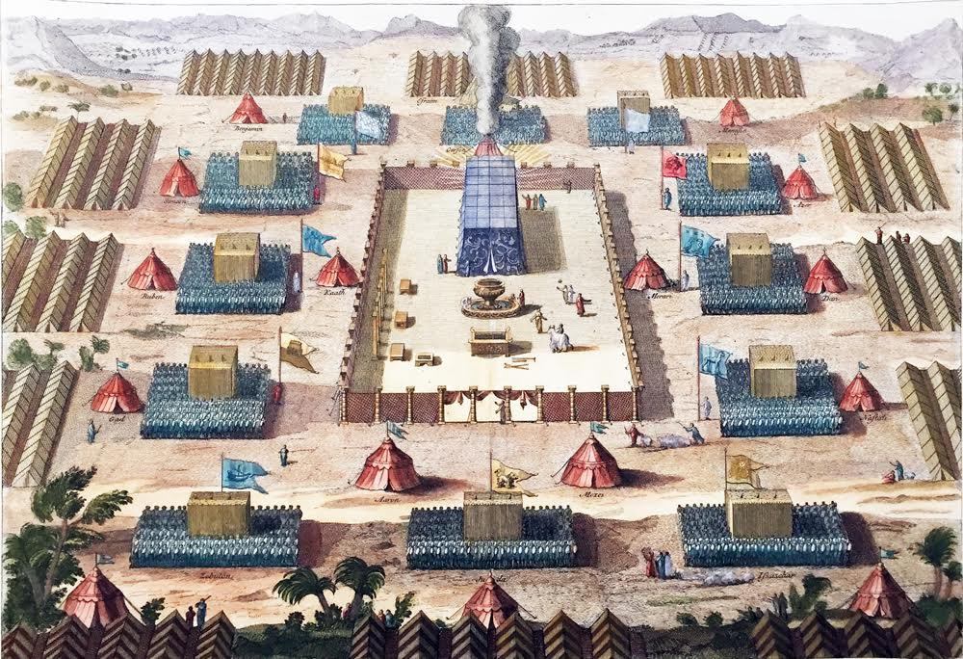
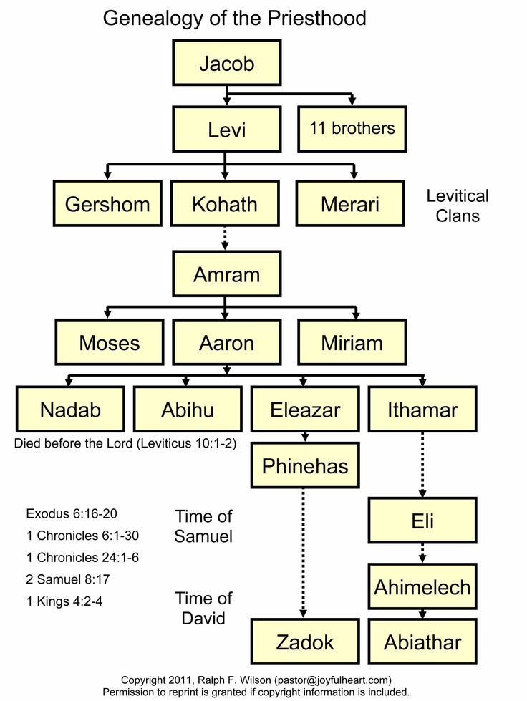
The Tabernacle
Numbers 1-4
1) Tabernacle is center
2) Levites on 3 sides
3) Priests at entrance
(east side)
4)12 tribes with banners
(4 groups of 3 tribes)
1:46, 603,550 men, 20+
3:29, 22,000 Levites, 1 mo +
& women, children, foreigners
= 2-3 million people

