Slide 1
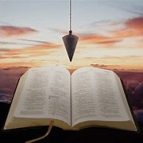
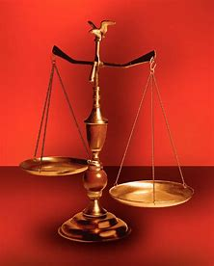
Fellowship Church, Jun 10, 2026 B. Heath
Straight and Balanced
(Luke 3:4-6)
Bio: Saints in the Way, and the Truth, and the Life
George Whitefield: Evangelist
Jonathan Edwards: Theologian
John Wesley: Methodist
OT: Ps 5:8, Pr 4:25-27
Amos 7:7-8, Is 28:13, 17
NT: Mt 3:3, Acts 9:11
Hebrews 12:13, Jude 3
1 Cor 15:1-4, 2 Tim 3:10
John 7:16
OT: Deut 25:13-16
Pr 20:10, Dan 5:25-28
NT: Hebrews 12:1
1 Cor 3:11-15
Philippians 4:5
James 3:17

Slide 2
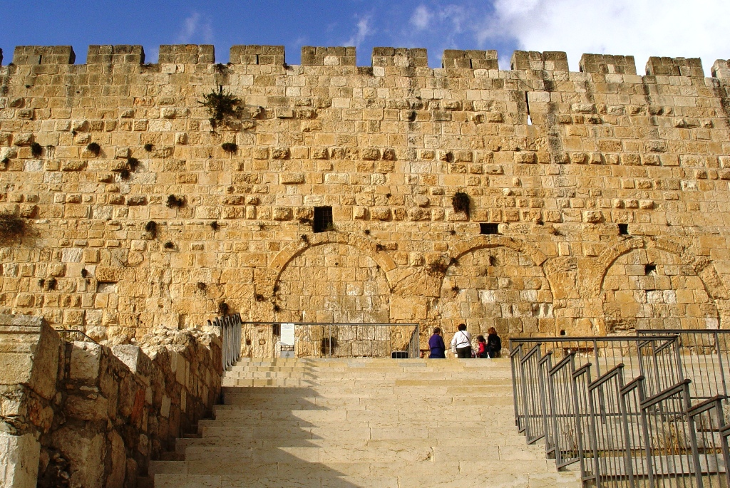
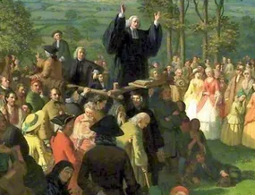
George Whitefield: Evangelist
Sight and Sound producer of movie “A Great Awakening” 2026
A GREAT AWAKENING | A Man of Faith | In Theaters April 3
Birth to College: 1714-1734
Salvation: 1735
England: 1735-1738
13 colonies: 1739-1770
Sanctification: 1735-1770
Glorification: 1770
Decision: Wake up sleepers (unsaved) & sleepy Christians (saved)

Slide 3
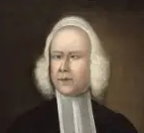
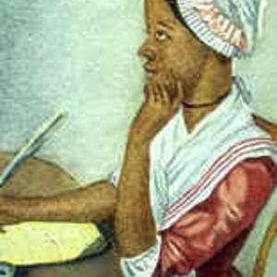
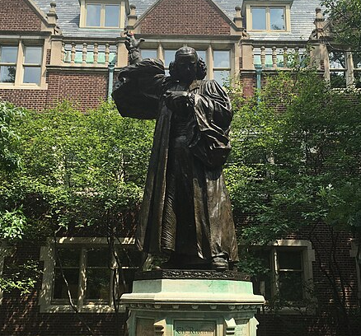
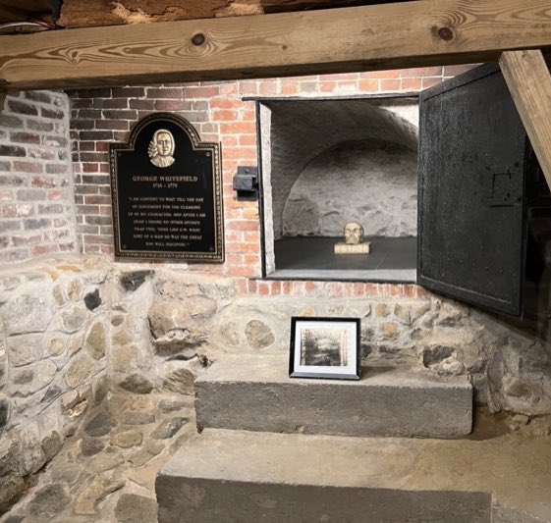
Blue Letter Bible preaching by George Whitefield
58 messages in text
George Whitfield — Sermons | SermonIndex
67 messages – indexed and 2 in audio
By Phillis Wheatley
“An Elegiac Poem On the Death of that celebrated Divine, and eminent Servant of Jesus Christ, the Reverend and Learned Mr. George Whitfield”.
Thy prayers, great Saint, and thy incessant cries,
Have pierc'd the bosom of thy native skies!
Thou moon hast seen, and ye bright stars of light
Have witness been of his requests by night!
He pray'd that grace in every heart might dwell:
He long'd to see America excell;
Best known poems: "On being brought from Africa to America“ and “His Excellency George Washington”
Whitfield to Wesley – universal redemption or election
Iain Murray on Whitefield and Wesley
Thomas Kidd: George Whitefield, America’s Spiritual Founding Father - Christ and Culture (2016)
John Piper Podcast, George Whitefield 1
GW 2

Slide 4
George Whitefield: Evangelist
Sight and Sound producer of movie “A Great Awakening” 2026 A GREAT AWAKENING | A Man of Faith | In Theaters April 3
Birth to College: 1714-1734 (Father died at 2, poor, 4 yrs old measles – eyes crossed with strabismus, tavern, acting ability/gift
Oxford – servitor, Wesley’s & the Holy Club, good works religion, B.A. arts)
Salvation: 1735 read book given by Charles Wesley, ”The Life of God in the Soul of Man”
England: 1735-1738 (Anglican, Wesley – holy club, field)
13 colonies: 1739-1770 (13 trans-Atlantic trips) Followed John & Charles Wesley (3rd of 3 bio to study) to Georgia, 1x.
7x, total of 9 years, 50%-80% of people heard.
Sanctification: read “Matthew Henry Commentary” 3x, the 4th time on his knees. Testimony of study on Jude.
Preached 30,000 messages (began in Georgia, 1-2 hours each, 2-3x daily, rode horse)
Persecution: 1740, in England by old light Wesley followers. 1760, mocked in play – Dr Squintum. Honorary Dr from Princeton.
lifelong friends with Benjamin Franklin and Jonathan Edwards
Glorification: in Massachusetts, buried in a Presbyterian church
Decision: Wake up sleepers (unsaved) and sleepy Christians (Romans 13:11-14, 11 And that, knowing the time, that now it is high time
to awake out of sleep: for now is our salvation nearer than when we believed. 1 Corinthians 11:27-32 (30 For this cause many are weak and
sickly among you, and many sleep). 1 Thessalonians 5:1- 11 (6, Therefore let us not sleep, as do others; but let us watch and be sober),
Ephesians 5:14 Wherefore he saith, Awake thou that sleepest, and arise from the dead, and Christ shall give thee light.)

