Slide 1

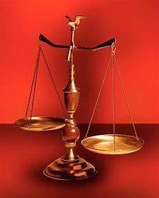
Fellowship Church, Feb 16, 2025 B Heath
Straight and Balanced
(Luke 3:4-6)
Expository Teaching
It's all about you Jesus (9:55-9:59)
Our Sanctification and the Rapture of the Church
1 and 2 THESSALONIANS
DESCRIPTIVE SPIRITUAL LAWS
#1 – The Model Young Church (1st love) (1 Thes 1)
#2 – The Model Ministers (character) (1 Thes 2)
#3 – The Model Minister’s Heart (1 Thes 3)
PRESCRIPTIVE SPIRITUAL LAWS
#4 – Two Sins (4:1-12) & the Rapture (4:13-18) (1 Thes 4)
#5 – Rapture of the Church (1Thes 5:1-11)
#6 – Sanctification of the churches (11 Thes 5:12-28)
BUILDS UPON 1 THESSALONIANS
#7 – Our Sanctification and the Return of the Lord Jesus (2 Thes 1)
#8 – Rapture of the Church then the Wrath of God (2 Thes 2)
#9 – Our Sanctification and Three Sins (2 Thes 3)
#10 – Review of 1 & 2 Thessalonians and self-assessment
OT: Ps 5:8, Pr 4:25-27
Amos 7:7-8
Isaiah 28:13, 17
NT: Mt 3:3, Acts 9:11
Hebrews 12:13, Jude 3
1 Corinthians 15:1-4
2 Timothy 3:10, John 7:16
OT: Deut 25:13-16
Proverbs 20:10
Daniel 5:25-28
NT: Hebrews12:1
1 Cor 3:11-15
Philippians 4:5
James 3:17

Slide 2
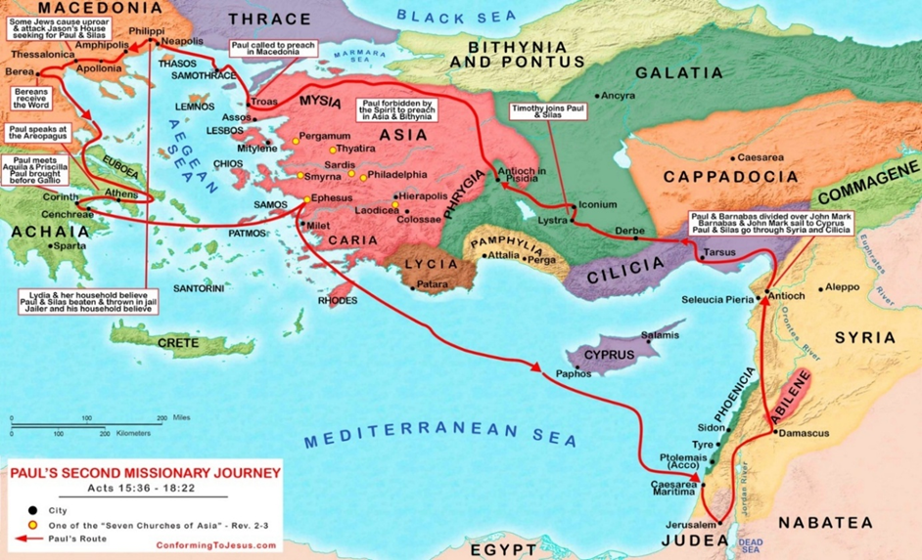
Notes:
-

Slide 3
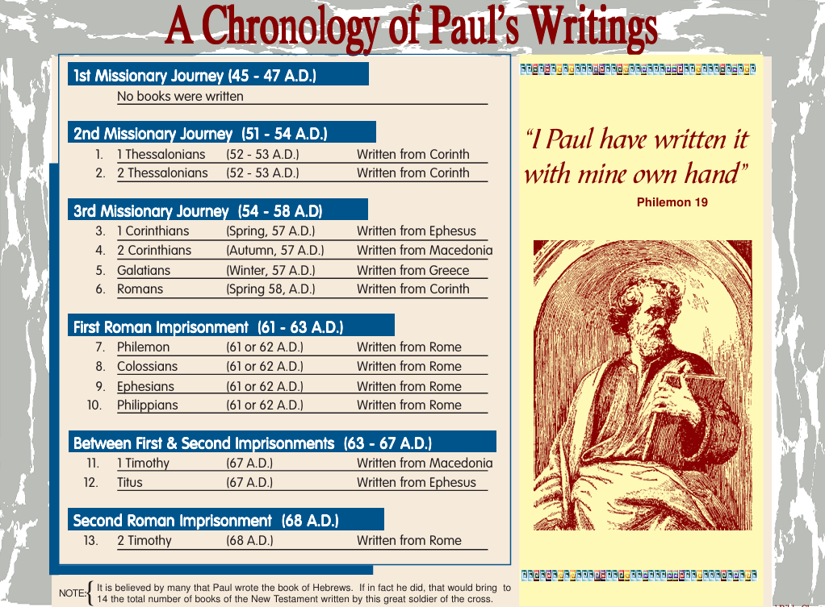
Notes:
-

Slide 4
Notes:
-

Slide 5
Our Sanctification and the Return of the Lord Jesus (2 Thessalonians 1)
1-2 Greeting (S2)
in God our Father and the Lord Jesus Christ (4 times)
Grace and peace
3-6 Our sanctification (S2) and God’s Judgment (R3b, R1 – rapture imminent)
- Your faith grows exceedingly and love toward one another abounds
- Patience and faith in your persecutions and tribulations
7-10 The Return of the Lord Jesus (R4-after the rapture & wrath of God on earth)
Jesus revealed from heaven with His mighty angels
In flaming fire-vengeance on them that know not God/obey not the gospel (R4)
Punished with everlasting destruction from the presence of the Lord and (R6b)
He shall come to be glorified in His saints (they shall reign with Jesus Christ)
11-12 The Ministers’ Prayer for their sheep (congregation – S2)
- Count you worthy of this calling (many are called and few are chosen - effectively
- The name of our Lord Jesus Christ may be glorified in you, and ye in Him
Notes:
-

Slide 6

Sunday School Through the Bible - 2025
Grow in grace, and in the knowledge of our Lord and Savior Jesus Christ
2 Peter 3:18
What is concealed in the Old Testament is revealed in the New Testament
In the Old Testament, we learn (Romans 15:4), and we are admonished (1 Cor 10:1-13). Also, we see the Lord Jesus Christ in Shadows (Col 2:17, Heb 8:5, 10:1) in Figures
or models (Heb 9:9, 11:19, 1 Peter 3:21), and in Types or antitypes (i.e., Abel and Cain, Jacob and Esau, David and Absolom, Christ and antichrist).
COMPLETED books of the Bible
Old Testament: Genesis (4), Exodus (4), Leviticus (2), Numbers (3), Deuteronomy (5), Psalms (4), Proverbs, Ecclesiastes, Amos, Obadiah, Malachi
New Testament: Mark, Colossians, 1-2 Thessalonians (10), Philemon, James, Jude
Invite to Fellowship Church 2025 daily schedule for Bible and prayer.
This week: Psalm 59 and 2 Samuel 22:1-24:25.
Next Sunday: 2 Thessalonians 2 Bible challenge: Count S1-10x, S2, R1-3x, R2, R3b-16x, R4, R6b-1x
Notes:
-

