Slide 1

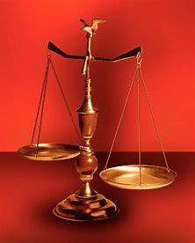
Fellowship Church, Jan 29, 2025 B. Heath
Straight and Balanced
(Luke 3:4-6)
Biblical characters (Hebrews 11:1-3, 6, 38-40, 12:1-4)
#12 – Faith of a changing heart with David (Heb 11:32b, 1-2 Sam)
#13 – Lifelong Shining Faith with Samuel (Heb 11:32c, 1 Sam)
#14 – The Comforter’s Faith with Nathan and Gad (Heb 11:32d)
#15 – Discipleship Faith with Elijah and Elisha (Heb 11:34b, 35a)
#16 –
#17 –
#18 –
#19 –
#20 –
OT: Ps 5:8, Pr 4:25-27
Amos 7:7-8, Is 28:13, 17
NT: Mt 3:3, Acts 9:11
Hebrews 12:13, Jude 3
1 Cor 15:1-4, 2 Tim 3:10
John 7:16
OT: Deut 25:13-16
Pr 20:10, Dan 5:25-28
NT: Hebrews 12:1
1 Corinthians 3:11-15
Philippians 4:5,
James 3:17

Slide 2
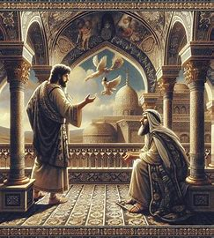


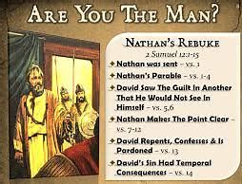
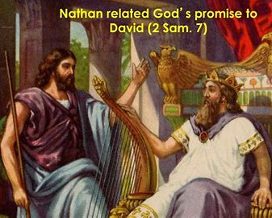
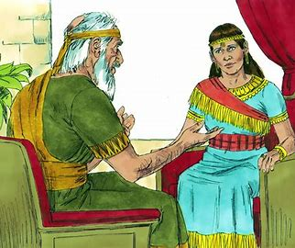
Comforter’s Faith with Nathan and Gad (Hebrews 11:32d, and [of] the prophets)
(1)
1 Samuel 22:5
Gad is King David’s public and
warfare Seer and helps David
flee from King Saul
(4)
2 Samuel 24 / 1 Chr 21
Gad sees David’s public sin of the military census
and warfare with God
(6)
1 Chronicles 29:29
Books never found and not inspired
(7)
2 Chronicles 9:29
Nathan the prophet with King Solomon
(8)
2 Chronicles 24:25
300 years later, Hezekiah rededicates the temple
(9)
Luke 3:31
Nathan’s linage to Jesus’ father Joseph
(2)
2 Samuel 7
Nathan is King David’s
private family Prophet
and helps David
do God’s will
(3)
2 Samuel 12
Nathan rebukes David
for his cold heart and extreme sins (1 Kings 15:5)
David is 50 years old
(5a)
1 Kings 1
David and Bathsheba named 3rd child Nathan
(5b)
1 Kings 1
Nathan’s private counsel to David through Bathsheba
David is 70 years old
(10)
Zechariah 12:12
Nathan ‘s family mourns in the tribulation

Slide 3
The Comforter’s Faith with Nathan and Gad (Hebrews 11:32d and [of] the prophets: )
Time: circa 1000 BC (last 20+ years of King David’s life) Place: Israel-Jerusalem
Characters: Nathan and Gad. Others: David, Joab, Uriah the Hittite (1 Kings 15:5), and Bathsheba.
Prophet thought: Were Nathan and Gad students of Samuel’s school of prophets? Samuel the Prophet leads
the first school of prophets (1 Samuel 19:20).
Old Testament: 1-2 Samuel, 1 Kings, 1 Chronicles, and Psalm 51
New Testament: There are no direct references to Nathan or God.
However, by faith (Romans 10:17), Romans 15:4 says the Old Testament is “written for our learning“
2 Timothy 3:16-17, All scripture is given by inspiration of God, and is profitable . . .
Hebrews 1:1-3, God spoke in the Old Testament to the prophets, has spoken to us by His Son
Hebrews 11:39-40, God provided Jesus Christ for us, that they without us should not be made perfect
Application: As Nathan and Gad were King David ‘s helpers from God, today, the Holy Spirit and the risen Jesus Christ are the Believer’s helpers from God. (Holy Spirit - John 14:16, 14:26, 15:26, 16:7, Jesus Christ - 1 John 2:1)
Comforter is also translated, Advocate or Helper
Next: Discipleship Faith with Elijah and Elisha

