Slide 1
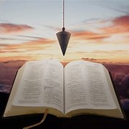
Fellowship Church, Apr 13, 2025 W. Heath
Straight and Balanced
(Luke 3:4-6)
Expository Teaching
It's all about you Jesus (9:55-9:59)
The Second Letter of Peter, Last Things to Remember
1. FEED MY LAMBS
Climbing the Stairway “into” Heaven (2 Peter 1)
2. PROTECT MY SHEEP
False Teachers in the Church (2 Peter 2)
3. GUIDE MY SHEEP (2 Peter 3)
I have fought a good fight, I have finished [my] course
4. THE GREAT SHEPHERD OF THE SHEEP (Hebrews 13:20)
Last words from “that Great Shepherd to the Sheep”
April 20: Resurrection breakfast and cantata
April 27: (Psalm 68) with discussion
OT: Ps 5:8, Pr 4:25-27
Amos 7:7-8
Isaiah 28:13, 17
NT: Mt 3:3, Acts 9:11
Hebrews 12:13, Jude 3
1 Corinthians 15:1-4
2 Timothy 3:10, John 7:16
OT: Deut 25:13-16
Proverbs 20:10
Daniel 5:25-28
NT: Hebrews 12:1
1 Cor 3:11-15
Philippians 4:5
James 3:17

Slide 2
Last Words from the Great Shepherd to the Sheep, in Biblical order
1. JESUS: Thursday evening in the upper room, “I pray for them “ (John 17:20-26) 12 Apostles then Church Thursday night at Gethsemane, “Father, not My will but Thy will be done” (Matthew 26:36-46)
Friday afternoon on the cross, “Father, into Thy hands I commend My spirit” (Luke 23:44-46)
40 days, “Feed my lambs/sheep” (John 21:15-17, 18-23) “power from on high” (Luke 24:44-52)
------------------------------------------------------------------------------------------------------------------------------------------------------------------------------------------------------------------------------------------
2. STEPHEN: “Lord, lay not this sin to their charge. And when he had said this, he fell asleep” (Acts 7)
3. PAUL: “a dispensation of the gospel is committed unto me, run race-receive uncorruptible crown“ (1 Cor 9)
rapture of the Church to Christ the Head (Col 1:18, Eph 1:22, 5:23, 1 & 2 Thessalonians, 1 Cor 15)
“that great shepherd of the sheep - - make you perfect in every good work” (Hebrews 13:20-21)
last days-ministers, “I have fought the good fight, I have finished [my course], bring my coat & Bible” (2 Tim 3-4)
4. JAMES: “Brethren, if any of you do err from the truth, and one convert him” (James 5:19-20)
5. PETER: 1st FEED My lambs, 2nd PROTECT My sheep, 3rd GUIDE My sheep/friend (2 Peter/John 21:15-17)
6. JUDE: common salvation - needful - content for the faith once delivered unto the saints (1-3, 4-19, 20-25)
------------------------------------------------------------------------------------------------------------------------------------------------------------------------------------------------------------------------------------------
7. JOHN: “Hear, what the Spirit says unto the churches” (Rev 1-3, 4-5) “Surely I come quickly” (22:16-21)

Slide 3
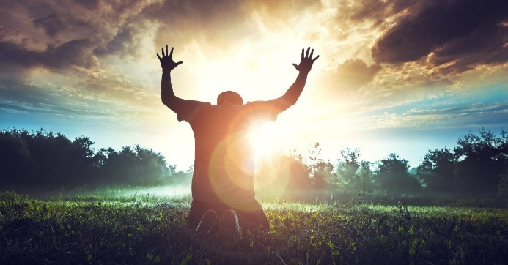
Sunday School Through the Bible (2023 - 2025)
Grow in grace, and in the knowledge of our Lord and Savior Jesus Christ
2 Peter 3:18
COMPLETED books of the Bible
Old Testament: Genesis (4), Exodus (4), Leviticus (2), Numbers (3), Deuteronomy (5), Psalms (4), Proverbs, Ecclesiastes, Amos, Obadiah, Malachi
New Testament: Mark, Colossians, 1-2 Thessalonians (10), Philemon, James, 2 Peter (4), Jude
Invite to Fellowship Church 2025 daily schedule for Bible and prayer
Next week: 1 Kings 21:1-2 Kings 1:8 (Mon-Sat) & Psalm 68 (Sun)
Notes:
-

