Slide 1

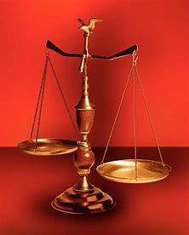
Fellowship Church, December 21, 2025 2 Peter 3:18 Sunday School Bill Heath
Music: Parables in Blues
Straight & Balanced
(Luke 3:4-6)
Jesus Teaches in Parables
1. New Wine in New Bottles (Luke 5:37-39)
2. Let us Bind the Strong Man (Mark 3:23-30)
3. Is My House Built on Rock? (Luke6:46-49)
4. Asaph’s Secret Revealed (Matthew 13:1-52)
5. Defiled Eating & Words (Mark 7:1-23)
6. Workers’ Time in the Vineyard (Mt 20:1-16)
7. The Rich Fool (Luke 12:13-21)
8. God’s Fairness Acts (Luke 12:41-48)
9. The Barren Fig Tree for 3+ Years (Luke 13:6-9)
10.
OT: 2 Kings 21:13, Ps 5:8 Pr 4:25-27, Amos 7:7-8 Isaiah 28:13, 17
NT: Mt 3:3, Acts 9:11
Hebrews 12:13, Jude 3
1 Corinthians 15:1-4
2 Timothy 3:10, John 7:16
OT: Deut 25:13-16
Proverbs 20:10
Daniel 5:25-28
NT: Hebrews 12:1
1 Cor 3:11-15
Philippians 4:5
James 3:17

Slide 2
6 months later is the parable of the Withered Fig Tree
1st Sunday of 2026, read the parable of the Lost Sheep, Coin, and Son (17-19) in Luke 15:1-32.
A parable is an earthly story with a heavenly truth.

Slide 3
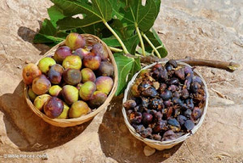
Parable: The Barren Fig Tree for 3+ Years, Luke 13:6-9
Key words | All are sinners. Repent or Perish (2nd death). Fig Tree & Fruit. Tree, fruit, and leaf begin in Genesis 3 and end in Revelation 22:1-2.
Context 12:1-13:9 13:1-5 | 12:1-59 are in the same time and place, c. 6 months before His crucifixion. 1-3 Galileans’ blood mixed with their sacrifice by Pilate (planned & government) 4-5 Jerusalemites die when the tower falls (unplanned & anyone, anytime)
(2) Content 13:6-9 | a) Jesus’ ministry time covers 3 Passover Feasts or 3 years, and He is the Passover Lamb of God, the 4th time on Friday on the cross at Calvary. b) A certain man and his vineyard = Jesus. Dresser (owner) of the vineyard = God. c) The fig tree represents the nation of Israel and nations in Luke 21:29 “all the trees”. The Lord blesses (good fig) or curses (bad fig) the nation of Israel, Jeremiah 24. The great tree Nebuchadnezzar, Daniel 4. Micah 4:4. John axes tree root, Mt 3:10, Lu 3:9. Future Israel in Romans 11 during the tribulation and the 1000-year reign of Christ.
Decision | How can I produce more consistent fruit of the Spirit in 2026 than in 2025?

Slide 4
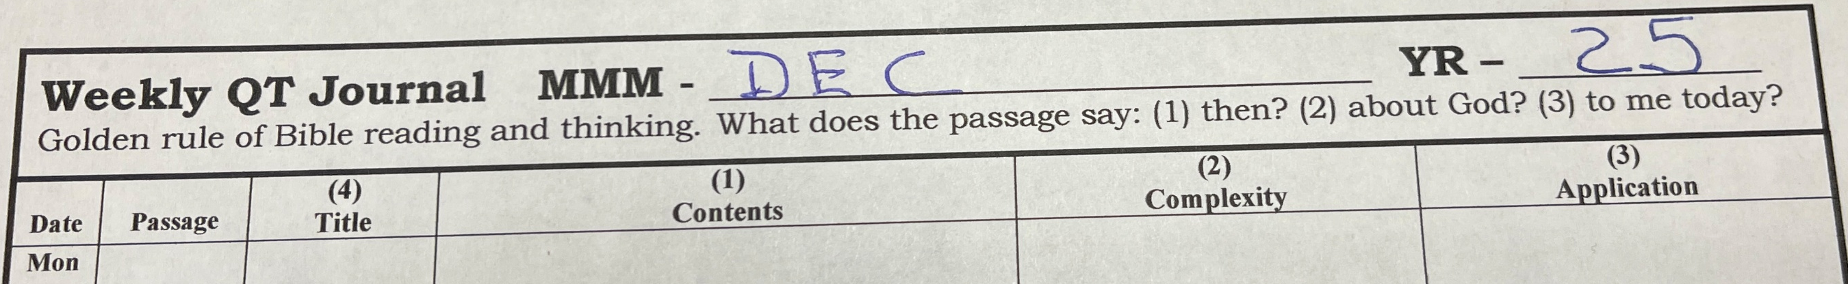
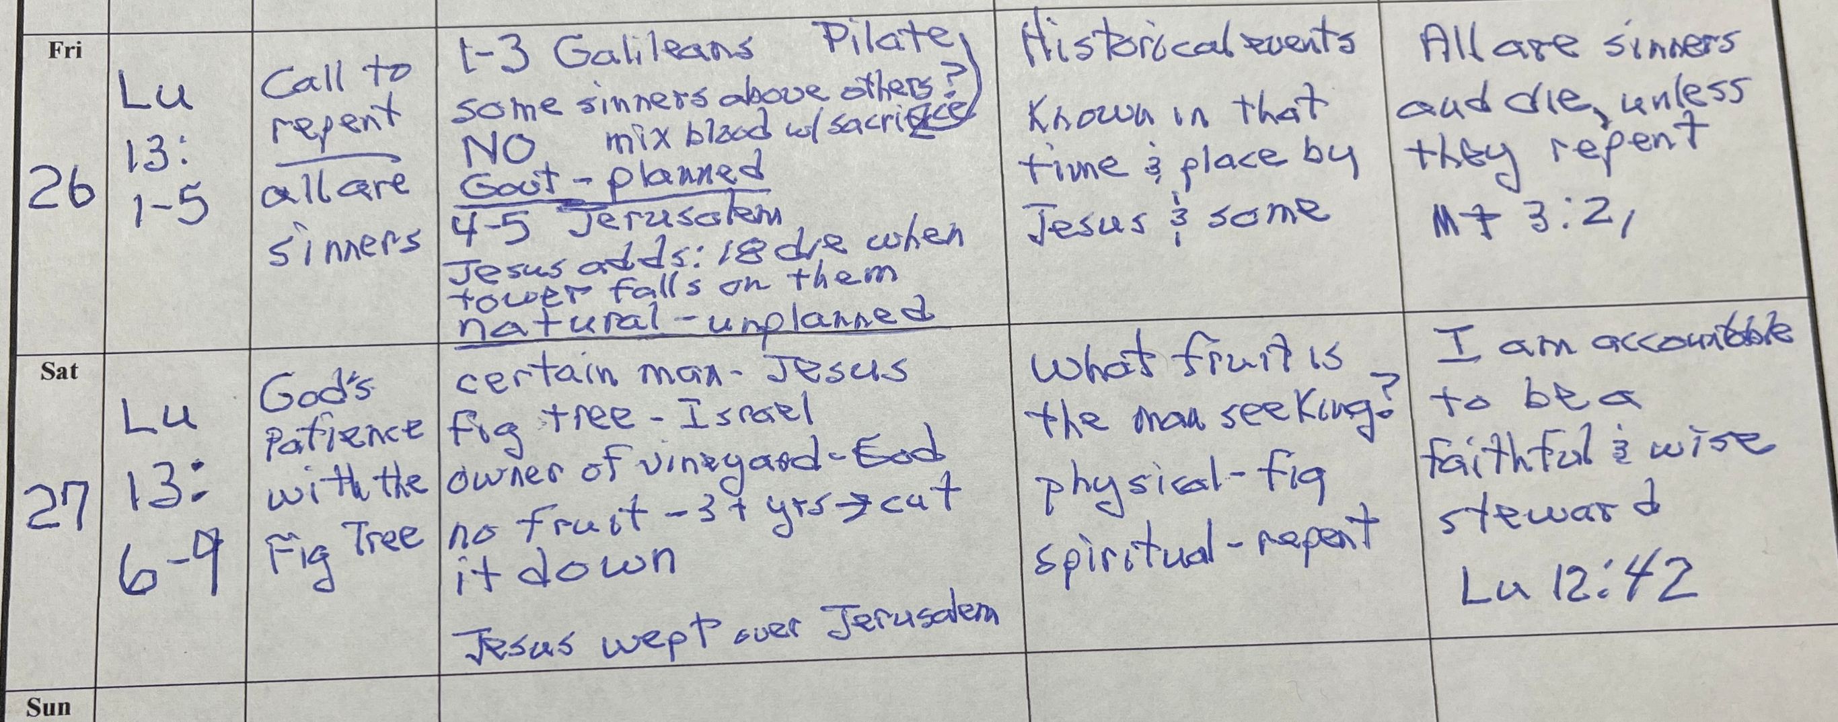
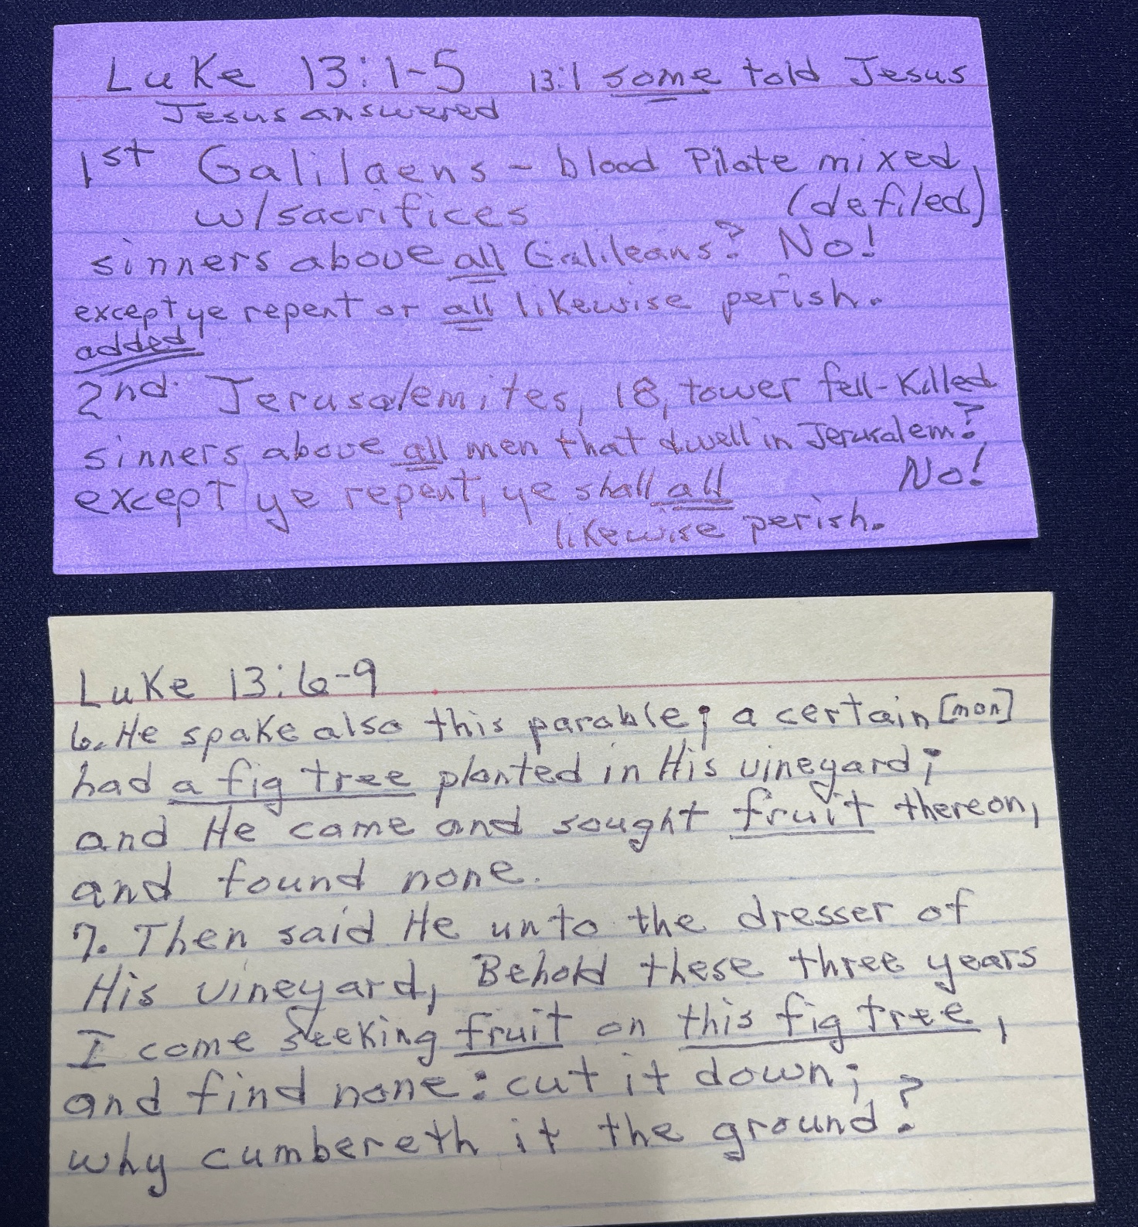
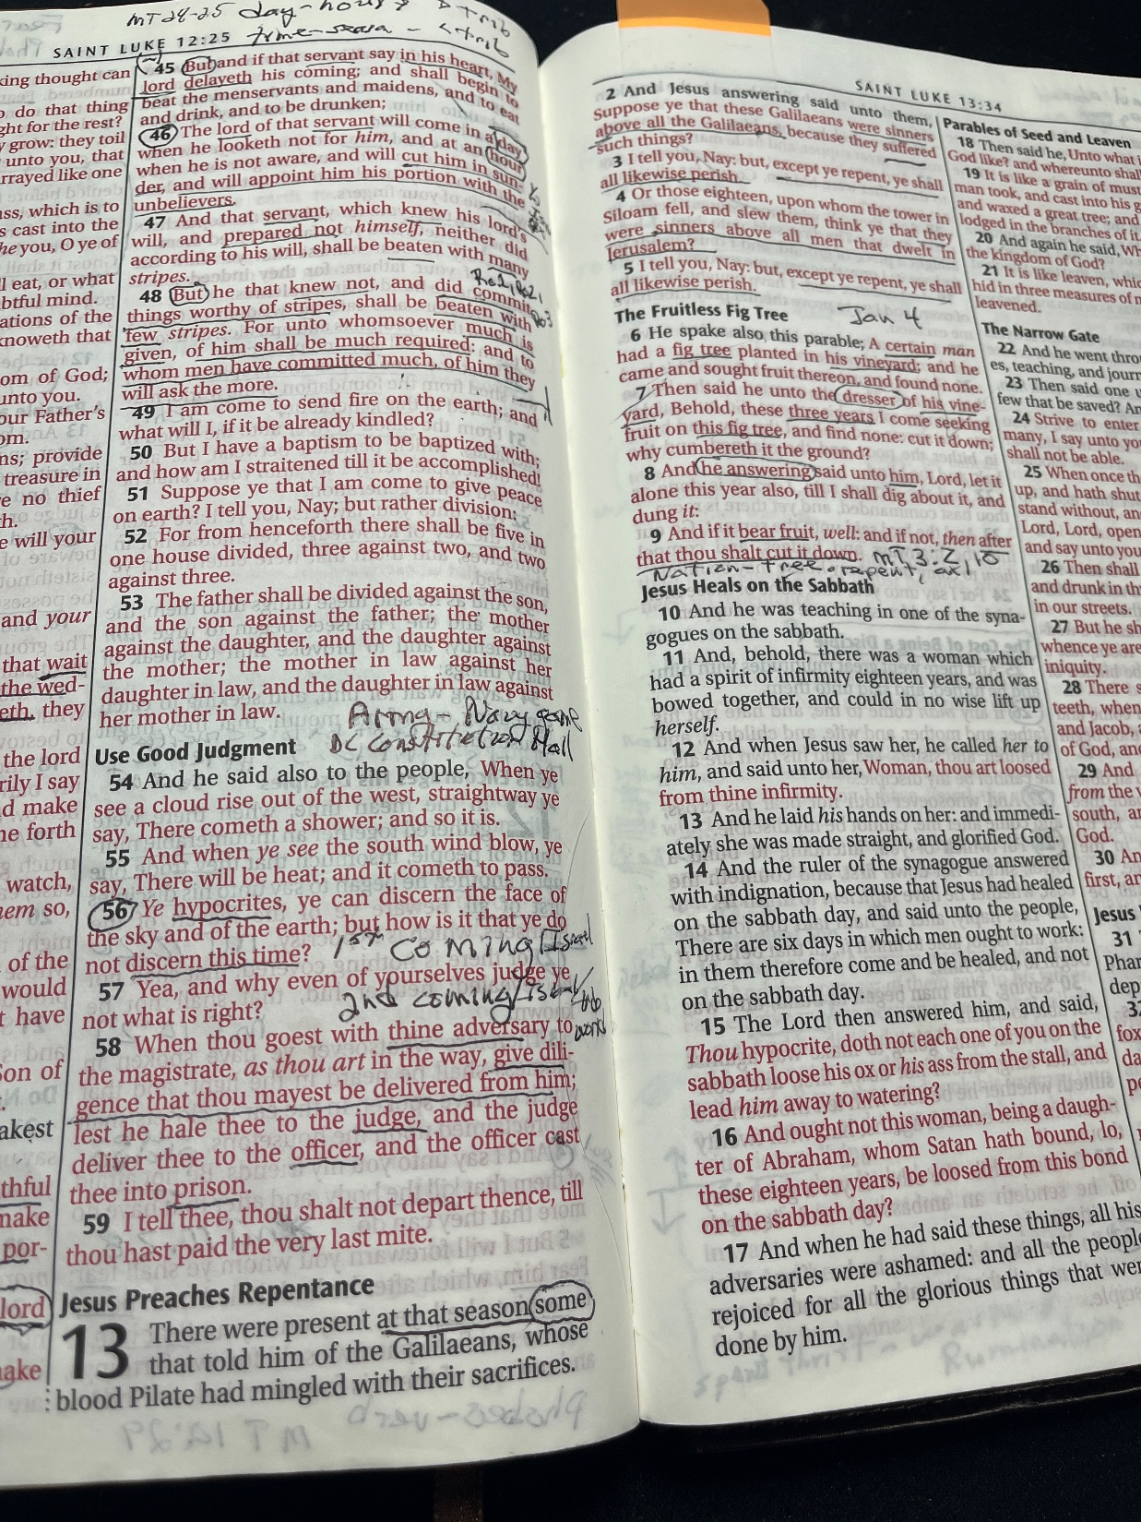
2026 Daily Word & Prayer Strategy for Spiritual Warfare
Daily schedule for 2 months
Weekly Journal and Guide
2026 Schedule
Jan 1, 1 Corinthians
Jan 4, Psalms (Sundays)
Feb 28, 2 Corinthians
Apr 4, Haggai
Apr 10, Zechariah
May 16, Malachi
May 28, John
Oct 1, Daniel
Dec 2, 1 Peter
Dec 16, 2 Peter
Dec 28, Jude
Bible & Index Cards

Slide 5

Sunday School Through the Bible (2023 - 2025)
Grow in grace, and in the knowledge of our Lord and Savior Jesus Christ
2 Peter 3:18
COMPLETED books of the Bible
Old Testament: Genesis (4), Exodus (4), Leviticus (2), Numbers (3), Deuteronomy (5), Ruth, Esther, Psalms (4), Psalm 68 (3), Asaph (12), Proverbs, Ecclesiastes, Amos, Obadiah, Malachi
New Testament: Mark, Parables (9), Colossians, 1-2 Thessalonians (10), Ephesians, Philemon, James, 2 Peter (4), 2 John, Jude
Invitation to Fellowship Church 2026 daily schedule for Bible and prayer
1 Corinthians – January and February 2026 (60-day daily word & prayer)

