Slide 1
Fellowship Church, Oct 27, 2024 B Heath
Straight and Balanced
(Luke 3:4-6)
It's all about you Jesus (9:55-9:59)
The Law of Moses
1 – 12 beginnings (origins) of life with Adam, Genesis 1-2
2a – 12 beginnings (origins) of death with Adam, Genesis 3
2b – death with Cain & Noah, Genesis 4:1-9:17
2c – death with Nimrod & Babel, Genesis 9:18-11:32
3 – 12 beginnings of Israel with Abraham, Genesis 12-50
4a – exit from slavery in Egypt to the Red Sea, Exodus 1-12
4b – from the Red Sea to Mount Sinai, Exodus 13-18
4c – Mt Sinai (Law) 10 Commandments, Exodus 19-24
4d – Mt Sinai (Law) the Tabernacle, Exodus 25-40
5a – Mt Sinai (Law) approaching a holy God, Leviticus 1-17
5b – Mt Sinai (Law) living a holy life, Leviticus 18-27
6a – Mt Sinai (Law) Prepare to Obey God, Numbers 1:1-10:10
6b – The Desert of Disobedience, Numbers 10:11-25
6c – Preparing for Your Eternal Inheritance, Numbers 26-36
7a – God’s Perspective of Your Past, Deuteronomy 1-3
7b –
OT: Ps 5:8, Pr 4:25-27
Amos 7:7-8
Isaiah 28:13, 17
NT: Mt 3:3, Acts 9:11
Hebrews 12:13, Jude 3
1 Corinthians 15:1-4
2 Timothy 3:10, John 7:16
OT: Deut 25:13-16
Proverbs 20:10
Daniel 5:25-28
NT: Hebrews12:1
1 Cor 3:11-15
Philippians 4:5
James 3:17

Slide 2
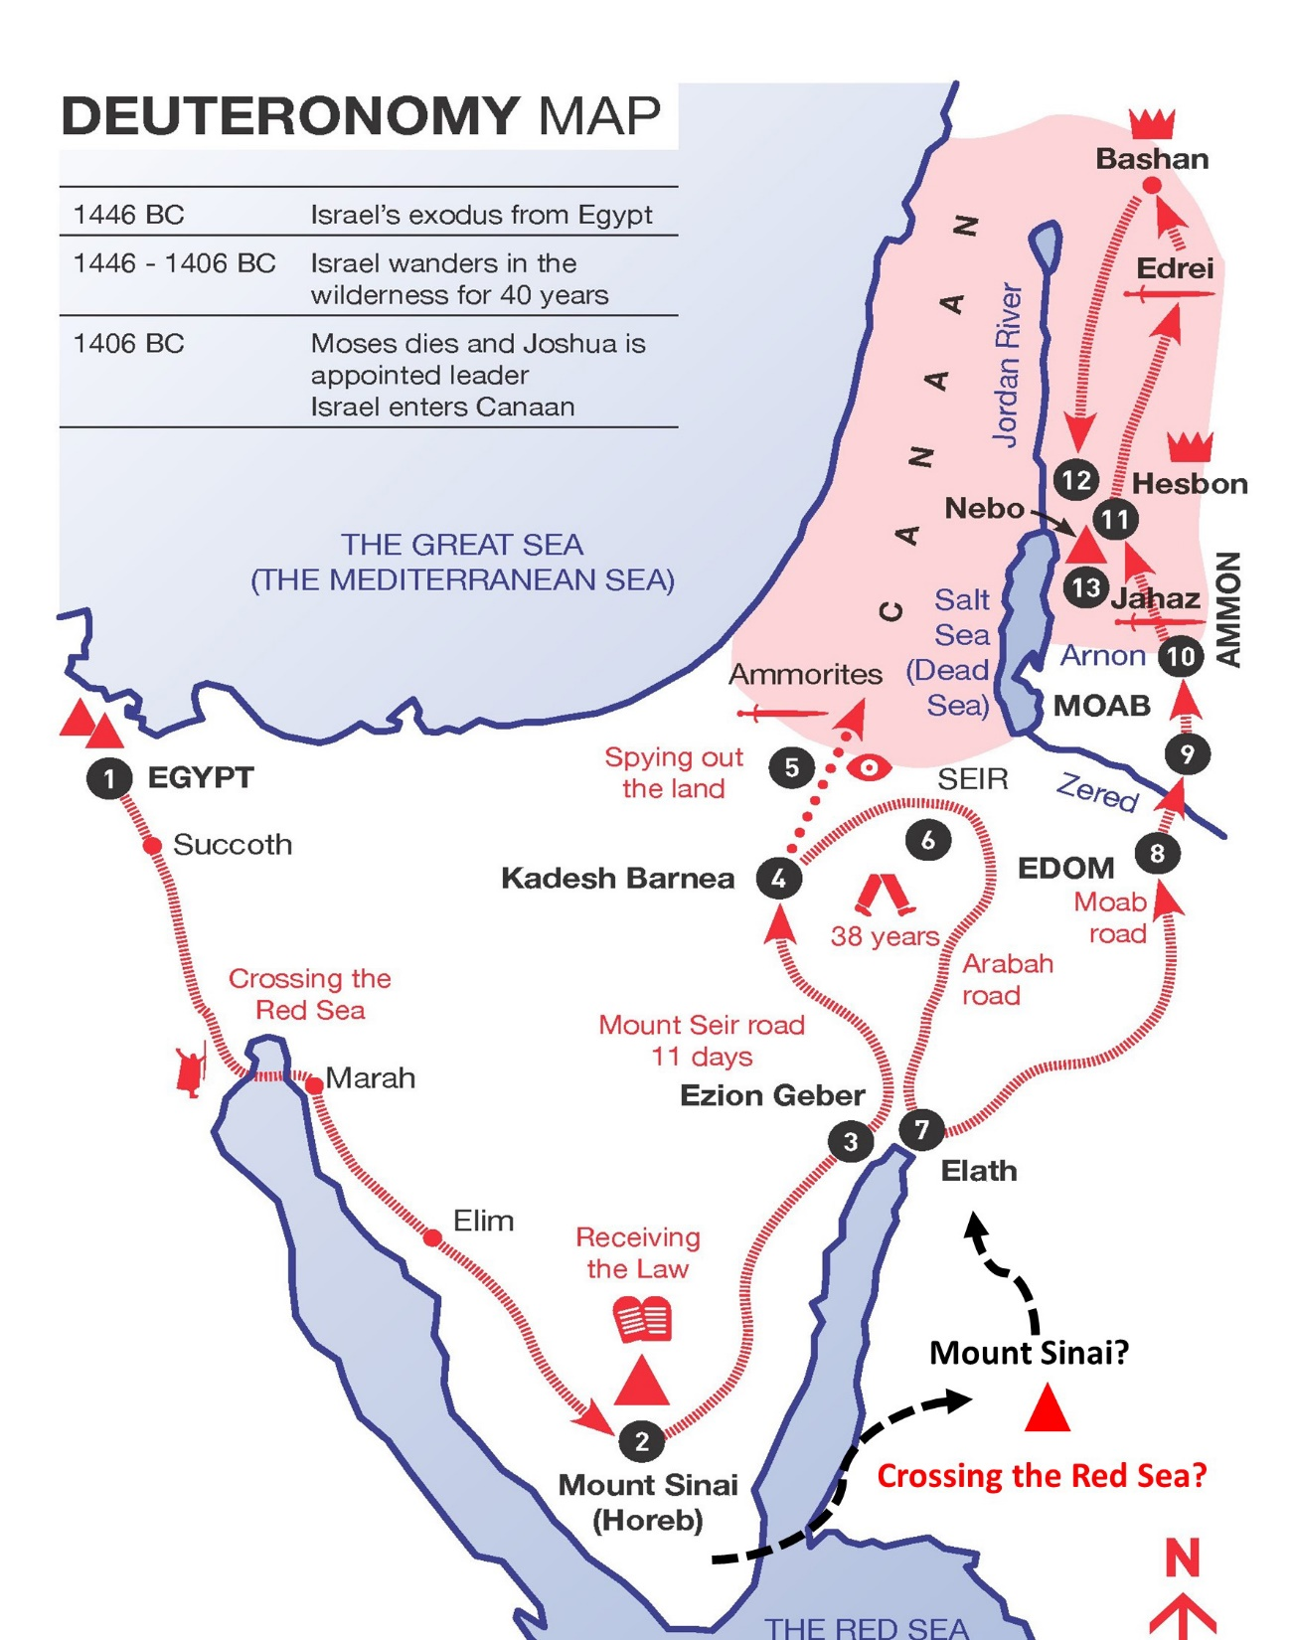
God’s Perspective of Your Past, Deuteronomy 1-3
Deuteronomy = Second Law
12 Ways I Love God,
obedience to his Commandments
Purpose: Moses' last messages to a new Israel and turnover to Joshua before they enter the promised land. Key passage: you know that man does not live by bread only, but by every [word] that proceeds out of the mouth of the LORD does man live. Deuteronomy 8:3, Matthew 4:4
Keyword: love - 16 0f 23x in Torah. 13 of 16 from man to God, by obedience to His written word.
Background: These are the words of Moses to Israel given in three messages during the last weeks or days of Moses’ life. The focus is on the parent’s role and responsibility of instructing the children in righteousness. Written in the ancient treatise format during the last weeks of Moses’ life, like John 13-17. It is a book of a love relationship in a series of three messages for us to learn (Romans 15:4).
Similar to later, where 1 and 2 Kings are man’s perspective, while 1 and 2 Chronicles are history from God’s perspective.

