Slide 1

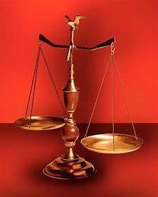
Fellowship Church, July 2, 2025 B. Heath
Straight and Balanced
(Luke 3:4-6)
The Faith - the Noun (Hebrews 1:1-3, 11:1-3, 6, 38-40, 12:1-4; Romans 15:23)
Old Testament: True Prophets of the Faith
#13 – Samuel: Lifelong Shining Faith (Heb 11:32f, 1 Sam)
#14 – Nathan & Gad: The Comforter’s Faith (Heb 11:32g)
#15 – Man of God & Old Prophet: Weak Prophets of the Faith
#16 – Azariah & Hanani: Two Prophets and Two Effects of Truth
#17 – Jehu, a Prophet, & Micaiah: Little-Known Prophets
#18 – Elijah: The Past, Present, and Future Prophet of the Faith
#19 – Jonah & Nahum: God’s Mercy & Judgment on Nineveh
#20 – Hosea, Joel, & Amos: Future Judgments and Blessings
#21 – Obadiah, Jonah, & Micah: Enemies of Hate, Anger, & Self
#22 – Isaiah:
#23 – Nahum, Habakkuk, & Zephaniah:
#24 – Jeremiah & Lamentations:
#25 – Ezekiel:
#26 – Daniel:
#27 – Haggai, Zechariah, & Malachi:
#28 – False Prophets in the Old Testament
#29 – New Testament Prophets
#30 –
OT: Ps 5:8, Pr 4:25-27
Amos 7:7-8, Is 28:13, 17
NT: Mt 3:3, Acts 9:11
Hebrews 12:13, Jude 3
1 Cor 15:1-4, 2 Tim 3:10
John 7:16
OT: Deut 25:13-16
Pr 20:10, Dan 5:25-28
NT: Hebrews 12:1
1 Cor 3:11-15
Philippians 4:5
James 3:17

Slide 2
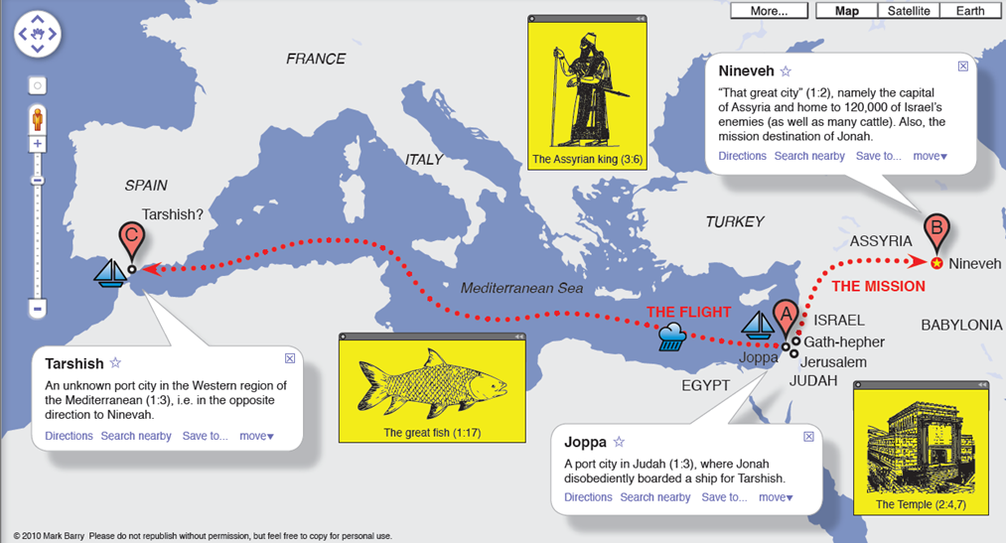
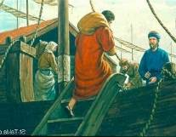
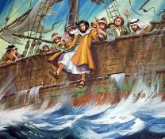

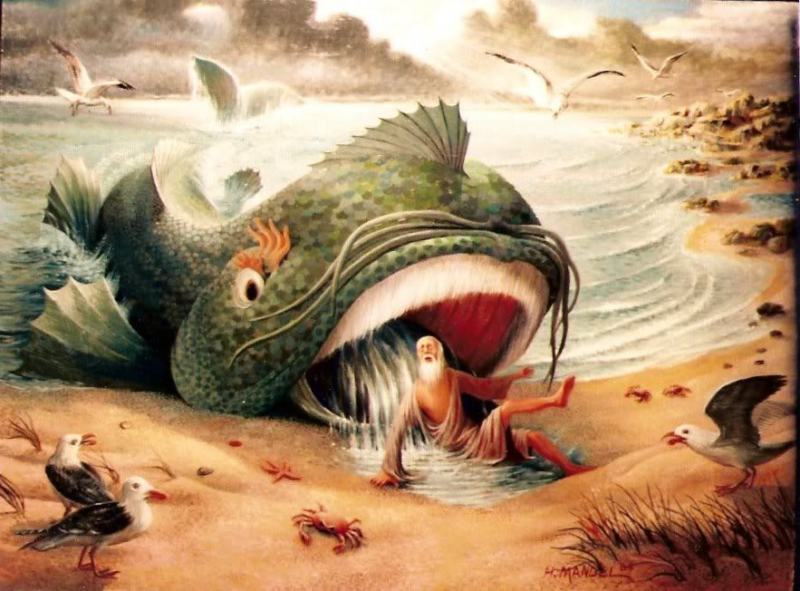
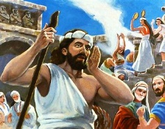
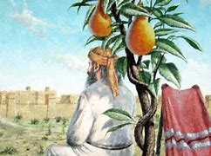
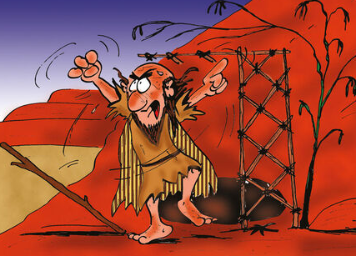
Jonah, the
Angry-Carnal
Prophet
1 - PROTEST
1
2
3 - PRAY
4
5 - PROCLAIM
6 - POUT
7 – ANGER-WRATH

Slide 3
Title: Jonah, the Angry-Carnal Prophet Jonah in Hebrew is a “dove or pigeon”
OLD TESTAMENT: God’s 9 miracles and 1 Reproof for Jonah
1. The LORD sent out a great wind into the sea (1:4)
2. The sailors cast lots and the lot fell upon Jonah (1:7)
3. The sailors cast Jonah into the sea, and the sea ceased from her raging (1:15)
4. The LORD had prepared a great fish to swallow up Jonah (1:17a)
5. The LORD spoke unto the fish, and it vomited out Jonah upon the dry land (2:10)
6. The LORD Preach unto Nineveh the preaching that I tell you (3:2)
7. The LORD prepared a gourd, and made it come up over Jonah for shade (4:6)
8. God prepared a worm when the morning rose the next day, and it smote the gourd that it withered (4:7)
God prepared a vehement east wind (4:8)
God reproves Jonah (Jonah 4:1-4, 4:9-11)
NEW TESTAMENT: 2 New Testament references (not prophecies) to the book of Jonah (2 Tim 2:15)
Jonah 1:1 Jonah is from Gath-Hepher in Galilee (2 Kings 14:25). Nathaniel (John 1:46) and the Pharisee (John 7:52) err in saying “nothing good and no prophet came from Galilee.”
Jonah 1:17b Jonah was in the belly of the fish three days and three nights. Matthew 12:38-42 and not in Luke 11:29-32 – the 3rd day (16x), when we focus on the content and context of “the sign of Jonah to an adulteress generation” (no sign). Partial days = Friday.
Learn from Jonah’s anger and wrath (Romans 15:4). Anger and wrath are temptations and sins to identify, prevent, and put away as revealed in Ephesians 4:26-27, Colossians 3:8, 1 Timothy 2:8, and James 1:19-20.
DECISION: OT anger and wrath of Cain (natural man) and Moses (spiritual man) are replaced with Jesus’ who is
greater than Jonah in righteousness & new heart and life for born-again believers. Matthew 11:28 and James 3:17-18.
Next: Micah
Paul on a ship with sailors is the spiritual man in Acts 27-28
Chapter
Protest
Pray
Preach
Pout
Today the Jews read Jonah during the Day of Atonement

Slide 4
OT True Prophets chart in respect to Hebrews 1:1-3, 11:1-3, 11:32-40
# | Name/ Scripture | Suffer-Persecute /Scripture | King (Saul to Zedekiah) | Public/ Private | Prophecy - Near/Far or None | Nation | Bless/ Curse | Vision/ Dream | Miracle Prophet or God | Notes | Heb 11
1 | Samuel | No /1 Sam 1-28 | Saul | Private | Near/for Saul | Israel | B/C |  |  | after death | 32c
2 | Gad | No/1 Sam 22:25 | David | Public | Near/for David | Israel | B/C |  |  | Book | 32d
3 | Nathan | No/2 Sam 7. 12. | David - | Private | Near/Far-seed of David | Israel | B/C/B |  |  | Solomon | 32d
4 | Ahijah | No/1 Ki 11:29-39 | Jeroboam - 1st | Private | Near/Jeroboam’s reign-son | N-Israel | B/C |  |  | 1 Ki 14:1-26 | 32d
5 | Shemaiah | No/1 Ki 12:22-24 | Rehoboam - 1st | Private | Near/for Rehoboam | S-Judah | B |  |  | Book 931 BC | 32d
6 | Iddo | No/2 Chr 9:29 | Jeroboam - 1 ^{st} | Private | Seer for Jeroboam | N-Israel | C | 1 Vision |  | Records 931 BC | 32d
7 | man of God | No/1 Kings 13 | Jeroboam – 1st | Private | Far/King Josiah, 270 yrs. | N-Israel | C |  | Hand | sick-heal | 32d
8 | old prophet | No/1 Kings 13 | Jeroboam – 1st | Private | Near/for man of God | N-Israel | C |  |  | Liar | 32d
9 | Azariah | No/2 Chr 15:1-7 | Asa – 3rd | Public | None | S-Judah | B |  |  | war w/Ethopia
10 | Hanani | No/2 Chr 16:7-10 | Asa – 3rd | Private | Near/ | S-Judah | C |  |  | war w/Israel-Syria
11 | Jehu | No/1 Ki 16:1-13, | Baasha-3rd | Private | Near/2 Chr 19:1-4 | N-Israel | C/B |  |  | Son of Hanani
12 | Prophet - | No/1 Ki 20:13-36 | Ahab-7th | Private | Near/Syria/man of God | N-Israel | B/B/C |  | Lion | Son of prophet
13 | Micaiah | Yes/1 Ki 22:1-28 | Ahab-death | Private | Near/400 to 1, 2 Chr 18:1-27 | N-Israel | C |  |  | Lying spirit | 33a
14 | Elijah | Yes/1 Ki 17-2 Ki 2 | Omri, Ahab – 7th | Public | Near/3 ½ years draught, 450 to 1 | N-Israel | B5/C3 |  | 8 | Gentile widow | 35
15 | Elisha | No/2 Ki 3-13 | Joram, Jehu – 8th, | Public | None/gentile general, Lu 4:27 | N-Israel | B11/C5 |  | 16 | Jezebel-death | 35
16 | Eliezer | No/2 Chronicles 20:37 | Jehosophat -4th | Private | Near/alliance with Ahaziah | S-Israel | C |  |  | Fleet destroyed
17 | Joel | No/2 Kings 11-15 | Joash ? |  | Far/ | S-Israel | C-B
18 | Jonah | No/Jonah 1-4 | Jehoash ? | Public | Near/40 days – repent | Nineveh | B |  | 9 by God | Great city repents
19 | Amos | No/2 Kings 14-15 | Jeroboam II | Public | Near/c 45 yrs | N-Israel | C/B 9:11 | 5 visions |  | Exile Assyria 722
20 | Hosea | No/2 Kings 15-18 | Jeroboam II |  | Near/c 40 yrs, Far/2700+ yrs (7x) | N-Israel | C-B |  |  | Gomer/3 children
21 | Isaiah | Yes/ | Uzziah-Manasseh |  |  | S-Judah
22 | Micah | No/ | Jotham-Hezekiah |  |  | S-Judah
23 | Nahum | No/Nahum 1-3 | Hezekiah | ? | Near/30 -50 years | Nineveh | C | 1 vision |  | 722 BC | 33a
24 | Habakkuk | No/ | Jehoiakim |  |  | S-Judah |  |  |  | Jehoiachin
25 | Zephaniah |  | Josiah |  |  | S-Judah
26 | Huldah | No/2 Kings 22:12-20 | Josiah-16th | Private | Near/immediate in Josiah’s life, 2 Ki 23:27 | S-Judah | B/C |  | 0 | 2 Chr 34:20-28
27 | Jeremiah | Yes/ | Josiah-Zedekiah |  |  | S-Judah |  |  |  | Exile Babylon 586
28 | Daniel | Yes/ | Josiah-Babylon |  |  | S-Judah
29 | Ezekiel |  | Josiah-Babylon |  |  | S-Judah
30 | Obadiah | No/ | Zedekiah |  |  | Edom
31 | Haggai | No/ | Zerubbabel |  |  | Israel
32 | Zechariah | Yes/ | Zerubbabel |  |  | Israel
33 | Malachi |  | Zerubbabel |  |  | Israel
OT True Prophets
Before Samuel
Enoch
Gen 5:24
Jude 1:14
Moses
Exodus 7:1 Deut 34:10
Acts 3:22,
7:37
Miriam – Ex 15:20
Deborah
Judges 4:9
Updated: 23 Jun 2025
W.H.

