Slide 1
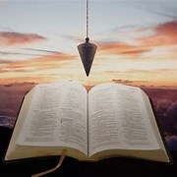
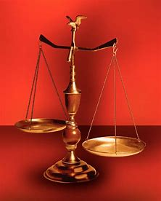
Fellowship Church, May 11, 2025 B Heath
Straight & Balanced
(Luke 3:4-6)
Expository Teaching
The Battle Belongs to the Lord (9:56-10:00)
Psalm 68
Victory Parade
for the Ark of God
OT: 2 Samuel 6-7, 1 Chronicles 13-16
NT: Ephesians
OT: Ps 5:8, Pr 4:25-27
Amos 7:7-8
Isaiah 28:13, 17
NT: Mt 3:3, Acts 9:11
Hebrews 12:13, Jude 3
1 Corinthians 15:1-4
2 Timothy 3:10, John 7:16
OT: Deut 25:13-16
Proverbs 20:10
Daniel 5:25-28
NT: Hebrews 12:1
1 Cor 3:11-15
Philippians 4:5
James 3:17

Slide 2
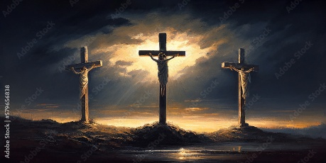
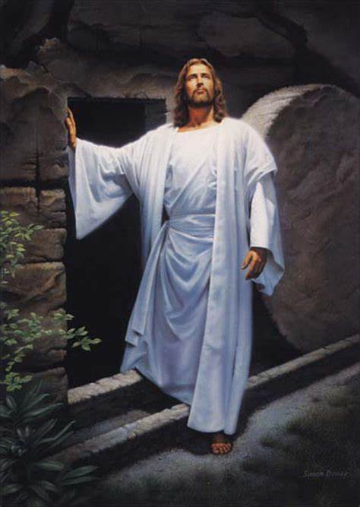
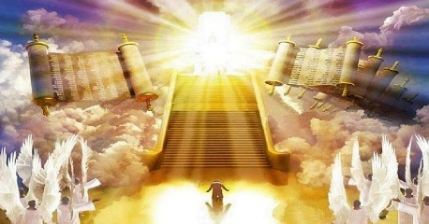
Psalm 68 (only Israel - physical warfare) Victory Parade for the Ark of God 1-6 God’s presence (Eph 1:1-3:21- sit) Let God arise (Numbers 10:35) 7-14 God protects (Eph 1:1-3:21- sit) (past-Moses & Barak) 15-19 God’s choice (Eph 1:1-3:21- sit)
(1st coming of Jesus, Eph 4:8) 20-28 Israel celebrates (Eph 4:1-6:9 - walk) Ark enters Jerusalem 29-32 God’s victory (Eph 6:10-24 – stand) (2nd coming of Christ, Rev 19) 33-35 God’s strength (Eph 6:10-24 – stand) (for & in Israel)
Ephesians (all people - spiritual warfare) Victory Parade for the glory of God (John 1:14)
1:1-3:21 SIT
- God has chosen us in Christ (1:4)
- God raised us up together and made us SIT together in heavenly [places] in Christ. (2:6)
- Prayers to God in 1:15-23 and 3:14-21
4:1-6:9 WALK
WALK worthy of the vocation wherewith ye are called (4:1) “speak – 4:15, 4:31”
WALK not as other Gentiles WALK (4:17)
WALK in love, as Christ also loved us (5:2)
WALK as children of light (5:8)
6:10-24 STAND
STAND against the wiles of the devil (6:11)
WithSTAND in the evil day (6:13a) “with=resist”
Having done all, to STAND (6:13b)
STAND therefore (6:14)
Christ crucified
Gal 2:20, Gal 6:14
Christ risen
on the 3rd day
Saints with Christ
Rev 4-5

Slide 3
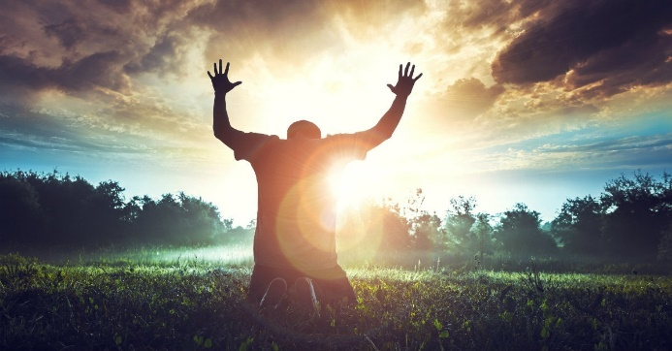
Sunday School Through the Bible (2023 - 2025)
Grow in grace, and in the knowledge of our Lord and Savior Jesus Christ
2 Peter 3:18
COMPLETED books of the Bible
Old Testament: Genesis (4), Exodus (4), Leviticus (2), Numbers (3), Deuteronomy (5), Psalms (4), Psalm 68 (2), Proverbs, Ecclesiastes, Amos, Obadiah, Malachi
New Testament: Mark, Colossians, 1-2 Thessalonians (10), Ephesians, Philemon, James, 2 Peter (4), Jude
Next Sunday:
New: use index cards to present Sunday School questions
to answer for all.
Invitation to Fellowship Church 2025 daily schedule for Bible and prayer
March 12-18. 2 Kings 9:14 to 11:12 (Mon-Sat) & Psalm 72 (Sunday)
Notes:
-

