Slide 1

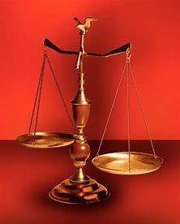
Fellowship Church, November 9, 2025 2 Peter 3:18 Sunday School B. Heath
Music: Parables in Blues
Straight & Balanced
(Luke 3:4-6)
Jesus Teaches in Parables
1. New Wine in New Bottles (Luke 5:37-39)
2. Let us Bind the Strong Man (Mark 3:23-30)
3. Is My Foundation on Rock? (Lu 6:46-49)
4.
5.
6.
7.
8.
9.
10.
OT: 2 Kings 21:13, Ps 5:8 Pr 4:25-27, Amos 7:7-8 Isaiah 28:13, 17
NT: Mt 3:3, Acts 9:11
Hebrews 12:13, Jude 3
1 Corinthians 15:1-4
2 Timothy 3:10, John 7:16
OT: Deut 25:13-16
Proverbs 20:10
Daniel 5:25-28
NT: Hebrews 12:1
1 Cor 3:11-15
Philippians 4:5
James 3:17

Slide 2
Next Sunday, 2 Tim 2:15 challenge. Read parable (5) about The Sower, Seed, & Soils. Select your soil(s) before you repented and believed in Jesus Christ? (1) by the wayside 13:19 ______. (2) stony ground 13:20-21______. (3) ______ among thorns 13:2.
How does this affect you today? (No wrong answer)
______________________________________________________________________________________________
______________________________________________________________________________________________
Open Mic for 1 to 2-minute testimonies! _______________________________________________________________

Slide 3
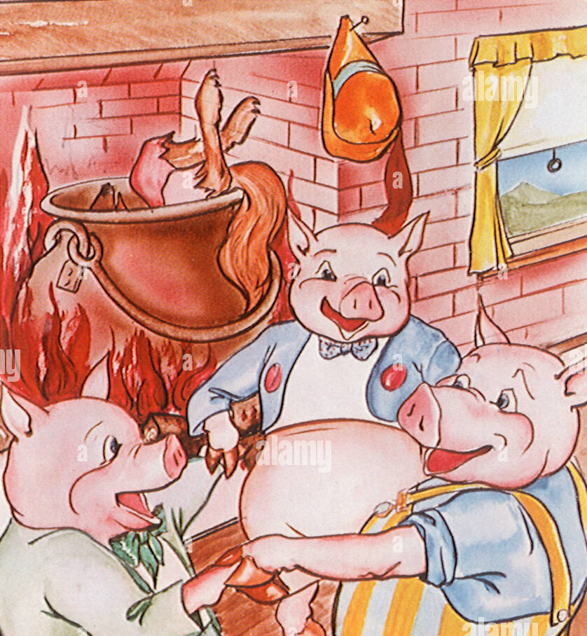
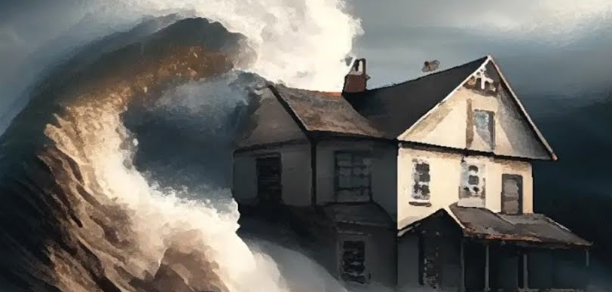
Is My Foundation on Rock?
Matthew 7:24-27 (7:21-27) & Luke 6:46-49 (6:37-49)
The Three Little Pigs story is close to this parable
Luke 6:46 & 49.
Curse: Lord, Lord > Hears & Does Not > Built House > No Foundation > Earth > Storm > Fall
Luke 6:47-48.
Blessing: Hears & Does > Built House > Foundation > Rock > Storm
digged deep could not shake the house
Key words
Lord, Lord: 5x in the Bible (Matthew 7:21, 7:22, 25:11, Luke 6:46, 13:25)
Hear: “it is written” (Mark 14:7, John 1:1-3, 13:17, Romans 10:13-17)
House: spiritual house & family (Matthew 12:50, Eph 2:20, 1 Peter 2:5)
Foundation: Jesus Christ (1 Corinthians 3:10-15, 2 Peter 2-3, Jude)
Rock: Jesus Christ (Mt 16:18 Peter’s confession, Ro 9:33, 1 Cor 10:4)
Storm: trials (John 17:13-21, 2 Cor 8:2, James 1:2-4, 1 Peter 1:6-9)
Fall: Not in Jesus Christ (John 3:16-18, 15:1-8, 1 John 2:19, Rev 20:11-15)
Decision: How much do I hear and do what Jesus said?

Slide 4

Sunday School Through the Bible (2023 - 2025)
Grow in grace, and in the knowledge of our Lord and Savior Jesus Christ
2 Peter 3:18
COMPLETED books of the Bible
Old Testament: Genesis (4), Exodus (4), Leviticus (2), Numbers (3), Deuteronomy (5), Ruth, Esther, Psalms (4), Psalm 68, Asaph (12), Proverbs, Ecclesiastes, Amos, Obadiah, Malachi
New Testament: Mark, Parables (6), Colossians, 1-2 Thessalonians (10), Ephesians, Philemon, James, 2 Peter (4), 2 John, Jude
Invitation to Fellowship Church 2025 daily schedule for Bible and prayer
Nov 10-16: 2 Chr 35-36, Heb 1:1-3 (Mon-Sat), Psalm 100 (Sun)

