Slide 1


Fellowship Church, Jun 24, 2026 B. Heath
Straight and Balanced
(Luke 3:4-6)
Bio: Saints in the Way, and the Truth, and the Life
George Whitefield: Evangelist
Jonathan Edwards: Theologian
John Wesley: Methodist
OT: Ps 5:8, Pr 4:25-27
Amos 7:7-8, Is 28:13, 17
NT: Mt 3:3, Acts 9:11
Hebrews 12:13, Jude 3
1 Cor 15:1-4, 2 Tim 3:10
John 7:16
OT: Deut 25:13-16
Pr 20:10, Dan 5:25-28
NT: Hebrews 12:1
1 Cor 3:11-15
Philippians 4:5
James 3:17

Slide 2
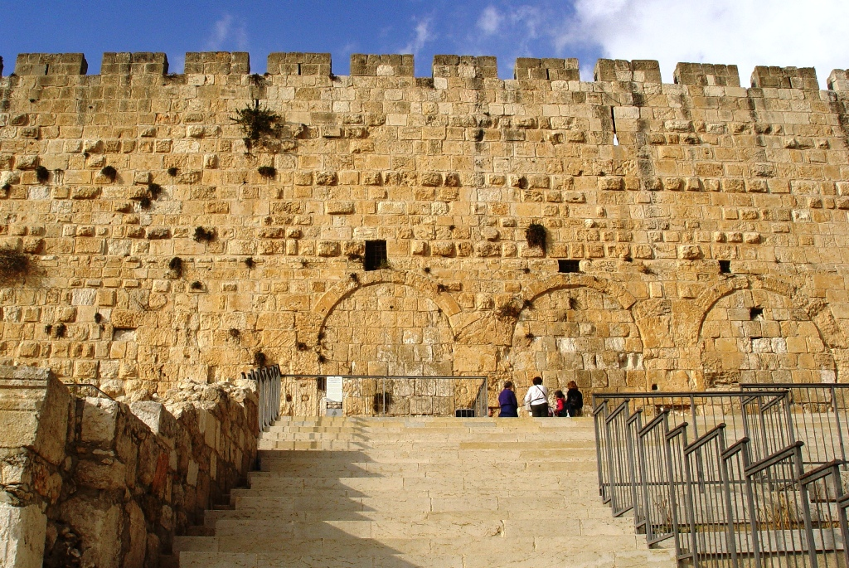
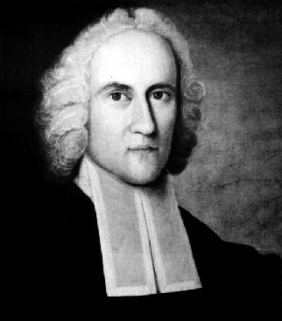

Jonathan Edwards: Theologian
Jonathan Edwards Resolutions by MOTB
Birth to College: 1703-1720
Salvation: 1720
Sanctification: 1720-1758
1727-1750 Pastor @ Congregational church
1740 Lifelong friend of George Whitefield
1740-1741 Sinners in the Hands of an Angry God
Glorification: 1758
Decision: God’s Sovereignty and Holiness

Slide 3
Jonathan Edwards: Theologian Jonathan Edwards Resolutions by MOTB
Birth to College: 1703-1720
Family of ministers since coming from London to Northhampton in 1640. Family of 10 sisters. Only son. All 6 feet tall.
Raised in Puritan theology. Battled with sin of the flesh until truly saved. Presbyterian churches.
Lived and stayed in New England states, mostly Massachusetts.
1720 graduated from Yale. Became tutor for 2 years at Yale.
Salvation: 1720
Sanctification: 1720 - 1758
1727-1750 Pastor @ Northhampton, 200 families 600 of 1000 in grand-fathers church, Solomon Stoddard.
1727 Married Sarah Pierrepoint. Song of Songs is a love relationship btwn Christ and the church!
Sarah later dealt with her sin of being jealous to defend her husband and consecration 15-day experience.
Wrote 70 personal resolutions. 1740 George Whitefield visits home, preaches at his church. Lifelong friends.
1740-1741 Prepares and Preaches sinners in the Hands of an Angry God (at home church, then 2 months later
Fired by his church (changes in communion & true salvation of parents, child baptism)
English & Indian church (wrote Freedom of the Will)
Wrote A Treatise Concerning Religious Affections (1 Peter 1:8) Examine behavior rather than emotions.
College of New Jersey (Princeton) < 2 months
Glorification: 1758 (slept after smallpox inoculation)
Decision: The Sovereignty of God and beauty of God’s Holiness

