Slide 1
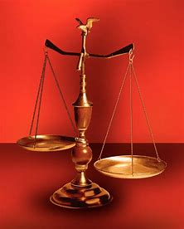
Fellowship Church, Nov 24, 2024 B Heath
Straight and Balanced
(Luke 3:4-6)
It's all about you Jesus (9:55-9:59)
The Five Books of Moses (Luke 24:27)
1 – 12 Beginnings (origins) of life with Adam, Genesis 1-2
2a – 12 Beginnings (origins) of death with Adam, Genesis 3
2b – death with Cain & Noah, Genesis 4:1-9:17
2c – death with Nimrod & Babel, Genesis 9:18-11:32
3 – 12 Beginnings of Israel with Abraham, Genesis 12-50
4a – Exit from slavery in Egypt to the Red Sea, Exodus 1-12
4b – From the Red Sea to Mount Sinai, Exodus 13-18
4c – Mt Sinai (Law) 10 Commandments, Exodus 19-24
4d – Mt Sinai (Law) the Tabernacle, Exodus 25-40
5a – Mt Sinai (Law) approaching a holy God, Leviticus 1-17
5b – Mt Sinai (Law) living a holy life, Leviticus 18-27
6a – Mt Sinai (Law) Prepare to Obey God, Numbers 1:1-10:10
6b – The Desert of Disobedience, Numbers 10:11-25
6c – Preparing for Your Eternal Inheritance, Numbers 26-36
7a – God’s Perspective of Your Past, Deuteronomy 1-3
7b – Moses’ Thesis Statement for his Last Messages, Deu 4
7c – Love God and Possess the Promise Land, Deu 5-12
7d – Laws for God to Bless Israel & Christians, Deu 13-26
7e – God’s Plan & Purpose Continue as Prophesied, Deu 27-34
Review of the Five Books of Moses
OT: Ps 5:8, Pr 4:25-27
Amos 7:7-8
Isaiah 28:13, 17
NT: Mt 3:3, Acts 9:11
Hebrews 12:13, Jude 3
1 Corinthians 15:1-4
2 Timothy 3:10, John 7:16
OT: Deut 25:13-16
Proverbs 20:10
Daniel 5:25-28
NT: Hebrews12:1
1 Cor 3:11-15
Philippians 4:5
James 3:17

Slide 2
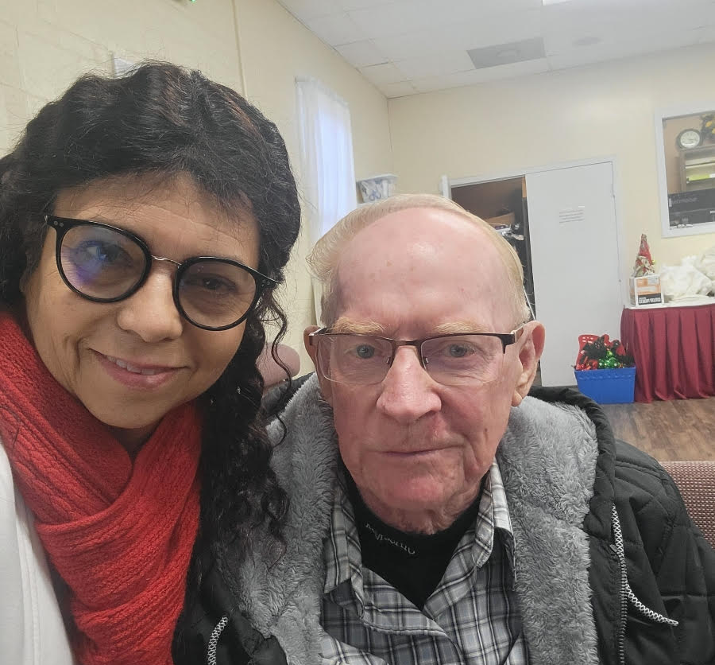
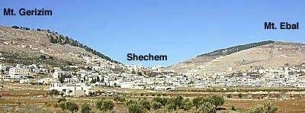
This Sunday School is dedicated to “Red “ Corley, who went to be with Jesus on Wednesday, Nov 20
5
“We miss you Red”
We know you were
rapture “harpazo” ready
4
2
3
Area View
Front View
1
Mt Ebal & Mt. Gerizim
Ceremony commanded Deuteronomy 27-30
Ceremony completed
Joshua 8:30-35

Slide 3
God’s Plan and Purpose continue as prophesied (Deu 27-34)
Application: Last things and turnover of duties as Jesus to the 12 Apostles in John 13-17
Moses’ Last Three Messages
Deuteronomy 1-4, 5-26, 27-34
27-28. Good News (Mt. Gerizim) or Bad News (Mt. Ebal): “Which do you want to hear first?”
27:1-10 Write these words (27:3, 8) on great stones without a hammer and with white plaster on Mt. Ebal
27:11-26 bad news for disobedience, 28:1-14 good news for obedience, 28:15-48 curses on disobedience
29-30. Go away from God, return to God, and love God – God desires our all or nothing!
29:4-5a 29:12-13, 30:10-16 30:19-20
31-32. The Song of Moses (Revelation 15:2-3)
Write this song (31:19) to praise & proclaim (1-4), punish (5-6), past provisions (7-14), poetry (15-18),
provoke & punish (32:19-38), and praise (32:39-43). Revelation 15 is sung by the Tribulation martyrs.
33. Moses’ last Blessing, Prophecy, and Praise for Jeshurun (Israel as God’s design)
33:1-4 33:6-25 33:26-29
34. Moses last hours and Passes his Wisdom unto Joshua (wrote by Joshua)
34:1-8 34:9-12
Keywords: Command/ed/s – 86x, Hearken/hear – 82x, this day – 77x, the LORD your God – 46x/the LORD our God – 19x (1-6, 29) Possess the land – 50x, Fathers (Abraham, Isaac, & Jacob) – 49x, Heart - 45x, Commandments – 42x, Love – 21x, Statutes & Judgments – 17x, Forget – 16x, Remember - 13x, Teach - 13x, Fire – 13x (Mt Sinai, Deu 4-5), Death/die – 13x (Deu 13-24), Cleave – 8x.

Slide 4
Sunday School Through the Bible - 2024
Mas de Cristo class
What is concealed in the Old Testament is revealed in the New Testament (19 mysteries).
(1) Learn – Romans 15:4 (2) Admonish – 1 Corinthians 10:1-13
(3) Shadow – Col 2:17, Heb 8:5, 10:1 (4) Figure (model) – Heb 9:9, 11:19, 1 Peter 3:21
(5) Type or antitype - specific people that are Godly or Ungodly
COMPLETED books of the Bible
Old Testament: Genesis (4), Exodus (4), Leviticus (2), Numbers (3), Deuteronomy (5), Psalms (4), Proverbs, Ecclesiastes, Amos, Obadiah, Malachi
New Testament: Mark, Colossians, Philemon, James, Jude
Invite to the 2024 daily Bible reading plan in 1 Samuel. Reminder – Be rapture ready for 2025.
Notes:
-

