Slide 1
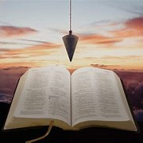
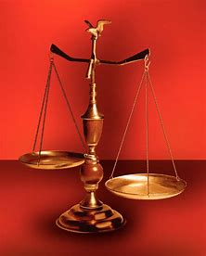
Fellowship Church, May 4, 2025 B Heath
Straight & Balanced
(Luke 3:4-6)
Expository Teaching
The Battle Belongs to the Lord (9:56-10:00)
Psalm 68
Victory Parade for the Ark of God
OT: 2 Samuel 6-7, 1 Chronicles 13-16 NT: Ephesians
OT: Ps 5:8, Pr 4:25-27
Amos 7:7-8
Isaiah 28:13, 17
NT: Mt 3:3, Acts 9:11
Hebrews 12:13, Jude 3
1 Corinthians 15:1-4
2 Timothy 3:10, John 7:16
OT: Deut 25:13-16
Proverbs 20:10
Daniel 5:25-28
NT: Hebrews 12:1
1 Cor 3:11-15
Philippians 4:5
James 3:17

Slide 2
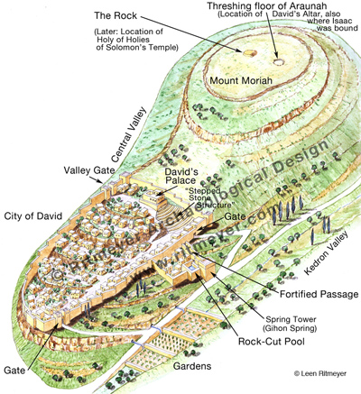
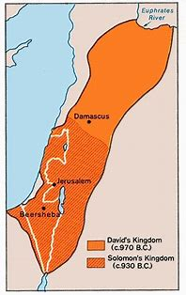
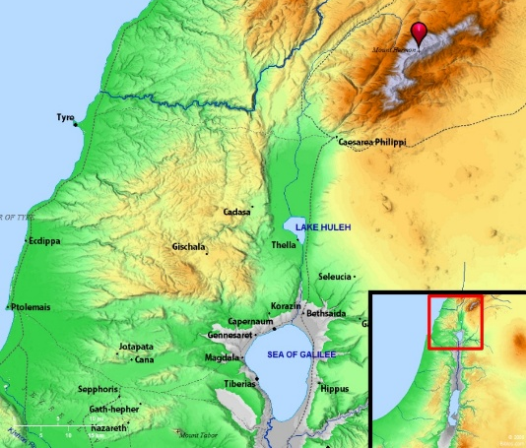
Victory Parade for the Ark
Psalm 68 covers 3500 years
1500/1200 BC: Moses/Barak (68:7-14)
1000 BC: King David (68:1-6, 15-17,
19-28)
33 AD: Jesus ascends (68:18 receive
gifts, Eph 4:8 gave gifts)
2025+ AD: Jesus returns (68:29-32)

Slide 3
Psalm 68 Victory Parade for the Ark of God 1-6 God’s presence Let God arise (Numbers 10:35) 7-14 God protects (past-Moses & Barak) 15-19 God’s choice Mt Zion vs Mt Balsam (1st coming of Jesus, Ephesians 4:8) 20-28 Israel celebrates entering Jerusalem 29-32 God’s victory (2nd coming of Christ, Revelation 19) 33-35 God’s strength (for & in Israel)
( King Saul
7 months,
1 Sam 6:1)
(Judges
c 400 years)
(20 + years
1 Sam 7:2)
Uzzah dies
(1 Sam 6:7-9)
Obed-edom
(3 months
2 Ki 6:10-12)
David’s Tent
(40 yrs, 2 Chr 5)

Slide 4
Sunday School Through the Bible (2023 - 2025)
Grow in grace, and in the knowledge of our Lord and Savior Jesus Christ
2 Peter 3:18
COMPLETED books of the Bible
Old Testament: Genesis (4), Exodus (4), Leviticus (2), Numbers (3), Deuteronomy (5), Psalms (4), Psalm 68 (2), Proverbs, Ecclesiastes, Amos, Obadiah, Malachi
New Testament: Mark, Colossians, 1-2 Thessalonians (10), Philemon, James, 2 Peter (4), Jude
Invitation to Fellowship Church 2025 daily schedule for Bible and prayer
March 5-11: 2 Kings 7:1-9:13 (Mon-Sat) & Psalm 71 (Sunday)
Notes:
-

