Slide 1

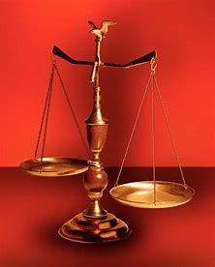
Fellowship Church, Nov 19, 2025 B. Heath
Straight and Balanced
(Luke 3:4-6)
The Faith, a noun, G3982, pis’-tis, 244x, Hebrews 11-11x (11:1-3, 6, 38-40, 12:1-4; Romans 15:23, Jude 1:3)
Old Testament: True Prophets of the Faith
#13 – Samuel: Lifelong Shining Faith (Heb 11:32f, 1 Sam)
#14 – Nathan & Gad: The Comforter’s Faith (Heb 11:32g)
#15 – Man of God & Old Prophet: Weak Prophets of the Faith
#16 – Azariah & Hanani: Two Prophets and Two Effects of Truth
#17 – Jehu, a Prophet, & Micaiah: Little-Known Prophets
#18 – Elijah: The Past, Present, and Future Prophet of the Faith (Heb 11:35)
#19 – Elisha: Prophet of Power and Water (Heb 11:35)
#20 – Jonah & Nahum: God’s Mercy & Judgment on Nineveh
#21 – Hosea, Joel, & Amos: Future Judgments and Blessings
#22 – Obadiah, Jonah, & Micah: Fight with Hate, Anger, & Darkness
#23 – Isaiah: Prophet of Majesty and Royalty (Heb 11:37)
#24 – Nahum, Habakkuk, & Zephaniah: God the Loving-Holy Judge
#25 – Huldah: Prophetess of Anomaly & Conformity of the Faith
#26 – Jeremiah & Lamentations:
#27 – Ezekiel:
#28 – Daniel:
#29 – Haggai, Zechariah, & Malachi:
#30 – Old Testament False Prophets
#31 – New Testament Prophets
OT: Ps 5:8, Pr 4:25-27
Amos 7:7-8, Is 28:13, 17
NT: Mt 3:3, Acts 9:11
Hebrews 12:13, Jude 3
1 Cor 15:1-4, 2 Tim 3:10
John 7:16
OT: Deut 25:13-16
Pr 20:10, Dan 5:25-28
NT: Hebrews 12:1
1 Cor 3:11-15
Philippians 4:5
James 3:17

Slide 2
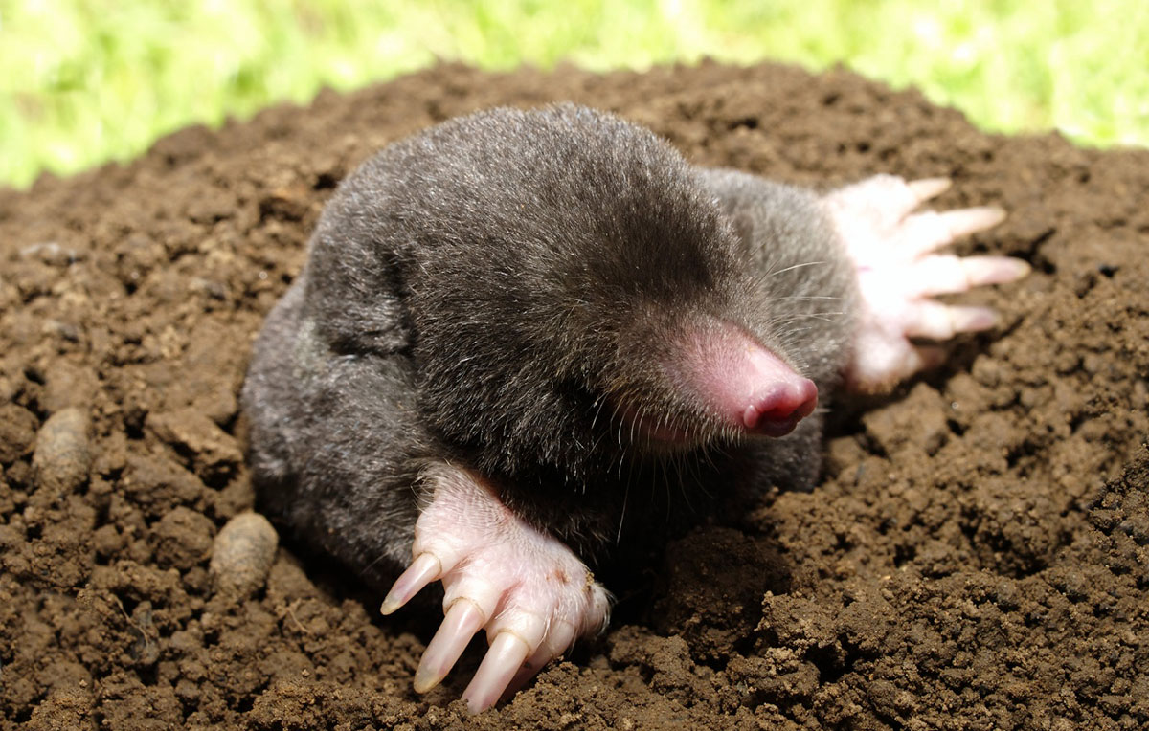
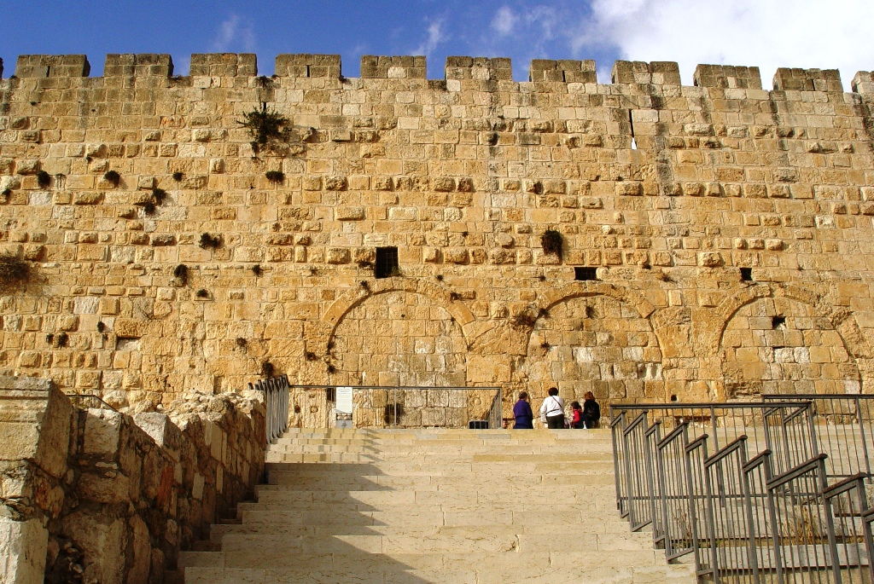
Huldah: Prophetess of Anomaly & Conformity of the Faith
Huldah is “weasel“ or “mole” Huldah gates
(S. wall of temple)
Time: 622 BC, 2 Chr 34:8 and 35:19 (King Josiah is 26)
Josiah’s name prophesied 300 years ago (1 Ki 13:2/2 Ki 23:15)
God inspired each holy prophet, 2 Pe 1:20-21. Huldah’s Hebrew, 78 words.
2 Kings 22:11-20
1. After King Josiah hears the law (Deuteronomy), 22:11-14
2. The LORD’s wrath is upon Israel (Judah), 22:15-17
3. The LORD’s peace is on Israel until Josiah’s grave, 22:18-20
2 Chronicles 34:18-28
1. After King Josiah hears the law (Deuteronomy), 34:18-22
2. The LORD will bring evil upon Israel (Judah), 34:23-25
3. The LORD’s peace is on Israel until Josiah’s grave, 34:26-28
DECISION: Examples of application today. Husband-wife, family,
local church, work, community
Gold standard for Bible study
1st What does it say then?
2nd What does it say about God?
3rd How does it apply to me today?
Anomaly to Men Prophets
1 of 200+ men prophets (OT)
1 woman prophet with words
1 near prophecy – within 13 yrs
Urgent need of King Josiah
Request of King Josiah
Confirmed Deuteronomy
No men prophets nearby
Conformity to Godly Wives
* Gen 3:16-19, Pro 31, Eph 5:22-33
1. “(name) the wife of (name)” 22x
Jael - Heber the Kenite, 2x
Deborah – Lapidoth, 1x
Bathsheba - Uriah the Hittite, 4x
Huldah – Shallum, 2x
2. “(name) the husband of (name)” 1x
Joseph - Mary (OT & NT)
3. “Aquila with his wife Priscilla”,
“Priscilla and Aquila” (NT, 6x)
* Gal 3:28 for salvation
* Col 3:11 for sanctification
Acts 5, Ananias & Sapphira (carnal)

Slide 3
OT True Prophets chart in respect to
Hebrews
11:1-3, 11:6,
11:32-40, 12:1
# | Name/ Scripture | Suffer-Persecute /Scripture | King (Saul to Zedekiah) | Public/ Private | Prophecy - Near/Far or None | Nation | Bless/ Curse | Vision/ Dream | Miracle Prophet or God | Notes | Heb 11
1 | Samuel | No /1 Sam 1-28 | Saul | Private | Near/for Saul | Israel | B/C | 0 | 0 | after death | 32c
2 | Gad | No/1 Sam 22:25 | David | Public | Near/for David | Israel | B/C | 0 | 0 | Book | 32d
3 | Nathan | No/2 Sam 7. 12. | David - | Private | Near/Far-seed of David | Israel | B/C/B | 0 | 0 | Solomon | 32d
4 | Asaph | No/Psalms 50, 73-83 | David | Public | Far/Tribulation and 1000-year reign | Israel | C/B | 0 | 0 | Revelation 6-20
5 | Ahijah | No/1 Ki 11:29-39 | Jeroboam - 1st | Private | Near/Jeroboam’s reign-son | N-Israel | B/C | 0 | 0 | 1 Ki 14:1-26 | 32d
6 | Shemaiah | No/1 Ki 12:22-24 | Rehoboam - 1st | Private | Near/for Rehoboam | S-Judah | B | 0 | 0 | Book 931 BC | 32d
7 | Iddo | No/2 Chr 9:29 | Jeroboam - 1 ^{st} | Private | Seer for Jeroboam | N-Israel | C | 1 Vision | 0 | Records 931 BC | 32d
8 | man of God | No/1 Kings 13 | Jeroboam – 1st | Private | Far/King Josiah by name, c. 300 yrs., 13:2 | N-Israel | C | 0 | Heal hand | Judah, 2 Ki 23:15 | 32d
9 | old prophet | No/1 Kings 13 | Jeroboam – 1st | Private | Near/for man of God, lion and donkey | N-Israel | C | 0 | 0 | Liar-like Lot | 32d
10 | Azariah | No/2 Chr 15:1-7 | Asa – 3rd | Public | None | S-Judah | B | 0 | 0 | war w/Ethiopia
11 | Hanani | No/2 Chr 16:7-10 | Asa – 3rd | Private | Near/ | S-Judah | C | 0 | 0 | war w/Israel-Syria
12 | Jehu | No/1 Ki 16:1-13, | Baasha-3rd | Private | Near/2 Chr 19:1-4 | N-Israel | C/B | 0 | 0 | Son of Hanani
13 | Prophet - | No/1 Ki 20:13-36 | Ahab-7th | Private | Near/Syria/man of God | N-Israel | B/B/C | 0 | Lion | Son of prophet
14 | Micaiah | Yes/1 Ki 22:1-28 | Ahab-death | Private | Near/400 to 1, 2 Chr 18:1-27 | N-Israel | C | 0 | 0 | Lying spirit | 33a
15 | Elijah | Yes/1 Ki 17-2 Ki 2 | Omri, Ahab – 7th | Public | Near/3 ½ years draught, 450 to 1 | N-Israel | B5/C3 | 0 | 8 | Gentile widow | 35
16 | Elisha | No/2 Ki 3-13 | Joram, Jehu – 8th, | Public | None/gentile general, Lu 4:27 | N-Israel | B11/C5 | 0 | 16 | Jezebel-death | 35
17 | Eliezer | No/2 Chronicles 20:37 | Jehosophat -4th | Private | Near/alliance with Ahaziah | S-Israel | C | 0 | 0 | Fleet destroyed
18 | Joel | No/2 Kings 11-15 | Joash -11th | ? | Far/ | S-Israel | C-B | 0 | 0
19 | Jonah | No/Jonah 1-4 | Jehoash - 11th | Public | Near/40 days – repent | Nineveh | B | 0 | 9 by God | Angry-carnal
20 | Amos | No/2 Kings 14-15 | Jeroboam II – 13th | Public | Near/c 45 yrs | N-Israel | C/B | 5 visions | 0 | Exile Assyria 722
21 | Hosea | No/2 Kings 15-18 | Jeroboam II – 13th | Public | Near/c 40 yrs, Far/2700+ yrs (7x) | N-Israel | C-B | 0 | 0 | Gomer/3 children
 | Oded | No/2 Chr 28:6-15 | Ahaz-12th | Public | Near/ | S-Judah | B | 0 | 0 | War victory
22 | Micah | Yes/rejection | Jotham-Hezekiah | Public | Near Assyria & Babylon, Far Jesus 1st 5:2 | N-S Israel | C-B | vision(s) | 0 | that day 25%, hear
23 | Isaiah | Yes/sawn in half | Uzziah-Hezekiah | Public | Near and Far/more than other prophets | S-Judah | C-B | Visions | 3/time-185 | Majesty, Royalty | 34
24 | Nahum | No/Nahum 1-3 | Hezekiah-13th | Personal | Near/30 -50 years | Nineveh | C | 1 vision | 0 | Israel, 722 BC | 33a
25 | Habakkuk | No/ | Zedekiah-20th | Personal | Near/ Babylon-Nebuchadnezzar | S-Judah | C-B | Vision | 0 | Trial to Triumph
26 | Zephaniah | No/ | Josiah-16th | Personal | Near-Babylon/Far 2nd coming of Jesus | S-Judah | C-B | 0 | 0 | Trib & 1000
27 | Huldah | No/2 Kings 22:11-20 | Josiah-16th | Private | Near/13 years, Josiah’s grave 2 Ki 23:27 | S-Judah | C-B | 0 | 0 | 2 Chr 34:18-28
28 | Jeremiah | Yes/ | Josiah-Zedekiah | Public |  | S-Judah |  |  |  | Exile Babylon 586
29 | Daniel | Yes/ | ? – Babylon | Public |  | S-Judah
30 | Ezekiel |  | ? – Babylon | Public |  | S-Judah
31 | Obadiah | No/ | Zedekiah-20th |  |  | Edom
32 | Haggai | No/ | Zerubbabel-Gov |  |  | Israel
33 | Zechariah | Yes/ | Zerubbabel |  |  | Israel
34 | Malachi |  | Zerubbabel |  |  | Israel
Before Samuel
Enoch
Genesis 5:24
Jude 1:14
Moses
Exodus 7:1 Deut 34:10
Acts 3:22,
7:37
Miriam
Exodus 15:20
Deborah
Judges 4:9
During & after Samuel
1 Samuel
19:18-24
2 Ki 4:38-41
Sons of the prophets-9x
Updated: 17 Nov 2025
W.H.

