Slide 1

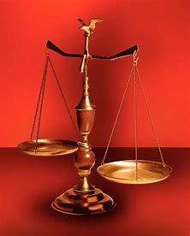
Fellowship Church, April 12, 2026 2 Peter 3:18 Sunday School Bill Heath
Music: Parables in Blues
Straight & Balanced
(Luke 3:4-6)
Jesus Teaches in Parables
11. The Prodigal Steward (Luke 16:1-13)
12. The Wedding Supper (Luke 14:7-24)
13. The Rich Man and Lazarus (Luke 16:19-31)
14. The Widow’s Persistent Prayers (Luke 18:1- 8)
15. The Pharisee & the Publican (Luke 18:9-14)
16. Ten Pounds to Ten Servants (Luke 19:11-27)
17. Words then Actions of Two Sons (Mt 21:28-32)
18. Servants in God’s Vineyard (Mt 21:33-46)
19. The King’s Wedding Feast (Matthew 22:1-14)
20. The Withered Fig Tree (Matthew 24:32-35)
21. Ten Virgins & Five Talents (Matthew 25:1-30)
22. I AM the Door of the Sheep (John 10:1-10)
23. Mysteries Revealed in the Parables of Jesus
OT: 2 Kings 21:13, Ps 5:8 Pr 4:25-27, Amos 7:7-8 Isaiah 28:13, 17
NT: Mt 3:3, Acts 9:11
Hebrews 12:13, Jude 3
1 Corinthians 15:1-4
2 Timothy 3:10, John 7:16
OT: Deut 25:13-16
Proverbs 20:10
Daniel 5:25-28
NT: Hebrews 12:1
1 Cor 3:11-15
Philippians 4:5
James 3:17

Slide 2
John 9:1-10:30, I AM the
A parable is an earthly story with a heavenly truth

Slide 4
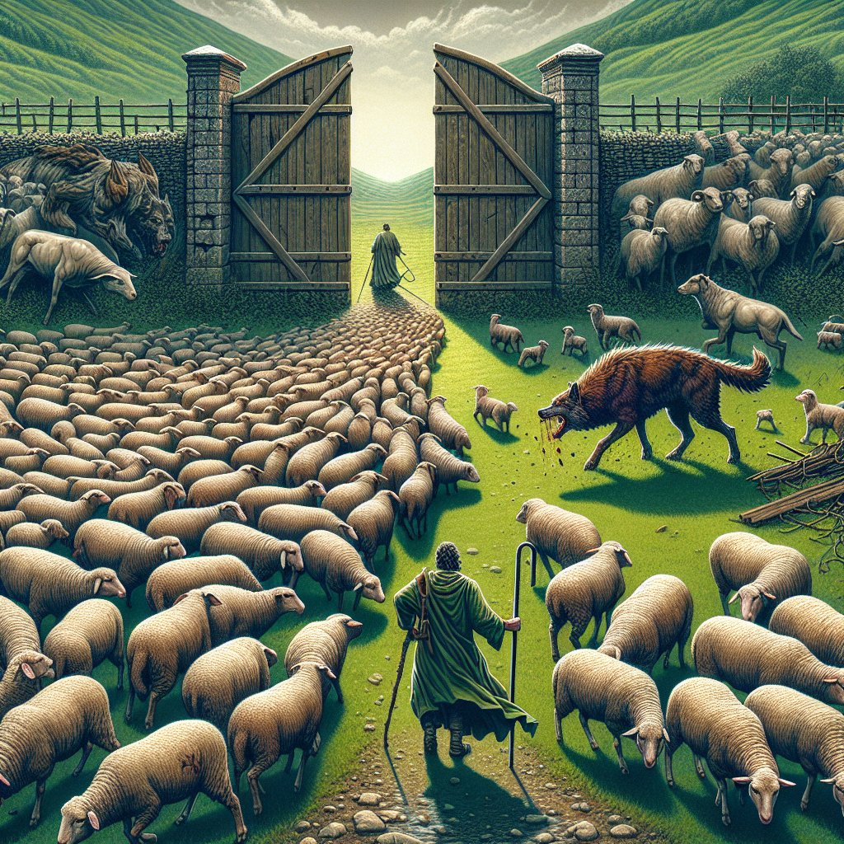
Parable: I AM the Door of the Sheep (John 10:1-10)
 | 9:1-37, 38-40 Scenario (a blind man sees) 10:1-6 Parable: the thief climbs up another way 10:7-10 Clarification: I AM the Door 10:11-18 and I AM the Good Shepherd ^{10:25-30 with eternal life} Can you hear the voice of the Good Shepherd today? Next Sunday: 22 Mysteries revealed in the parables of Jesus . 19 x, the churches’ saints, 3x, the tribulation saints.

Slide 5
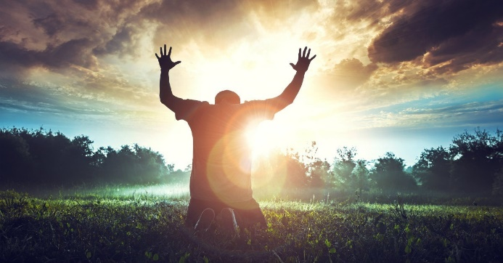
Sunday School Through the Bible (2019 - 2026)
Grow in grace, and in the knowledge of our Lord and Savior Jesus Christ
2 Peter 3:18
COMPLETED books of the Bible
Old Testament: Genesis (4), Exodus (4), Leviticus (2), Numbers (3), Deuteronomy (5),
1-2 Kings (12), Ruth, Esther, Psalms (4), Psalm 68 (3), Asaph (12), Proverbs, Ecclesiastes, Daniel (12), Hosea (9), Amos, Obadiah, Malachi
New Testament: Mark, Parables (30), Colossians, 1-2 Thessalonians (10), Ephesians, Philemon, Hebrews, James, 2 Peter (4), 1 John (13), 2 John, 3 John, Jude, Revelation (22)
Wednesdays: Judges (15), Song of Songs (15),
Topics: Prayer (15), Hebrews 11/prophets (36), various (40)
Invite to Fellowship Church 2026 daily schedule for Bible and prayer
Zechariah–April 10 to May 15, 2026 (Psalm 119-March 29 to August 23)

Slide 6
Parable: I AM the Door of the Sheep (John 10:1-10)
 | Time: a Sabbath in the Winter Place: Jerusalem near a synagogue Audience: Pharisees 9:1-37 Blind man since birth given sees. Healed on the sabbath. Cast out of the synagogue. 9:4 I must works the works of Him that sent Me, while it is day: the night comes when no man can work. Fasting, John 9:38-40 Scenario (a blind man sees) 10:1-6 Parable: Thief climbs up another way (wisdom. door 4x, shepherd 6x, sheep 14x) (+) sheepfold/fold 2x, porter 1x. (-) climbs up some other way, thief, robber, stranger not follow, Voice: hear – shepherd calls by name, leads out, goes before-sheep follow, know His voice. Hear not the voice of strangers. He that has an ear, let him hear what the Spirit says unto the churches” Rev 2-3. 10:7-10 Clarification: I AM the Door (parable = proverb, John 16:25-29) wisdom. 10:8 Jer 23:1-8 (-) thieves & robbers: sheep did not hear. Thief steals, kills, and destroys. Hireling 3x flees the sheep, cares not for the sheep. (+) any man enter in the door is saved, shall go in & out, and find pasture. Have life (salv grace) and life more abundantly (sanct grace) 10:11-18 and I AM the Good Shepherd (power, lay down my life-4x, 17-18. power, take it again-2x) Commandment 10:16 other sheep, I MUST bring, they hear my voice, one fold-one shepherd. Eph 1-3. Israel & church. Wolf (satan) hireling flees. 10:25-30 with eternal life (10:27 My sheep hear My voice, and I know them, and they follow Me. No man can pluck them out Do you hear the voice of the Good Shepherd today? Hebrews 13:2 the great shepherd of the sheep. Next Sunday: Mysteries revealed in the parables of Jesus (22x) 19 x, the church(es) saints, 3x, the tribulation saints.

