Slide 1

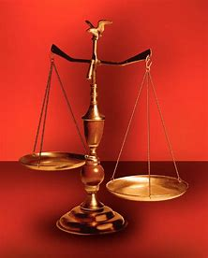
Straight and Balanced
Revealing Jesus Christ
with John’s 12 I AMs
“the disciple whom Jesus loved”
Gospel of John = 7 I AMs
Revelation = 5 I AMs
Fellowship Church, June 14, 2026, by Bill Heath

