Slide 1


Fellowship Church, July 8, 2026 B. Heath
Straight and Balanced
(Luke 3:4-6)
1 minute video before YouTube
Bio: Saints in the Way, and the Truth, and the Life
George Whitefield: Evangelist
Jonathan Edwards: Theologian
John Wesley: Methodist

Slide 2
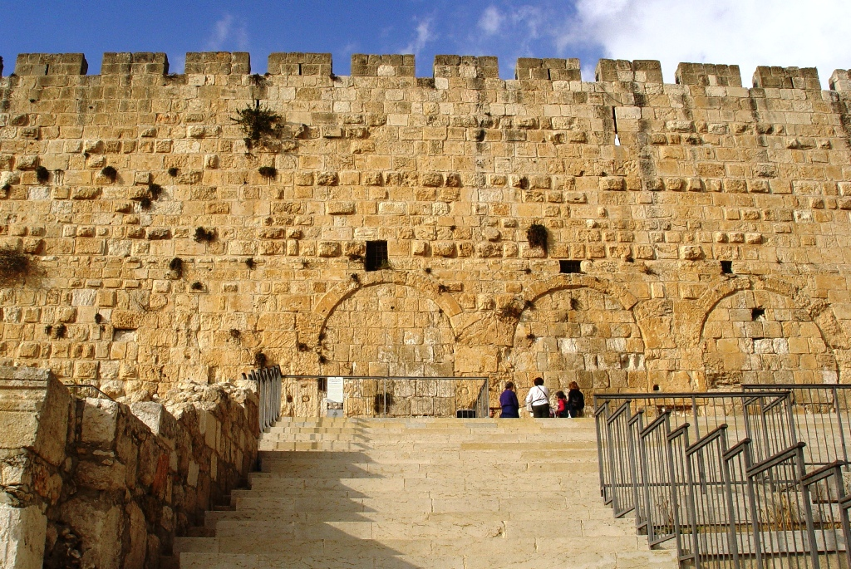
50th year spiritual birthday of a late bloomer (W.H.)
Birth to military: 1955-1973, Iowa. 1973-1977, U.S. Navy (Puerto Rico)
Salvation: 1976, July 8, 9:00pm Puerto Rico (John 14:6, 1st love)
Sanctification: 1976-20xx (John 6:44, 7:14-17, 7:39)
Children of God: (Mo Letters, Luke 14:33)
Met Brunnie-June 8, 1977 (3 children), church & deliverance (Nov 1977)
Music, tithe-Jan 22, 1978, baptism-Feb 19, 1978 (2 Peter 2)
Consecration (Wayne, Romans 6, Oct 2, 1978, John Wesley)
Japan-Korea-Israel 1998-2015 (trials, daily QT, RD Bible, awakening, G.Whitefield)
Maryland (retire from work, FC, S. Maryland/DC, Jonathan Edwards)
Glorification: 20xx
Decision: Continue growing in the way, the truth, and the life

