Slide 1
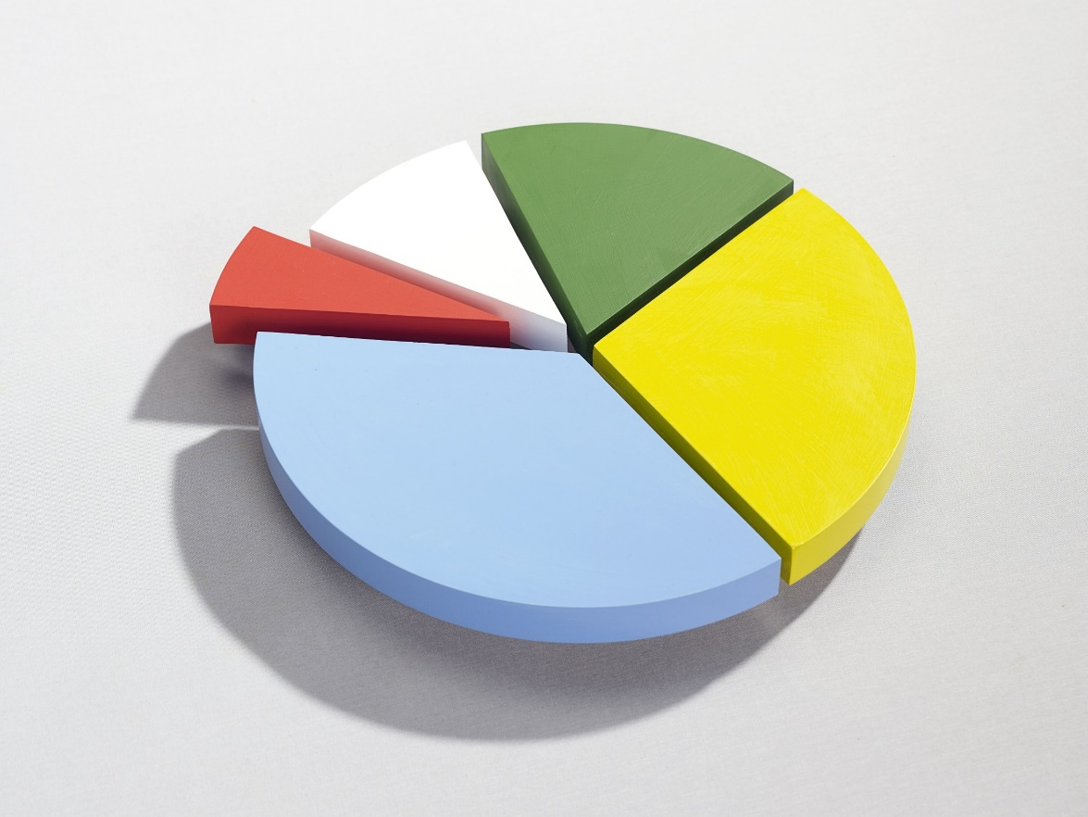
Men of Purity, Power, and Praise (MOPPP)
Straight & Balanced Sunday School, July 12, 2026
Balanced character in thoughts, words, and actions
time management and priorities
(good and evil)
Straight
1 – The Holy Spirit, 2 - Prosper Your Soul (3 John 2), 3 – Angelic warfare (good & evil), 4 – My spiritual warfare

Slide 2
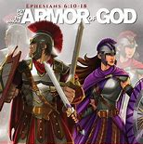
Spiritual Warfare - Strategy
Men of Purity, Power, and Praise (MOPPP)
(Philippians 4:8, 2 Peter 1:5)
We meet:
Why purity first?
Defensive warfare:
Offensive warfare:
Warfare types & durations:
Lessons from King David.
Next in spiritual warfare series
Proverbs 31, 1 Cor 16:13-14

Slide 3
Onward Christian Soldiers (1 minute)
Putting on and keeping on the armor of God
HERE AND NOW!

