Slide 1
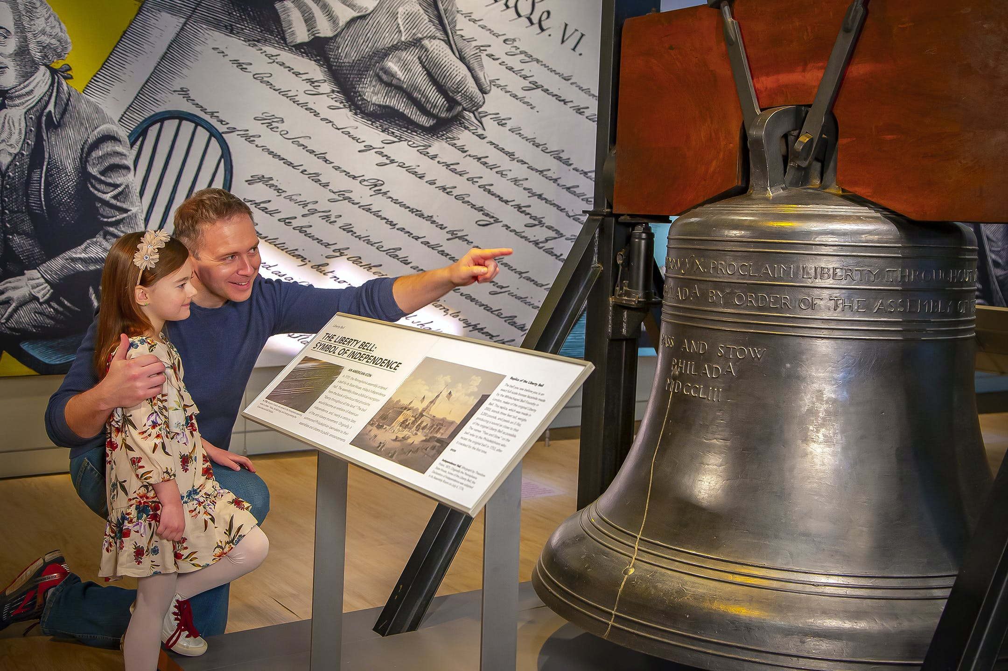
The Greatest Freedom - in Warfare
(Celebrate the 250th anniversary of the Declaration of Independence from Great Britian)
Leviticus 25:10b “it shall be a jubilee unto you;
and ye shall return every man unto his possession,
and ye shall return every man unto his family”
(physical freedom by the law of Moses)
John 8:32b “the truth shall make you free”
(spiritual freedom by the grace of God)
Associate Pastor Bill Heath, 5 July 2026
God’s freedom involves a time of preparation and a price to pay
for those who fight the good fight in their times.
Pennsylvania Colony Bell
1752, Philadelphia
Leviticus 25:10a

Slide 2
The Greatest Freedom – in Warfare
John 8:31-32 and Jeremiah 12:5
1620-1783. Preparations: Mayflower Compact
Warfare: Indians and European nations
1730-1750. The 1st Great Awakening (top three)
Jonathan Edwards, George Whitefield, John Wesley
1776 to 1783. Execution until the Treaty of Paris
Action: Declaration of Independence and war (Ben Franklin, Thomas Jefferson, & John Adams)
Spiritual Warfare Strategy – MOPPP (next slide)

Slide 3
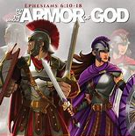
Spiritual Warfare Strategy
Men of Purity, Power, and Praise (MOPPP)
We meet
Why purity first?
Defensive warfare
Offensive warfare
Warfare types & durations
Lessons from King David

Slide 4
Onward Christian Soldiers
Putting on and keeping on the armor of God
HERE AND NOW!

