Slide 1


Fellowship Church, Aug 19, 2026 B. Heath
Straight and Balanced
(Luke 3:4-6)
Bio: Saints in the Way, and the Truth, and the Life
1st Great Awakening
George Whitefield: Salvation/Life (John 3:7)
Jonathan Edwards: Glorification/Truth (Deu 32:35)
William Heath: Late Bloomer (John 14:6)
3. John Wesley: Sanctification/Way (1 John)
4. Three Women who Anoint Jesus Portra the Gospel

Slide 2
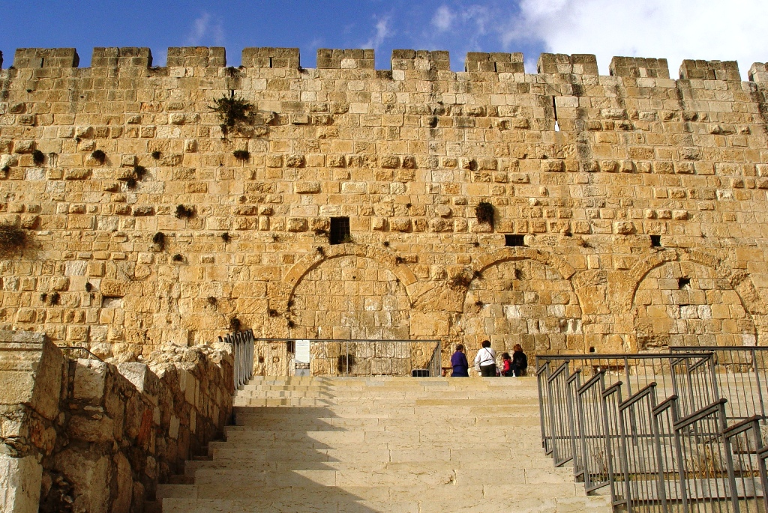
Three Women who Anoint Jesus Portray the Gospel
Birth to born again: Year to Year (the natural man in Adam)
Saved: Year (I am born-again, a baby in Christ)
Sanctify: Year (I grow in grace, from saved to glorify)
Glorify: Year (I die, then the judgment)
Note: perhaps symbolism by the founding fathers. The stars and stripes of the flag of the U.S.A. are red, white, and blue.
with His stripes we are healed (Isaiah 53:5)
by Whose stripes ye were healed
(1 Peter 2:24)

Slide 3
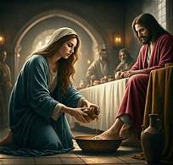
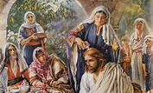
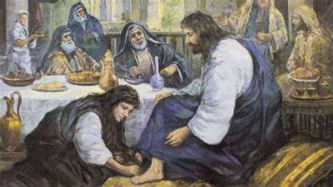
Three Women who Anoint Jesus Portray the Gospel
Saved (born-again) | Sanctify (fruit) | Glorify (Heaven)
Luke 7:36-50 Son of Man Jesus is prophet (past) | John 12:1-8 Son of God Jesus is priest (present) | Matthew 26:1-13 Son of David Jesus is king (future)
A Woman Sinner | Mary | A Woman

