Slide 1
Fellowship Church, Dec 8, 2024 B Heath
Straight and Balanced
(Luke 3:4-6)
It's all about you Jesus (9:55-9:59)
The Five Books of Moses (Luke 24:44)
1 – 12 Beginnings (origins) of life with Adam, Genesis 1-2
2a – 12 Beginnings (origins) of death with Adam, Genesis 3
2b – death with Cain & Noah, Genesis 4:1-9:17
2c – death with Nimrod & Babel, Genesis 9:18-11:32
3 – 12 Beginnings of Israel with Abraham, Genesis 12-50
4a – Exit from slavery in Egypt to the Red Sea, Exodus 1-12
4b – From the Red Sea to Mount Sinai, Exodus 13-18
4c – Mt Sinai (Law) 10 Commandments, Exodus 19-24
4d – Mt Sinai (Law) the Tabernacle, Exodus 25-40
5a – Mt Sinai (Law) approaching a holy God, Leviticus 1-17
5b – Mt Sinai (Law) living a holy life, Leviticus 18-27
6a – Mt Sinai (Law) Prepare to Obey God, Numbers 1:1-10:10
6b – The Desert of Disobedience, Numbers 10:11-25
6c – Preparing for Your Eternal Inheritance, Numbers 26-36
7a – God’s Perspective of Your Past, Deuteronomy 1-3
7b – Moses’ Thesis Statement for his Last Messages, Deu 4
7c – Love God and Possess the Promise Land, Deu 5-12
7d – Laws for God to Bless Israel & Christians, Deu 13-26
7e – God’s Plan & Purpose Continue as Prophesied, Deu 27-34
Review of the Five Books of Moses (Luke 24:44)
OT: Ps 5:8, Pr 4:25-27
Amos 7:7-8
Isaiah 28:13, 17
NT: Mt 3:3, Acts 9:11
Hebrews 12:13, Jude 3
1 Corinthians 15:1-4
2 Timothy 3:10, John 7:16
OT: Deut 25:13-16
Proverbs 20:10
Daniel 5:25-28
NT: Hebrews12:1
1 Cor 3:11-15
Philippians 4:5
James 3:17

Slide 2
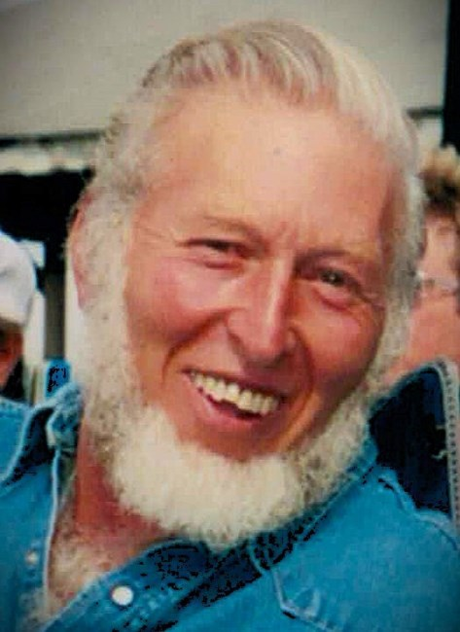
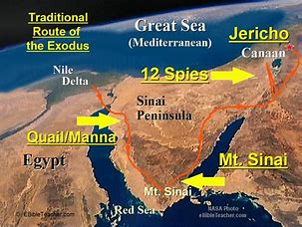
This Sunday School is dedicated to Jerry, who went to be with Jesus on Wednesday, November 27, 2024
Review of the Five Books of Moses (Luke 24:44)
Genesis: beginnings (in time & origins)
Exodus: exit (from Egypt)
3. Leviticus: holiness (with God)
4. Numbers: wilderness (40 years & census)
5. Deuteronomy: repeat (Moses’ final msg)
We miss you Jerry
We know you were rapture “harpazo” ready!

Slide 3
Jesus fulfilled the Law. (Matthew 5:17-19). The law is our schoolmaster (Galatians 3:24-25).
The law is holy (Romans 7:12-14). The law is fulfilled in the believer (Romans 8:1-4).
Review of the Five Books of Moses (Luke 24:44)
THE LAW (ending focus on Moses at Mount Sinai, Mount Nebo, and the Mount of Transfiguration)
The law – 281x (NT only: Romans 50x, Galatians 23x, Acts 18x, Hebrews 11x)
The law of Moses – 21x (NT only: Luke 7:22, 24:44; John 7:23; Acts 13:39, 15:5, 28:23; 1 Corinthians. 9:9.)
The law of God – 7x (Joshua 24:26, Nehemiah 8:8, 15. Romans 7:22, 7:25, 8:7.)
The law and the prophets – 6x (Matthew 7:17, 22:40; Luke 16:16; John 1:45; Acts 13:15. Romans 3:21.)
The law and the prophets and the psalms – 1x (Luke 24:44)
THE GOSPEL (ending focus on Jesus at Mount Calvary and the Mount of Olives)
Matthew 28:1-15, resurrection. Mark 16:19-20, ascension. Luke 24:49-53, Holy Spirit. John 21:20-25, return.
The gospel – 104x. The Gospel of God – 7x (6 by the Apostle Paul Romans 1:1, 15:16; 2 Cor 11:7, 1 Thes 2:2, 8-9 and referring to Paul’s doctrine and teaching in 1 Peter 4:17). The harmony of the Apostles Peter, Paul and John.
Ro 8:1-4 ¶ [There is] therefore now no condemnation to them which are in Christ Jesus, who walk not after the flesh, but after the Spirit. 2 For the law of the Spirit of life in Christ Jesus hath made me free from the law of sin and death. 3 For what the law could not do, in that it was weak through the flesh, God sending his own Son in the likeness of sinful flesh, and for sin, condemned sin in the flesh: 4 That the righteousness of the law might be fulfilled in us, who walk not after the flesh, but after the Spirit.

Slide 4
Sunday School Through the Bible - 2024
Mas de Cristo class
What is concealed in the Old Testament is revealed in the New Testament (19 mysteries).
In the Old Testament, we learn (Romans 15:4), and we are admonished (1 Corinthians 10:1-13). Also, we see the Lord Jesus Christ in Shadows (Col 2:17, Heb 8:5, 10:1) in Figures
(or models, Heb 9:9, 11:19, 1 Peter 3:21), and in Types or antitypes (specific people, i.e., Abel and Cain, Jacob and Esau, David and Absolom)
COMPLETED books of the Bible
Old Testament: Genesis (4), Exodus (4), Leviticus (2), Numbers (3), Deuteronomy (5), Psalms (4), Proverbs, Ecclesiastes, Amos, Obadiah, Malachi
New Testament: Mark, Colossians, Philemon, James, Jude
Invite to the 2025 daily schedule for the Word and prayer. Reminder – Be rapture ready for 2025.
Notes:
-

