Slide 1
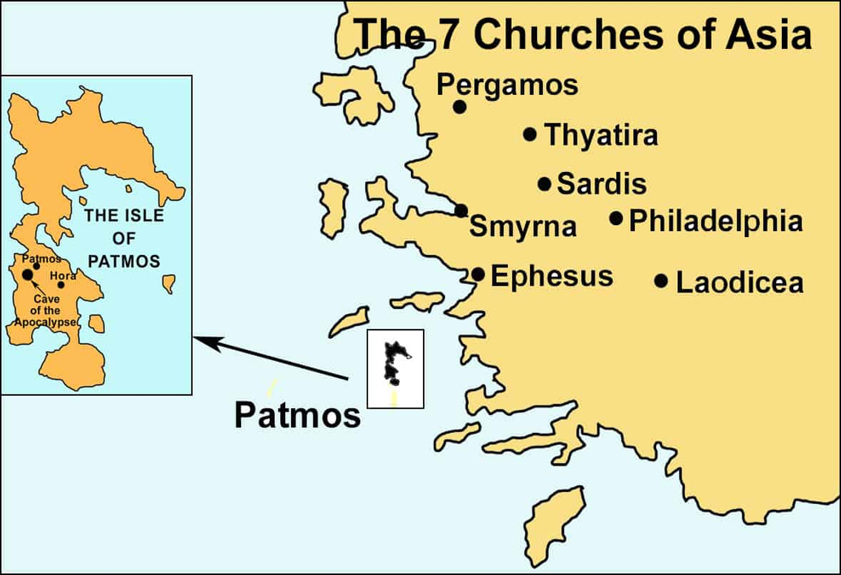
Revelation 2:1a
“unto
the angel
of the church
at Ephesus write;
Four views
a church
the churches
a saint
a dispensation

Slide 2
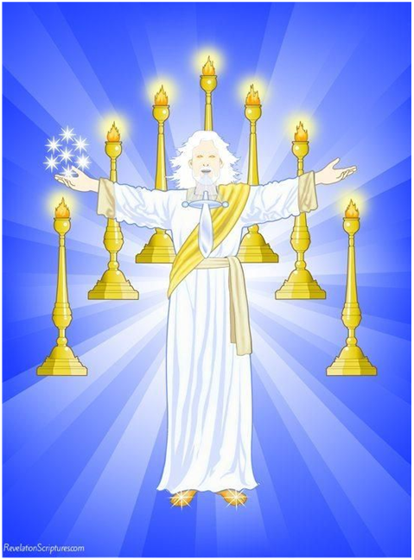
Revelation 2:1-7
2:1a Ephesus = relax?
2:1b 1:12-13, 20
7 stars-angels, candlesticks-churches
2:2-6 I know thy works (common)
(+) 7 good works (2:2-3, 6)
(-) 1 evil work - left thy first love (2:4-5)
“remember, repent, repeat”
2:7a hear what the Spirit says (common)
2:7b to him that overcomes (common)
2:7c promise (eat of the Tree of Life)

Slide 3
Revelation 2:1a “unto the angel of the church at Ephesus write;
Time and Place
53-55 A.D., Paul at Ephesus (Acts 18:1-3, 18-21, 24-26. 19:1-20:1. 20:16-38)
60-62 A.D., Paul wrote a letter from Rome to the (Ephesians)
81-96 A.D., Roman Emperor Domitian
94-96 A.D., The Apostle John in exile at Patmos
95-96 A.D., John wrote Revelation from Patmos
c.100 A.D., John slept
“the things which are”
Pentecost to John’s death
Four views
a church (Rev 2:1a, 2-6, Eph 1:1a, 6:20-24)
the churches (Rev 2:7b, 22:16-21. Eph 1:1b-6:19, Colossians-Laodicea-4x)
a saint (Rev 2:7a, 2:7c. Eph 6:10-17)
a dispensation (Rev 1:8, 2:1-3:22. Eph 1:10. 3:2, Col 1:25. Revelation 1:3, 22:18-19)

Slide 4
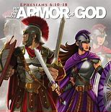
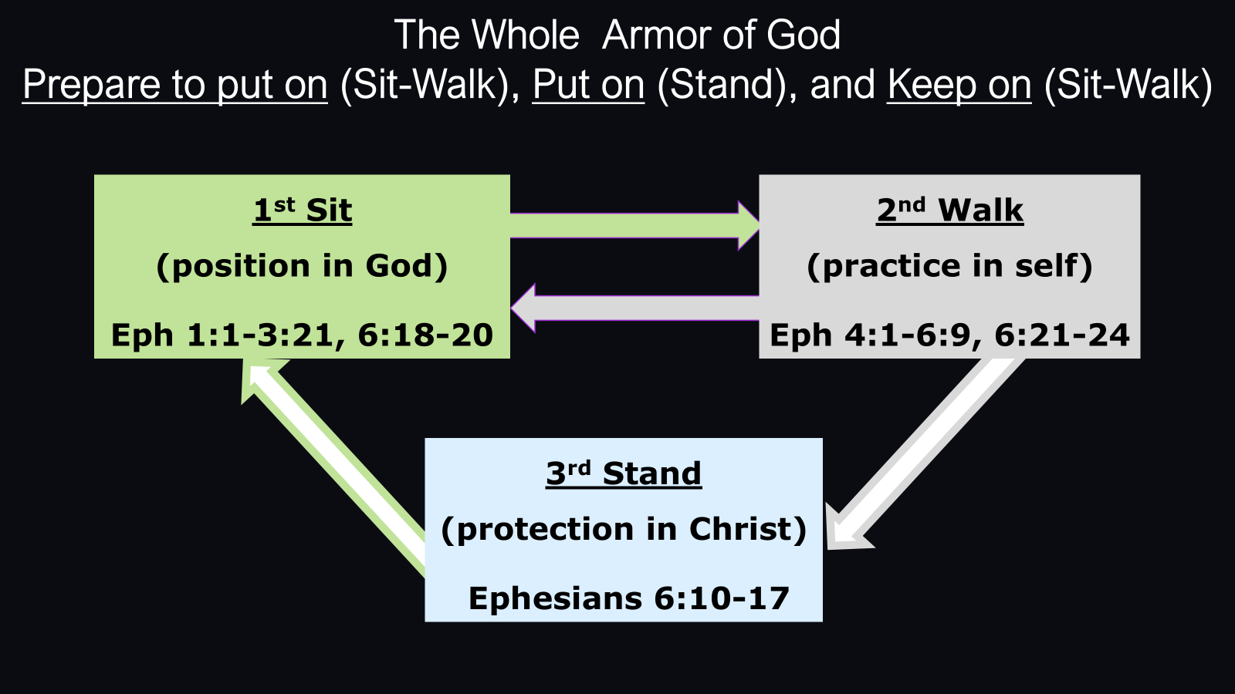
The church at Ephesus in Revelation 2:1-7
2:1a Ephesus = relax?
2:1b 1:12-13, 20
7 stars-angels, candlesticks-churches
2:2-6 I know thy works (common)
(+) 7 good works (2:2-3, 6)
(-) 1 evil work - left thy first love (2:4-5)
“remember, repent, repeat”
2:7a hear what the Spirit says (common)
2:7b to him that overcomes (common)
2:7c promise (eat of the Tree of Life)
Ephesians 5:22-33

Slide 6
The Church at Ephesus in the Book of Acts
Five years later Paul wrote from Rome
Acts 18. Aquila & Priscilla. Apollos.
Trip 2 – Corinth – Jerusalem.
Strengthen the Disciples.
Acts 19. Trip 3. Three years at Ephesus.
False & True Deliverance.
$ / True God - $ / False Gods.
Acts 20. Much Exhortation.
Tears – Wept.
To Jerusalem
Ephesians 5:22-33

Slide 7
The Whole Armor of God
Prepare to put on (Sit-Walk), Put on (Stand), and Keep on (Sit-Walk)
1st Sit
(position in God)
Eph 1:1-3:21, 6:18-20
2nd Walk
(practice in self)
Eph 4:1-6:9, 6:21-24
3rd Stand
(protection in Christ)
Ephesians 6:10-17

Slide 8
Ephesians 6:10-17. The Armor of God
1 of 3 Bible passages for deliverance
from the cultic church – Children of God (1977)
Read book Sit, Walk, Stand by Watchman Nee (1980)
Illustration and passage for (2010) in Japan
Series at Fellowship Church, White Plains MD (2026)

Slide 9
Ephesians Nouns & Pronouns for the Father, Son, & Spirit
Posture |  | Father /God | Son /Christ | holy Spirit
Sit sub-total |  | *45x | 50x | **9x or 60%
Position *The Father is more than the Son in 1:1-14. (past - by God) **God’s Spirit is the most frequent.
Walk sub-total |  | *17x | *48x | 5x or 33%
Practice (daily) *The Son is almost 3x more than the Father.
Stand sub-total |  | *3x | **1x | 1x or 7%
Protection *The Father is 3x more than the Son. (in Christ) **The Spirit is Scripture from the word of God.
Jn 19:30, Eph 1:10, 4:22-24, Col 2:9-15 Total |  | 65x + | 99x + | 15x |  | = 179x
 | Percent | 36.3% | 55.3% | 8.4% |  | 100%
Many to One
Concept
Objective
Inductive
Reasoning
Crosswalk &
Concordance
between
Sit-Walk
&
Stand
953
words

Slide 10
Ephesians 1:1-3:21, 6:18-20. I/We Sit in God’s past work “in Christ” & salvation.
I SIT in Christ (10x) | with ordained access | to bow my knees | to the Father
IDENTITY 1:3-14 | revelation(ed) (3x) 1: 17 | commonwealth 2:12 | eternal 3:11
saints (*7x) 1:1 | enlightened 1:18 | aliens/Israel 2:12 | SUPPLICATE 3:14-21
heaven/ly (*6x) 1:3 | exceeding (3x) 1:19 | nigh (near) 2:13 | family /spiritual/ 3:15
chosen 1:4 | greatness 1:19 | enmity (2x) 2:15 | inner man 3:16
foundation (2x) 1:4 | power (5x)/dynamis/ 1:19 | cross 2:16 | dwell 3:17
predestinated (2x) 1:5 | dominion 1:21 | preached 2:17 | rooted/grounded 3:17
adoption 1:5 | church (*3x) 1:22 | access (2x) 2:18 | comprehend 3:18
praise (3x)/glory (8x) 1:6 | SIT 2:1-10 | ordained 2:20 | breadth/length 3:18
rich/es (6x) 1:7 | quickened 2:1 | building 2:21 | depth/height 3:18
abounded/prudence 1:8 | prince /under the king/ 2:2 | MYSTERY (4x) 3:1-13 | PRAY/SUPPICATE 6:18-20
purpose(d) (4x) 1:9 | of the air 2:2 | read 3:4 | perseverance 6:18
dispensation (2x) 1:10 | saved (2x) 2:5 | unsearchable 3:8 | watching 6:18
PRAYER (5x) 1:15-23 | ONE 2:11-22 | beginning 3:9 | utterance 6:19
Notes: 1st verse of 2 or more written (2x). *All words are only in the sit posture except saints, heaven and church. Creation, salvation, and glory are unconditional works of God with the purpose of God’s glory.

Slide 11
Ephesians 4:1-6:9, 6:21-24. I/We WALK in practice (w/ self & mankind, my sanctification is conditional)
Old Man details in columns 1-3 (53 words) New Man details in columns 4-6 (142 words)
Put off old man | with no inheritance | in the Devil (1 /**1).
no more tossed /ch 4/ | sin not | reprove them (2x)
no more carried | steal no more | idolator
no more cunning | no corrupt talk | vain words
deceive(ful) (2x) | grieve not holy Spirit | unfruitful works
darkened/ness (2x) | bitterness | shame
alienated | clamor | awake you that sleeps
ignorance | evil (2/**1, wicked) | unwise
blindness-heart | malice | be no drunk
lasciviousness | fornication /ch 5-6/ | no spot /husband-wife/
unclean/ness (3x) | covetous/ness(2x) | no wrinkle
greediness | filthiness | without blemish
put away lying | fool/ish (2x) talking | provoke not /fathers-children/
anger(ry) (2x) | jesting, not convenient | service not to me /work/
wrath (4/*1) | whoremonger | not threatening
**Put on new man | with an inheritance | in Christ
Walk (6 /*2) /ch 4/ | give/gave (7/*6) | no fellowship w/darkness
speak (10x) | gift (2/*2) saints (2/*7) | walk circumspectly
beseech | grows/grow up (*1/1) | redeem time
walk worthy | Head-body (>>2/*1>) | singing-heart
calling (2/*2) | walk-children-light (6/*3) | heart/s (5/*1)
called (2/*2) | edifying (3x) renewed mind | submit/ting (2x)
lowliness | righteousness (2x) | fear (2x) trembling
meekness | holiness, church (6/*3) | sanctify & cleanse
longsuffering | truth (2x) labor-work | nourish & cherish
walk in love (13/*6) | tenderhearted (2x) | reverence obey (2x)
forbearing | followers of God /ch 5-6/ | honor parents
endeavoring peace | sweetsmelling savour | brother(ren) (1/**1)
unity (2x), peace (3x) | thanks (2/*1) | comfort hearts
one (15/*5) | light (5x) good (5/*3) | sincerity amen
Old Man: *sit 1 / **stand 2
New Man: *sit 45 / **stand 2

Slide 12
Ephesians 6:10-17. I/We STAND in Christ for protection.
STAND against the devil and | **PUT ON the whole armor of GOD
Finally, my brethren (1/**1) **6:23 / 6:10 | whole body fitly joined together and compacted, every joint (4:16)
be strong in the Lord & in the power /kratos/ 6:10 | Wherefore take unto you the whole armor of God 6:13
of His might /strength, G2479/ 1:19 / 6:10 | that ye may be able to withstand in the evil day 6:13
Put on the whole armor of God 6:11 | and having done all, to stand 6:13
that ye may be able to 6:11 | Stand therefore, 6:14
stand (4x) 6:13, 6:14 (2x) 6:11 | 1st having your LOINS girt about with the TRUTH and 6:14
against (6x) 6:12, 6:13 (4x) 6:11 | 2nd having on the BREASTPLATE of RIGHTEOUSNESS 6:14
the wiles /way, methods & strategy/ 6:11 | 3rd and your FEET shod with the preparation 6:15
of the devil (1/**1) 6:11 | of the GOSPEL of PEACE 6:15
for we wrestle not against flesh & blood 6:12 | 4th ABOVE ALL, taking the SHIELD of [the] FAITH 6:16
but against principalities (1/*1) 6:12 | wherewith ye shall be able to QUENCH /4:30, grieve Spirit/
against powers (1/*3), (exousía) 6:12 | ALL the FIERY DARTS of the WICKED. 6:16
Against the rulers of the darkness (1/**2) 6:12 | 5th and take the HELMET of SALVATION /mind/ 6:17
of this world (1/*6) 6:12 | 6th and the SWORD of the SPIRIT 6:17
against spiritual wickedness in high (1/**1) 6:12 | which is the Word of God (specific Scripture) 6:17
Crosswalk: *sit / **walk

Slide 13
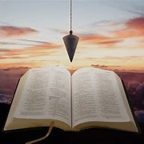
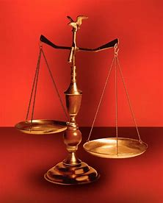
Straight & Balanced
Spiritual Warfare
1. A Father’s Love (John 4:43-53)
2. Our God Squad (12 COs that love me)
3. Great Freedom in Warfare (John 8:32)
4. Men of Purity, Power, & Praise in Warfare
5. I AM the Light of the World (John 8-9)
6. Quit You Like Men (Proverbs 31)
Ephesians
7-11. Prepare to put on the armor (Eph 1:1-6:9)
12. Put on the armor of God (Eph 6:10-17)
13-14. Keep on the armor of God (Eph 6:18-24)
15- . The church at Ephesus (Acts 18-20)
The church of Ephesus (Revelation 2:1-7)
Fellowship Church, Sunday School, September 27, 2026
by brother Bill Heath

