Slide 1
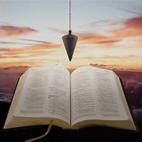
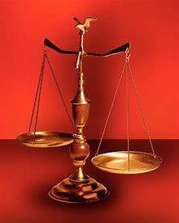
Straight and Balanced
(Luke 3:4-6)
The Faith, a noun, G3982, pis’-tis, 244x, Hebrews 11-11x (11:1-3, 6, 38-40, 12:1-4; Romans 15:23, Jude 1:3)
Fellowship Church, Dec 3, 2025 B. Heath
Old Testament: True Prophets of the Faith
#13 – Samuel: Lifelong Shining Faith (Heb 11:32f, 1 Sam)
#14 – Nathan & Gad: The Comforter’s Faith (Heb 11:32g)
#15 – Man of God & Old Prophet: Weak Prophets of the Faith
#16 – Azariah & Hanani: Two Prophets and Two Effects of Truth
#17 – Jehu, a Prophet, & Micaiah: Little-Known Prophets
#18 – Elijah: The Past, Present, and Future Prophet of the Faith (Heb 11:35)
#19 – Elisha: Prophet of Power and Water (Heb 11:35)
#20 – Jonah & Nahum: God’s Mercy & Judgment on Nineveh
#21 – Hosea, Joel, & Amos: Future Judgments and Blessings
#22 – Obadiah, Jonah, & Micah: Fight with Hate, Anger, & Darkness
#23 – Isaiah: Prophet of Majesty and Royalty (Heb 11:37)
#24 – Nahum, Habakkuk, & Zephaniah: God the Loving-Holy Judge
#25 – Huldah: Prophetess of Anomaly & Conformity of the Faith
#26 – Jeremiah & Lamentations: Speak, Weep, and Turn unto the LORD
#27 – Ezekiel:
#28 – Daniel:
#29 – Haggai, Zechariah, & Malachi:
#30 – Old Testament False Prophets
#31 – New Testament Prophets
OT: Ps 5:8, Pr 4:25-27
Amos 7:7-8, Is 28:13, 17
NT: Mt 3:3, Acts 9:11
Hebrews 12:13, Jude 3
1 Cor 15:1-4, 2 Tim 3:10
John 7:16
OT: Deut 25:13-16
Pr 20:10, Dan 5:25-28
NT: Hebrews 12:1
1 Cor 3:11-15
Philippians 4:5
James 3:17

Slide 2
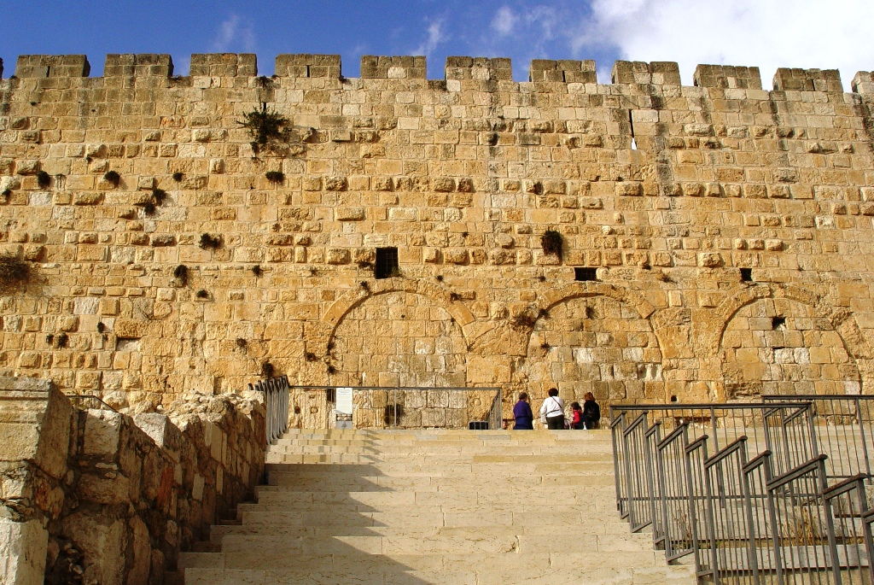

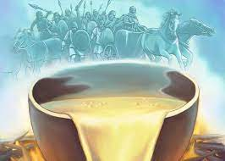
Jeremiah: Speak, Weep, and Turn unto the LORD
Time: c. 627-580 BC. King Josiah and the last 4 evil kings of Judah (1:2)
Purpose: Ordained a prophet unto the nations at the midnight hour (1:5)
Key Words: Return or Turn – 90x. Backsliding(s) – 13x, chapter 3 – 9x. Backward 2x.
12 Helps for me to speak, weep, and turn to God: Scripture
1) Jeremiah - I cannot speak / LORD - you will speak My words 1:1-10
2) Run with footmen and weary? Contend with horses & flood? 12:5
3) Rejoice as I find and eat the Bible and obey God 15:16
4) Not wanting to speak, yet God’s Word is fire in my heart 20:9
5) God’s Word is like a fire and like a hammer that breaks rocks 23:29
6) By grace deserved by the faithful Rechabites 35:18-19
Because I am not past the point of no return (OT-nation, NT-individual, 1 Cor 9:27)
7) Living waters or broken cisterns (Jeremiah rose early to pray, 7x) 2:13
8) Hard ground of my heart (Hebrews 3:8, 3:12, 3:15, 4:7 or 4:12, 8:10, 10:22, 13:9) 4:3-4
9) I refused the old paths (pray not for Israel, 3x, Jer 7-14, 1 John 5:16) 6:16-17
10) Jeremiah’s soiled linen girdle (1 Cor 5:1-6:11, 1 Cor 11:27-34, 2 Cor 7) 13:1-11
11) My deceitful & wicked heart (not Hebrews 6:4-7, but 6:9-12, and Acts 5:1-11) 17:9-10
12) I speak, even if not heard (God not hear prayer, 4x, Jer 26-44, James 2x) 26:2-3
Application for me today; to speak, weep, and turn!
Gold standard for Bible study
1st What it says then.
2nd What it says about God.
3rd Application for me today.
Uniqueness of Jeremiah
Autobiography to learn (Ro 15:4)
2 visions: almond rod & boiling pot
Focus on Israel, near and far, judgment for sin to fulfill prophecy. The new covenant is for Israel, Jer 31. The New Testament is for the body of Christ – the true Church.
1st bloom, wakeful tipped boiling pot
Jer 1:11-16
Jeremiah’s 70-year prophecy
605 BC, 25:1-38 (11-12) & 29:1-14 (10)
2 Chronicles 36:7, Daniel 2:35, 2:45,
9:1-27 (1-2) Daniel understood Jeremiah.
536 BC, Ezra 1:1-4, 3:6, 3:8
Temple reconstruction begins.

Slide 3
OT True Prophets chart in respect to Hebrews 11:1-3, 11:6, 11:32-40, 12:1
# | Name/ Scripture | Suffer-Persecute /Scripture | King (Saul to Zedekiah) | Public/ Private | Prophecy - Near/Far or None | Nation | Bless/ Curse | Vision/ Dream | Miracle Prophet or God | Notes | Heb 11
1 | Samuel | No /1 Sam 1-28 | Saul | Private | Near/for Saul | Israel | B/C | 0 | 0 | after death | 32c
2 | Gad | No/1 Sam 22:25 | David | Public | Near/for David | Israel | B/C | 0 | 0 | Book | 32d
3 | Nathan | No/2 Sam 7. 12. | David - | Private | Near/Far-seed of David | Israel | B/C/B | 0 | 0 | Solomon | 32d
4 | Asaph | No/Psalms 50, 73-83 | David | Public | Far/Tribulation and 1000-year reign | Israel | C/B | 0 | 0 | Revelation 6-20
5 | Ahijah | No/1 Ki 11:29-39 | Jeroboam - 1st | Private | Near/Jeroboam’s reign-son | N-Israel | B/C | 0 | 0 | 1 Ki 14:1-26 | 32d
6 | Shemaiah | No/1 Ki 12:22-24 | Rehoboam - 1st | Private | Near/for Rehoboam | S-Judah | B | 0 | 0 | Book 931 BC | 32d
7 | Iddo | No/2 Chr 9:29 | Jeroboam - 1 ^{st} | Private | Seer for Jeroboam | N-Israel | C | 1 Vision | 0 | Records 931 BC | 32d
8 | man of God | No/1 Kings 13 | Jeroboam – 1st | Private | Far/King Josiah by name, c. 300 yrs., 13:2 | N-Israel | C | 0 | Heal hand | Judah, 2 Ki 23:15 | 32d
9 | old prophet | No/1 Kings 13 | Jeroboam – 1st | Private | Near/for man of God, lion and donkey | N-Israel | C | 0 | 0 | Liar-like Lot | 32d
10 | Azariah | No/2 Chr 15:1-7 | Asa – 3rd | Public | None | S-Judah | B | 0 | 0 | war w/Ethiopia
11 | Hanani | No/2 Chr 16:7-10 | Asa – 3rd | Private | Near/ | S-Judah | C | 0 | 0 | war w/Israel-Syria
12 | Jehu | No/1 Ki 16:1-13, | Baasha-3rd | Private | Near/2 Chr 19:1-4 | N-Israel | C/B | 0 | 0 | Son of Hanani
13 | Prophet - | No/1 Ki 20:13-36 | Ahab-7th | Private | Near/Syria/man of God | N-Israel | B/B/C | 0 | Lion | Son of prophet
14 | Micaiah | Yes/1 Ki 22:1-28 | Ahab-death | Private | Near/400 to 1, 2 Chr 18:1-27 | N-Israel | C | 0 | 0 | Lying spirit | 33a
15 | Elijah | Yes/1 Ki 17-2 Ki 2 | Omri, Ahab – 7th | Public | Near/3 ½ years draught, 450 to 1 | N-Israel | B5/C3 | 0 | 8 | Gentile widow | 35
16 | Elisha | No/2 Ki 3-13 | Joram, Jehu – 8th, | Public | None/gentile general, Lu 4:27 | N-Israel | B11/C5 | 0 | 16 | Jezebel-death | 35
17 | Eliezer | No/2 Chronicles 20:37 | Jehosophat -4th | Private | Near/alliance with Ahaziah | S-Israel | C | 0 | 0 | Fleet destroyed
18 | Joel | No/2 Kings 11-15 | Joash -11th | ? | Far/ | S-Israel | C-B | 0 | 0
19 | Jonah | No/Jonah 1-4 | Jehoash - 11th | Public | Near/40 days – repent | Nineveh | B | 0 | 9 by God | Angry-carnal
20 | Amos | No/2 Kings 14-15 | Jeroboam II – 13th | Public | Near/c 45 yrs | N-Israel | C/B | 5 Visions | 0 | Exile Assyria 722
21 | Hosea | No/2 Kings 15-18 | Jeroboam II – 13th | Public | Near/c 40 yrs, Far/2700+ yrs (7x) | N-Israel | C-B | 0 | 0 | Gomer/3 children
 | Oded | No/2 Chr 28:6-15 | Ahaz-12th | Public | Near/ | S-Judah | B | 0 | 0 | War victory
22 | Micah | Yes/rejection | Jotham-Hezekiah | Public | Near Assyria & Babylon, Far Jesus 1st 5:2 | N-S Israel | C-B | Visions | 0 | that day 25%, hear
23 | Isaiah | Yes/sawn in half | Uzziah-Hezekiah | Public | Near and Far/more than other prophets | S-Judah | C-B | Visions | 3/time-185 | Majesty, Royalty | 34
24 | Nahum | No/Nahum 1-3 | Hezekiah-13th | Personal | Near/30 -50 years | Nineveh | C | 1 vision | 0 | Israel, 722 BC | 33a
25 | Habakkuk | No/ | Zedekiah-20th | Personal | Near/ Babylon-Nebuchadnezzar | S-Judah | C-B | Vision | 0 | Trial to Triumph
26 | Zephaniah | No/ | Josiah-16th | Personal | Near-Babylon/Far 2nd coming of Jesus | S-Judah | C-B | 0 | 0 | Trib & 1000
27 | Huldah | No/2 Kings 22:11-20 | Josiah-16th | Private | Near/13 years, Josiah’s grave 2 Ki 23:27 | S-Judah | C-B | 0 | 0 | 2 Chr 34:18-28
28 | Jeremiah | Yes/no wife, pit, etc | Josiah-Zedekiah | Public | Near-Babylon/70-year captivity | S-Judah | C-B | Visions | 0 | Exile Babylon 586 | 36
29 | Daniel | Yes/ | ? – Babylon | Public |  | S-Judah
30 | Ezekiel |  | ? – Babylon | Public |  | S-Judah
31 | Obadiah | No/ | Zedekiah-20th |  |  | Edom
32 | Haggai | No/ | Zerubbabel-Gov |  |  | Israel
33 | Zechariah | Yes/ | Zerubbabel |  |  | Israel
34 | Malachi |  | Zerubbabel |  |  | Israel
Before Samuel
Enoch
Genesis 5:24
Jude 1:14
Moses
Exodus 7:1 Deut 34:10
Acts 3:22,
7:37
Miriam
Exodus 15:20
Deborah
Judges 4:9
During & after Samuel
1 Samuel
19:18-24
2 Ki 4:38-41
Sons of the prophets-9x
Updated: 17 Nov 2025
W.H.

