Slide 1

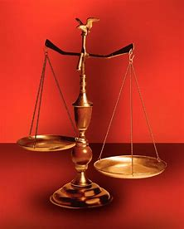
Straight and Balanced
A Father’s Love
John 4:43-53
Fellowship Church, June 21, 2026, by Bill Heath

Slide 2
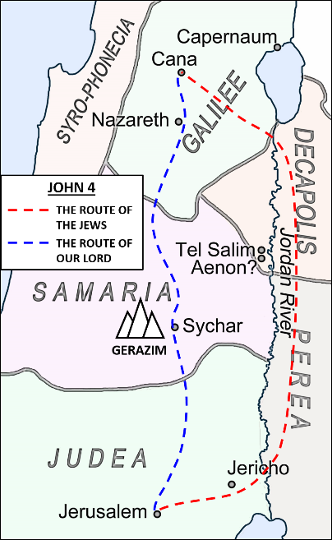
^{A Father’s Love}
^{John 4:43-53}
^{43-46 Narrative}
^{47 Father}
^{48 Jesus}
^{49 Father}
^{50 Jesus}
^{51-53 Father}
Song Good, Good Father by Chris Tomlin

