Slide 1
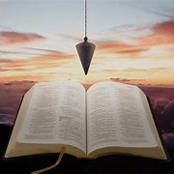
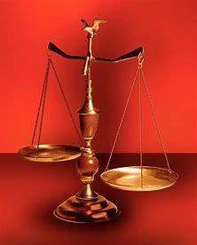
Fellowship Church, June 15, 2025 B Heath
Straight & Balanced
(Luke 3:4-6)
Expository Teaching
Slapstick Theater (Aquila and Priscilla)
God’s Design for Elect Ladies
Priscilla, a Model New Testament Elect Lady
1st: Psalm 68, Victory Parade for the Ark (2 Sam 6-7, 1 Chr 13-16)
2nd: How to Keep on the Armor of God (Ephesians; sit, walk, and stand)
3rd: The Elect Lady, an example for all Christian Women (2 John)
4th: Ruth, the Kind, Virtuous, Old Testament Lady (Ruth)
5th: Esther, the Beautiful, Obedient, Old Testament Lady (Esther)
6th: Priscilla, a Model New Testament Elect Lady (Acts 18)
7th: God’s Design for NT Elect Ladies (Genesis to Revelation)
OT: 2 Kings 21:13, Ps 5:8 Pr 4:25-27, Amos 7:7-8 Isaiah 28:13, 17
NT: Mt 3:3, Acts 9:11
Hebrews 12:13, Jude 3
1 Corinthians 15:1-4
2 Timothy 3:10, John 7:16
OT: Deut 25:13-16
Proverbs 20:10
Daniel 5:25-28
NT: Hebrews 12:1
1 Cor 3:11-15
Philippians 4:5
James 3:17

Slide 2
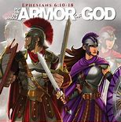
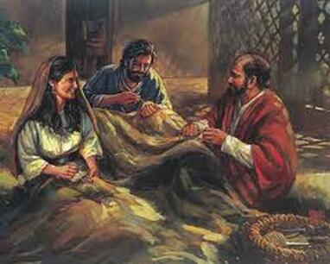
Ephesians
1-3 SIT, 4:1-6:9 WALK
6:10-20 STAND
Be STRONG in the Lord,
STAND against
the wiles of the devil (6:11)
withSTAND in the evil day (6:13a)
having done all, to STAND (6:13b)
STAND therefore (6:14a)
Armor of God (6:14b-17)
1st Loins – Truth
2nd Breastplate – Righteousness
3rd Feet – Gospel of Peace
4th Shield – of Faith
5th Helmet – Salvation
6th Sword – Word of God
7th Prayer (6:18-20)
Priscilla, A Model New Testament Lady
TENTMAKERS
Same armor and different roles
for men and women, and husbands and wives in spiritual warfare since the
Garden of Eden
Next Sunday
Elect Ladies (Genesis to Revelation)

Slide 3
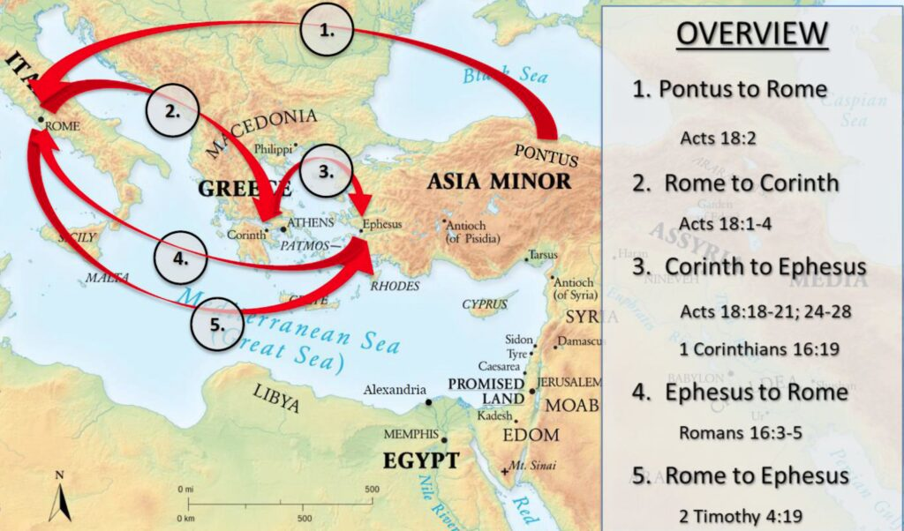
The Travels of
Aquila and Priscilla

Slide 4
Priscilla, A Model New Testament Elect Lady
Time and Place | Events
God’s Providence Macedonia/Pontus 49 AD Rome | Acts 16:6 to 18:1. 2nd mission trip of Paul at Phillipi, Thessalonica, Berea, Athens, and now at Corinth Acts 18:2. Paul found a Jew named Aquila /an eagle/ from Pontus with his wife Priscilla /little ancient/ Acts 18:2. recently exiled from Rome by the Roman Emperor Claudius
51 AD Corinth | Acts 18:3. They lived and worked as tentmakers. Paul lived and worked with them for 18 months (18:4-11).
52 AD Ephesus Two-togetherness | Acts 18:18-19. Priscilla and Aquila went to Ephesus with Paul, and Paul left them at Ephesus. Acts 18:24-28. Aguila and Priscilla heard the Jew Apollos in the synagogue on the sabbath and expounded unto him the way of God more perfectly. Apollos only knew the baptism of John (3 yrs 19:1-7). 1 Corinthians 16:19b. “Aquila and Priscilla salute you much in the Lord, with the church that is in their house.” Paul wrote to the Ephesians from prison in Rome around 57 AD.
Time ? Rome Godly Marriage for Ministry | Romans 16:3-5a. “Greet Priscilla and Aquila my helpers in Christ Jesus. Who have for my life laid down their own necks: unto whom not only I give thanks, but also all the churches of the Gentiles. Likewise greet the church that is in their house. “ Paul wrote from Corinth on his 3rd mission trip c. 61 AD.
68 AD Ephesus | 2 Timothy 4:19 “Salute Prisca and Aquila, and the household of Onesiphorus.” /bringing profit, 2 Tim 1:16-18/ Paul wrote from Rome in prison before being killed by the Roman Emperor Nero. c. 68 AD.
New Testament | 1 Corinthians 7:5 husbands and wives . . . give yourselves to fasting and prayer. 1 Corinthians 14:34 Wife learns from husband at home. Example-Friday night Romans 3, morning QT. 1 Peter 3:1-6 as Sarah with Abraham, 7 heirs together of the grace of life; that your prayers be not hindered.
Genesis to Revelation | Next Sunday: God’s Design for New Testament Elect Ladies. Angels. Genesis 1-3. Sarah, Deborah, Ruth, Huldah, Esther, Proverbs 31. Jesus’ words, Mary, Mary Magdalene, Peter’s mother-in-law, Ephesians 5:22-33.

Slide 5

Sunday School Through the Bible (2023 - 2025)
Grow in grace, and in the knowledge of our Lord and Savior Jesus Christ
2 Peter 3:18
COMPLETED books of the Bible
Old Testament: Genesis (4), Exodus (4), Leviticus (2), Numbers (3), Deuteronomy (5), Ruth, Esther, Psalms (4), Psalm 68 (2), Proverbs, Ecclesiastes, Amos, Obadiah, Malachi
New Testament: Mark, Colossians, 1-2 Thessalonians (10), Ephesians, Philemon, James,
2 Peter (4), 2 John, Jude
Use index cards to present Sunday School questions
to answer for all to hear.
Invitation to Fellowship Church 2025 daily schedule for Bible and prayer
June 16-22: 2 Kings 23:26 to 1 Chronicles 1:27 (Mon-Sat), Psalm 77 (Sun)
Notes:
-

