Slide 1

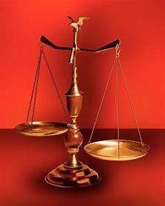
Fellowship Church, Nov 6, 2024 B. Heath
Straight and Balanced
(Luke 3:4-6)
Biblical characters (Hebrews 11:1-3, 6, 39-40)
#1 – Abel’s Faith & Innocent Blood (Heb 11:4, Gen 4)
#2 – Walking with God & with Enoch (Heb 11:5-6, Gen 5)
#3 – Secure on the Ark with Noah (Heb 11:7, Gen 6-11)
#4a – Faith with Abraham (Heb 11:8-19, Gen 12-23)
#4b – Faith with Sarah (Heb 11:11-12, 1 Peter 3:6)
#4c – OT & NT Strangers & Pilgrims (Heb 11:13-16, 1 Pe 2:11)
#5 – Faith & Laughter with Isaac (Heb 11:17-19, Gen 18-24)
#6 – Faith with Jacob/Israel (Heb 11:20-21, Gen 25-36)
#7 – Faith with Joseph beyond Death (Heb 11:22, Gen 37- 50)
#8 – Faith with Moses the Deliverer (Heb 11:23-29, Exo-Deu)
#9 – A Battleplan for Victory with Joshua (Heb 11:30, Joshua 6)
#10 – Faith then Works with Rahab (Heb 11:31, Joshua 2, 6)
#11 – Faith with the Judges (Heb 11:32, Judges)
#12 – Faith with David (Heb 11:32, 2 Samuel, 1 Chr)
#13 – Faith with Samuel (Heb 11:32, 1 Samuel)
#14 – Faith with the Prophets (Heb 11:32-38, Is-Malachi)
#15 – Faith for All (Heb 11:39-40, Old Testament saints)
OT: Ps 5:8, Pr 4:25-27
Amos 7:7-8, Is 28:13, 17
NT: Mt 3:3, Acts 9:11
Hebrews 12:13, Jude 3
1 Cor 15:1-4, 2 Tim 3:10
John 7:16
OT: Deut 25:13-16
Pr 20:10, Dan 5:25-28
NT: Hebrews12:1
1 Cor 3:11-15,
Philippians 4:5,
James 3:17

Slide 2
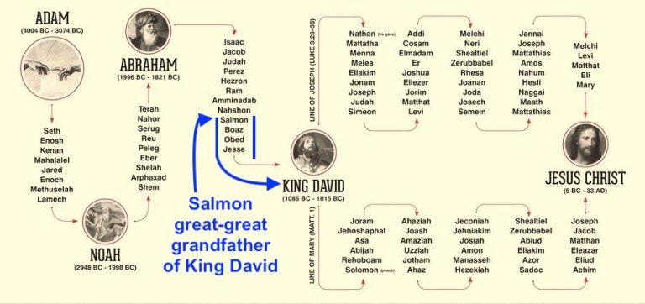

Slide 3
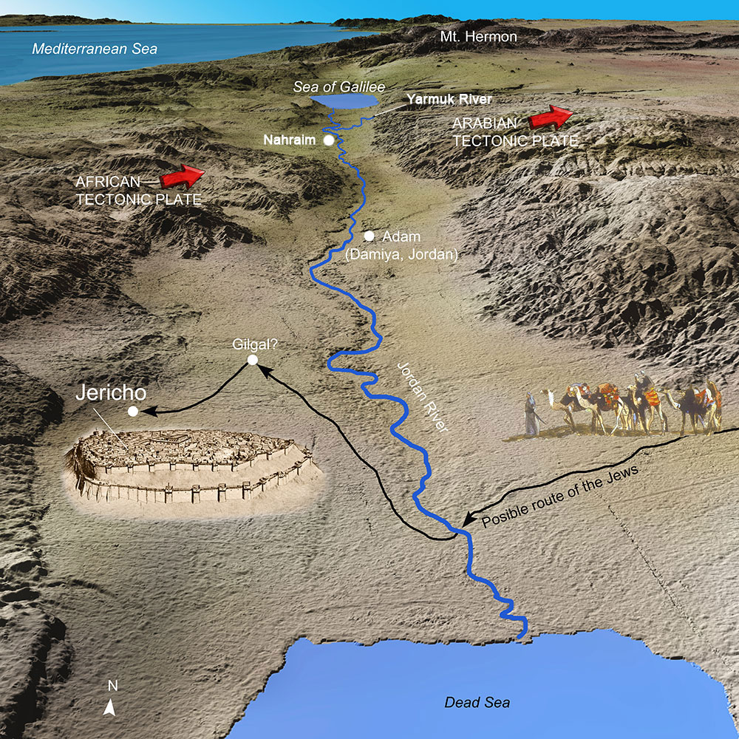
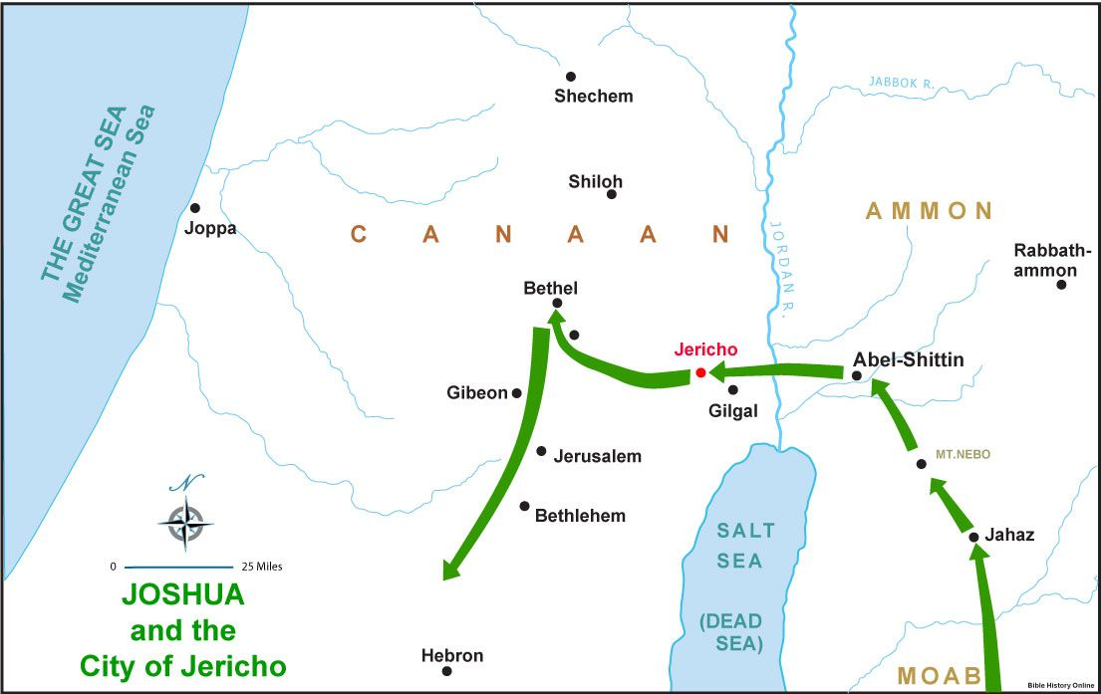

Slide 4
Faith then Works with Rahab (Hebrews 11:31)
Text: Heb 11:31 By faith the harlot Rahab perished not with them that believed not,
(Rev 21:7-8 fearful & unbelieving) when she had received the spies with peace
(W1-2:1b peace, like Luke 10:6 when Jesus sent out the 70 witnesses)
Joshua 2 (God’s preparation and timing in Rahab’s faith followed by works)
1-11 Rahab’s courage to hide the spies & deceive the king’s men (W2-2:4 & Joshua 6:17b)
W3 – vs 6-11 hid them in the stalks of flax. W4 – told spies the fear of all Jericho.
12-24 Rahab’s covenant with the two spies (2:12-14, 17-24 & Joshua 6:22)
W4 – 2: 15, let them down by a cord. W5 – 2:16, Advised to go the opposite direction to the mountain for 3 days.
Joshua 6:23 & 25 Rahab’s continuance with God’s people
23 left them outside the camp of Israel, 25 dwell in Israel because she hid the two spies
Matthew 1:5 Rahab marries Salmon >father of Boaz >great-great grandfather of David >Mary
James 2:25 -26 Likewise also was not Rahab the harlot justified by works, when she had received the messengers, and had sent [them] out another way? For as the body without the spirit is dead, so faith without works is dead also.

Slide 5

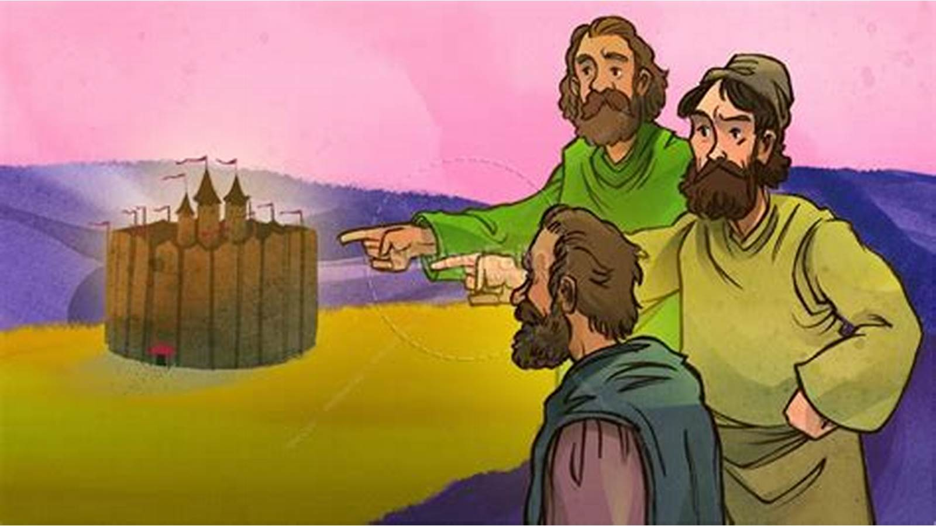
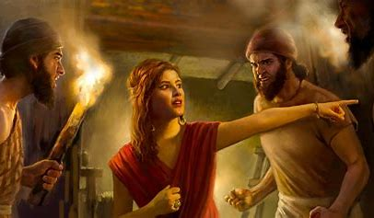
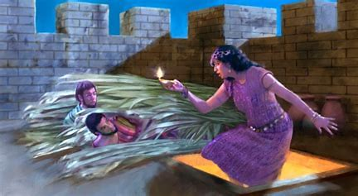
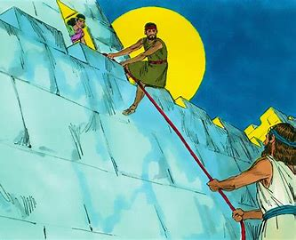
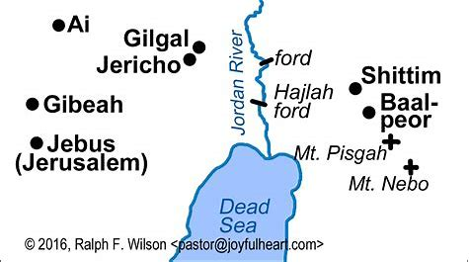
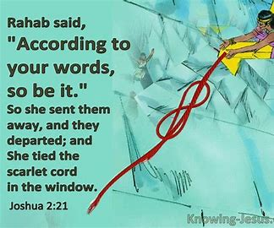
Joshua 4:19 Israel crossed the Jordan
on the tenth day of the first month.
The 14th day is Passover in spring when the river is flooding.

