Slide 1
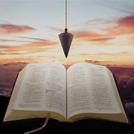
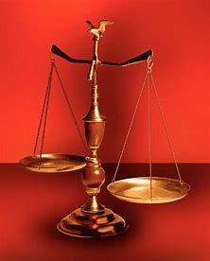
Fellowship Church, Apr 6, 2025 B Heath
Straight and Balanced
(Luke 3:4-6)
Expository Teaching
It's all about you Jesus (9:55-9:59)
The Second Letter of Peter, Last Things to Remember
1. FEED MY LAMBS
Climbing the Stairway “into” Heaven (2 Peter 1)
2. PROTECT MY SHEEP
False Teachers in the Church (2 Peter 2)
3. GUIDE MY SHEEP (2 Peter 3)
I have fought a good fight, I have finished [my] course
4. THE GREAT SHEPHERD OF THE SHEEP (Hebrews 13:20)
Thoughts on Jesus, Peter, Paul, and John
OT: Ps 5:8, Pr 4:25-27
Amos 7:7-8
Isaiah 28:13, 17
NT: Mt 3:3, Acts 9:11
Hebrews 12:13, Jude 3
1 Corinthians 15:1-4
2 Timothy 3:10, John 7:16
OT: Deut 25:13-16
Proverbs 20:10
Daniel 5:25-28
NT: Hebrews 12:1
1 Cor 3:11-15
Philippians 4:5
James 3:17

Slide 2
Notes:
-

Slide 3
A. 2 Timothy 3: 1-9, 10-17: Protect & Warn the Sheep
Action by the local church Pastor
B. 2 Peter 2: Protect & Warn the Sheep
Information for the Church
C. Jude: Protect & Warn the Sheep
Action by the local church

Slide 4
The Shepherd and the Sheep
John 10:1-21 Jesus is the Good Shepherd
John 21:15-17 Jesus said to Simon Peter
Do you love Me? Do you love Me? Do you love (friend) Me?
Feed My lambs, feed My sheep, feed My sheep
2 Peter 1: Peter FEEDS Jesus’ lambs
2 Peter 2: Peter PROTECTS Jesus’ sheep
2 Peter 3: Peter GUIDES Jesus’ sheep
Hebrews 13:20 “that great shepherd of the sheep”

Slide 5
2 Peter 3 – Peter GUIDES Jesus’ Sheep
1-2 Review FEED My lambs (holy prophets and apostles, 2 Peter 1)
Write, pure minds, remembrance. Old Testament holy prophets. New Testament apostles. /Ephesians 2:20, 4:11/
3-6 Review PROTECT My sheep (last days scoffers, 2 Peter 2)
willingly ignorant of the word of God /Genesis 1, 9/
7-18 GUIDE My sheep (as friends, elder and younger, 1 Peter 5)
7-14 heavens and earth, Word, fire, judgment /Revelation 20-22/
long-suffering, come “to” repentance
all holy conversation and godliness /Revelation 2-3/
be diligent to be found of Him in peace, without spot and blameless
15-16 Paul’s wisdom, his epistles speaking things hard to understand
The unlearned and unstable wrestle, as with other Scriptures, unto their own destruction
17-18 knowing these things before, beware
unless ye also, being led away with the error of the wicked, fall from your own stedfastness.
But grow in the grace and knowledge of our Lord and Savior Jesus Christ
Next Sunday: THAT GREAT SHEPHERD OF THE SHEEP (Hebrews 13:20)
Thoughts on Jesus, Peter, Paul, and John
Notes:
-

Slide 6
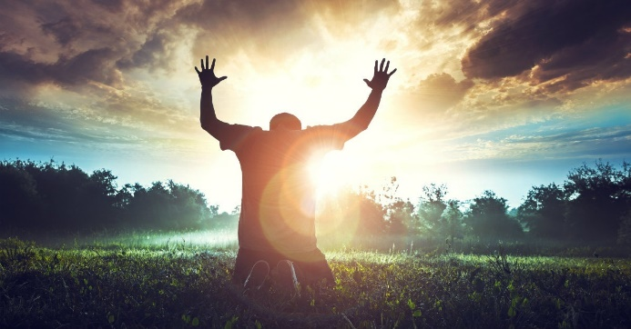
Sunday School Through the Bible (2020 - 2025)
Grow in grace, and in the knowledge of our Lord and Savior Jesus Christ
2 Peter 3:18
COMPLETED books of the Bible
Old Testament: Genesis (4), Exodus (4), Leviticus (2), Numbers (3), Deuteronomy (5), Psalms (4), Proverbs, Ecclesiastes, Amos, Obadiah, Malachi
New Testament: Mark, Colossians, 1-2 Thessalonians (10), Philemon, James, 2 Peter (4), Jude
Invite to Fellowship Church 2025 daily schedule for Bible and prayer.
This week: Psalm 66 and 1 Kings 17:8-20:43
Notes:
-

