Slide 1
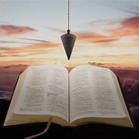
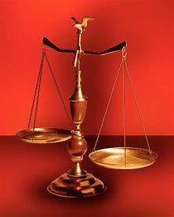
Straight & Balanced
Spiritual Warfare (5 of 7)
1. A Father’s Love (John 4:43-53)
2. Our God Squad (12 COs that love me)
3. Great Freedom in Warfare (John 8:32)
4. Men of Purity, Power, & Praise in Warfare
5. Quit You Like Men (Proverbs 31)
Ephesians
6. Preparing to put on the armor of God
7. Put on & keep on the whole armor of God
Fellowship Church, Sunday School, July 19, 2026
by Bill Heath, Associate Pastor

Slide 2
John 8-9
> Feast of Tents
Jerusalem
Pharisees-scribes
Key words
Jn 7-8: Sin-16x
Jn 7: Father – 21x
(God-12 or devil-9)
Key verses
8:31-32 truth-free
9:4 work-night
9:38 believe-worship
I AM the Light of the World (John 8:12, 9:5)
Genesis 1:1a In the beginning God (Elohim) created
Genesis 1:3-5 And God said, Let there be light: . . .
John 1:1-5 . . . And the light shines in darkness . . .
1 John 1:7 But if we walk in the light . . . fellowship
Revelation 21:23 the city had no need of the sun
Revelation 22:5 no night there, God gives them light

Slide 3
(-) Curse Israel due to disobedience
1 Samuel 4:9
1st Be strong,
2nd quit yourselves like men,
3rd O ye Philistines, that ye be not servants unto the Hebrews, as they have been to you:
4th quit yourselves like men,
5th and fight.
1050 BC
Old Testament Hebrew language
Abraham our father (patriarchy), one land (Ro 4)
Law of Moses (10 commandments)
One God, one nation (separated out)
Circumcise (physical and spiritual-heart, Ro 4)
Bless one nation and individuals (Gen 12:1-3)
Matthew 5-7, 19:1-9, Acts 17:30, Romans 15:4, 1 Corinthians 10:1-13 (1 Cor 10:14, 1 John 5:21)
WISDOM
Proverbs 31
1-9
King
Man
Husband
(11-12, 23, 28)
10-31
Queen
Woman
Wife
950 BC
dominion
Genesis 1:16, 28.
Psalm 8 (8:5-6)
and Hebrews 2:6-7.
Ephesians 5:23-24, 25-27.
(+) Bless the church due to obedience
1 Cor 16:13-14
1st Watch ye,
2nd stand fast in the faith,
3rd quit you like men,
4th be strong.
5th Let all your things be done with charity.
53 AD
New Testament Greek language
Our father Abraham, the world (Ro 4)
Grace upon grace, by Jesus (love one another)
One way to God, all nations (separated in)
Circumcise (spiritual-heart, Ro 4)
Bless individuals and local churches (Revelation 1-3, 22:16-21)
“quit” = acquit. To clear one’s self of incumbent duties by full performance

Slide 4
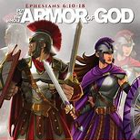
Onward Christian Soldiers (1 minute)
Put on and keep on the whole armor of God
HERE AND NOW!

