Slide 1
Fellowship Church Sunday School
Jan – May 2022, Acts of the Apostles
Today – Turn to Acts 1
“The Father will send the Holy Spirit”
Teacher: Bill Heath
Play at 9:55-10:00 Worship Guitar 20:35

Slide 2
2022 – Year of the New Bottle
Let us Pour the New Wine into New Bottles (in the New Testament)
(Job 32:9, Matthew 9:17, Mark 2:22, Luke 5:37-39, Acts 2:13)
Fellowship Church 2022 Welcome
Jan – May 2022, Acts of the Apostles Doctrine (Acts 2:42)
Worship God
Scripture
Prayer
Fellowship
Witnessing
Holy Spirit
Salvation
Time Management
Persecution
Good works
Kingdom of God
Priorities
Church Attendance
Wonderful Works of God
Church Government

Slide 3
Acts TRANSITIONS IN THE ACTS OF THE APOSTLES 33-67 A.D.
1-2 Old Testament (1) to New Testament (Acts 2)
1:4 Jerusalem (1-7) / Antioch (8-21) / Rome (22-28)
1:8 Jerusalem (2, 1-7), Samaria (8, 8-9), Judea (10, 10-12),
Uttermost (19, 13-28)
1:6-12 Kingdom to Israel (Genesis 12 to Malachi, Matthew to John,
Revelation 19-20)
1:15-26 Apostle Peter (Acts 1-12) / Apostle Paul (Acts 13-28)
2:1 Church began at Pentecost (Acts 2 until Revelation 3)
10 & 15 from Jew to Gentile, and 1 Nation to All Nations
Pattern: Prayer – Power – Proclaim - Persecution – More Prayer

Slide 4
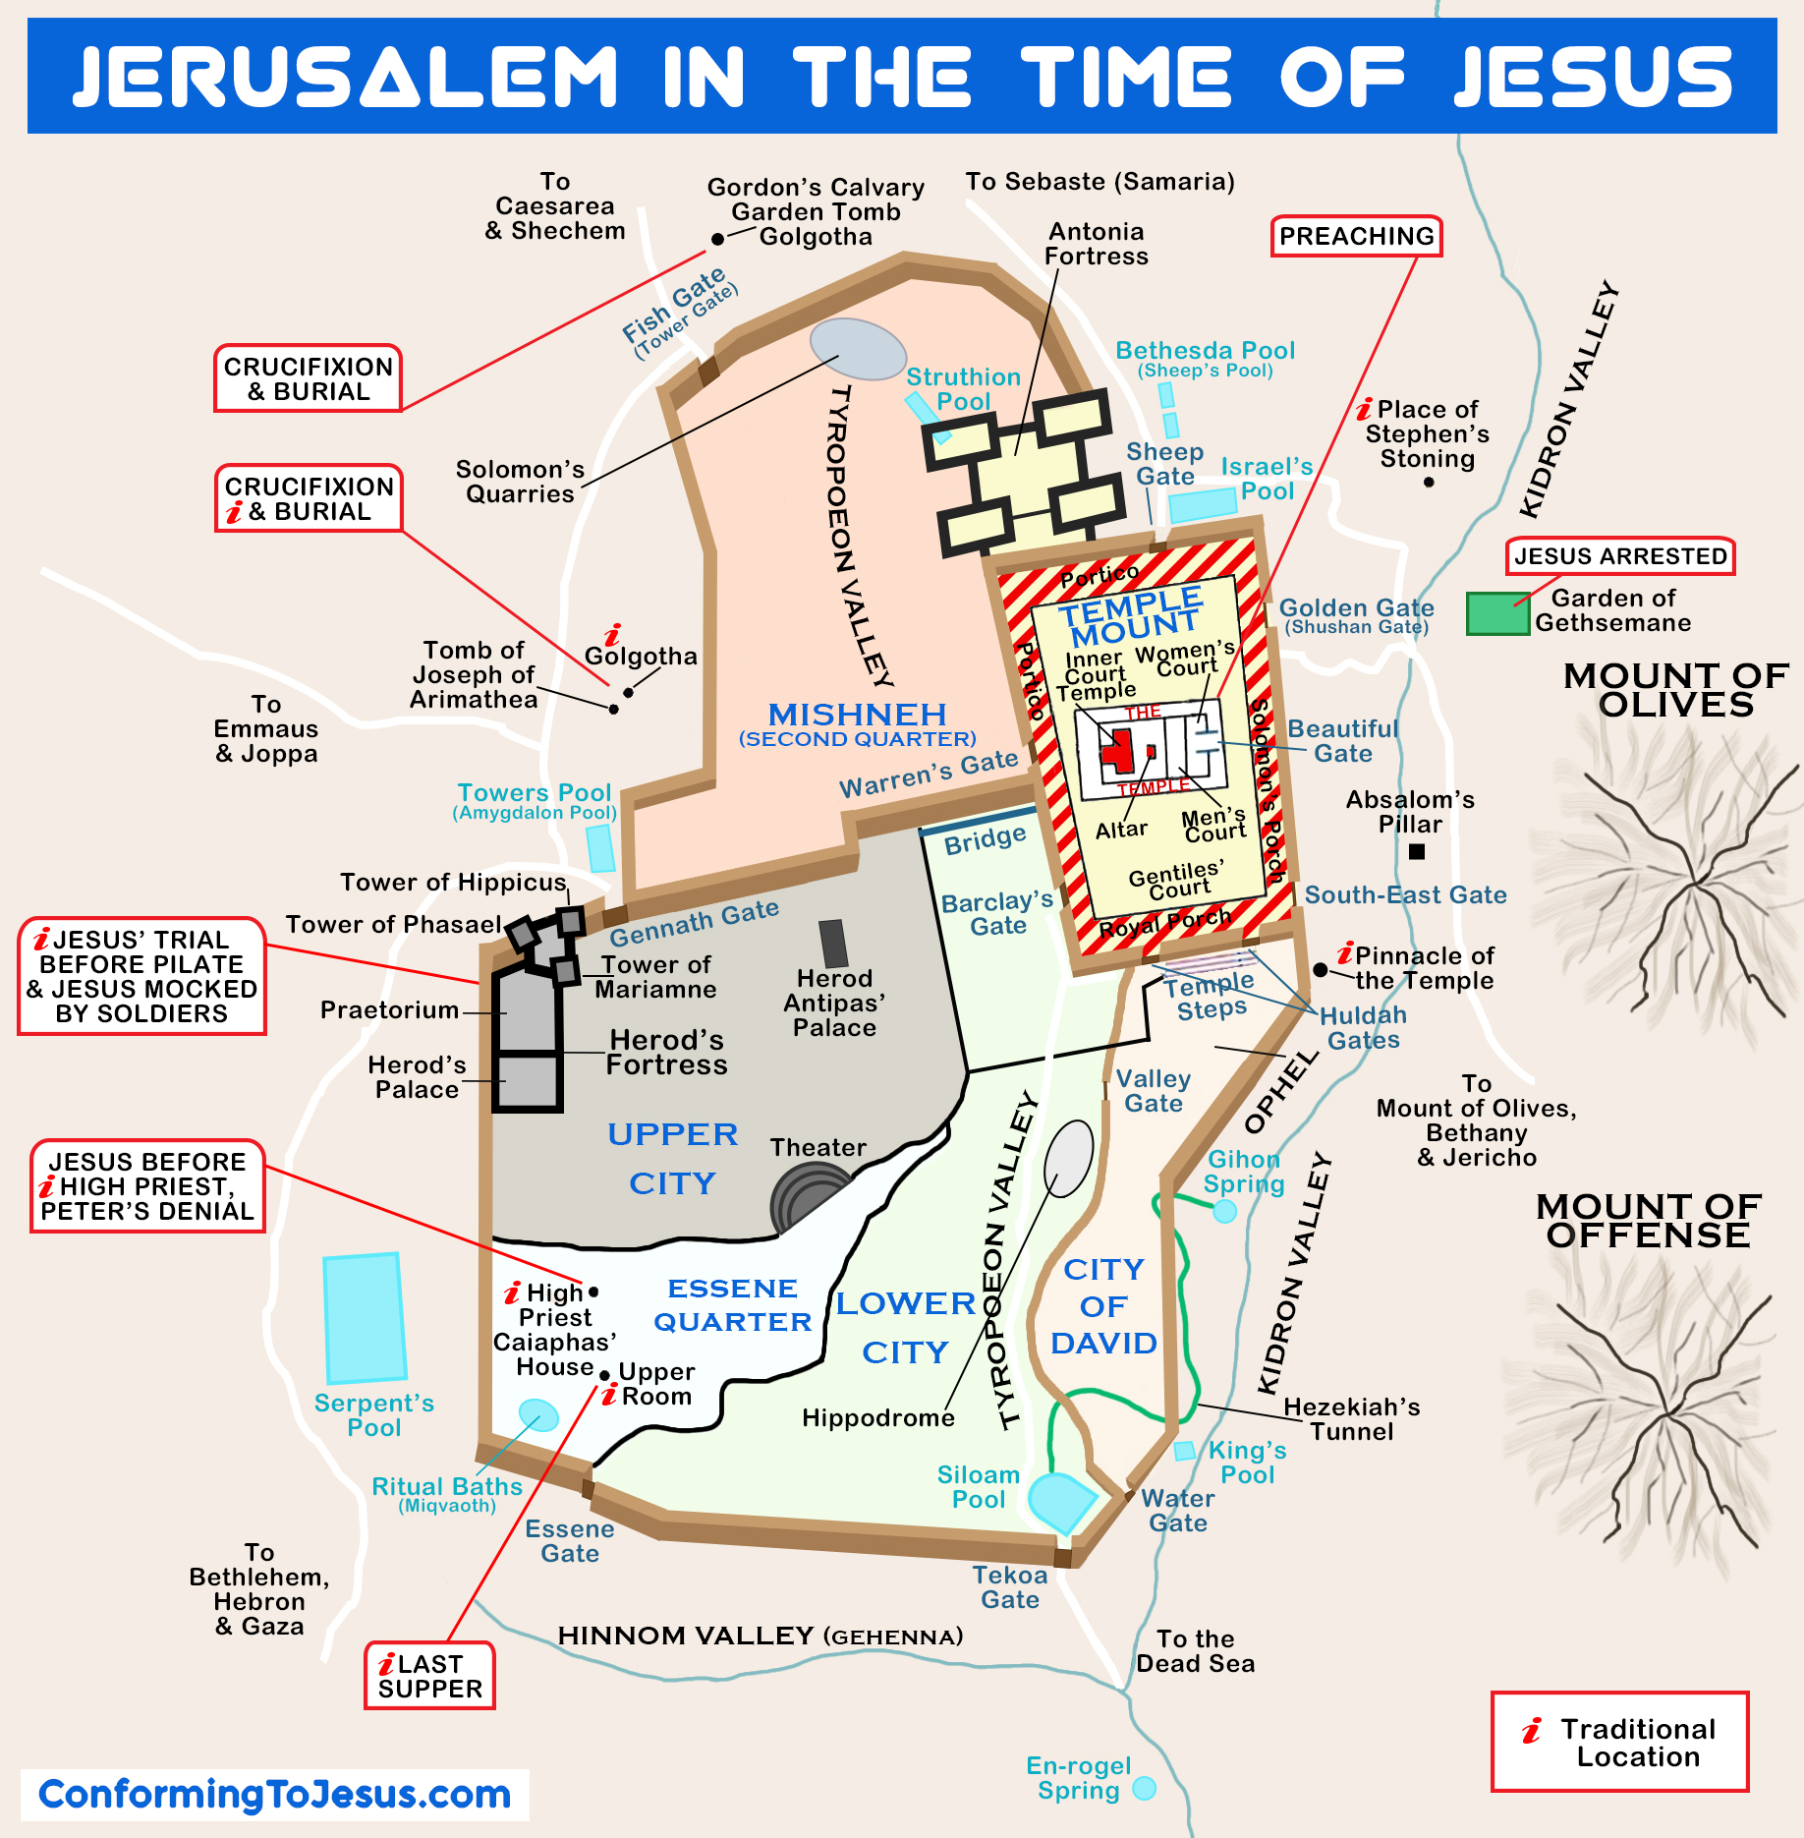
Acts 1
33 A.D. Summer
(7 sabbaths = 49 + 1 = 50. 50 days after the Resurrection, Leviticus 23:15-16, Acts 2:1 is the feast of Pentecost)
Upper Room
Mount of Olives

Slide 5
Acts 1 – The Father will send the Holy Spirit
1:1-5 Introduction & Review (Theophilus – 40 days, Kingdom of God)
1:6-11 The 11 Apostles question about the Kingdom to Israel
Jesus Ascends into Heaven (after 40 days of appearances)
1:12-14 Prayer in the Upper Room (around 25 disciples from Galilee)
1:15-26 Judas’ Suicide (It is written, Psalm 69:25 and 109:8)
Judas Replaced by Matthias (12 Apostles)
Note: The 4 sections above are the same section breaks as the Fellowship Church 2022 Quiet Time Schedule from January 1 to 4. Copies are on the table or church website https://fellowshipchurchwhiteplains.com
.

Slide 6
Question and Answer Time
Next Sunday read-ahead/study - Acts 2
Challenge: Create your own outline and chapter/section titles
Teacher: Bill Heath

