Slide 1
Fellowship Church Sunday School Jan – May 2022, Acts of the Apostles Today – Turn to Acts 10 Prayer > Power > Proclaim > Persecute Teacher: Bill Heath

Slide 2
Acts TRANSITIONS IN THE BOOK OF ACTS 33-67 A.D. Apostle Peter (Acts 1-12) / Apostle Paul (Acts 13-28) Jerusalem (1-10) / Antioch (11-21) / Rome (22-28) 1:3 Jesus spoke for 40 days about the kingdom of God 1:6-8 Kingdom to Israel (Genesis 12 to Malachi, Matthew to John, Rev 19-20) 1:8 Jerusalem/Judea (2, 3-7), Samaria (8-9), Uttermost (10-28) (19) 2:1 The Church began at Pentecost (Acts 2), Church ends in (Revelation 3) 6-8 12 Jewish Apostles plus 7 Greek non-apostles (leaders, Stephen and Philip) 10 & 15 from Jew to Gentile, from 1 Nation to All Nations (Galatians & Hebrews) A pattern in Acts: Prayer > Power > Proclaim > Persecution

Slide 3
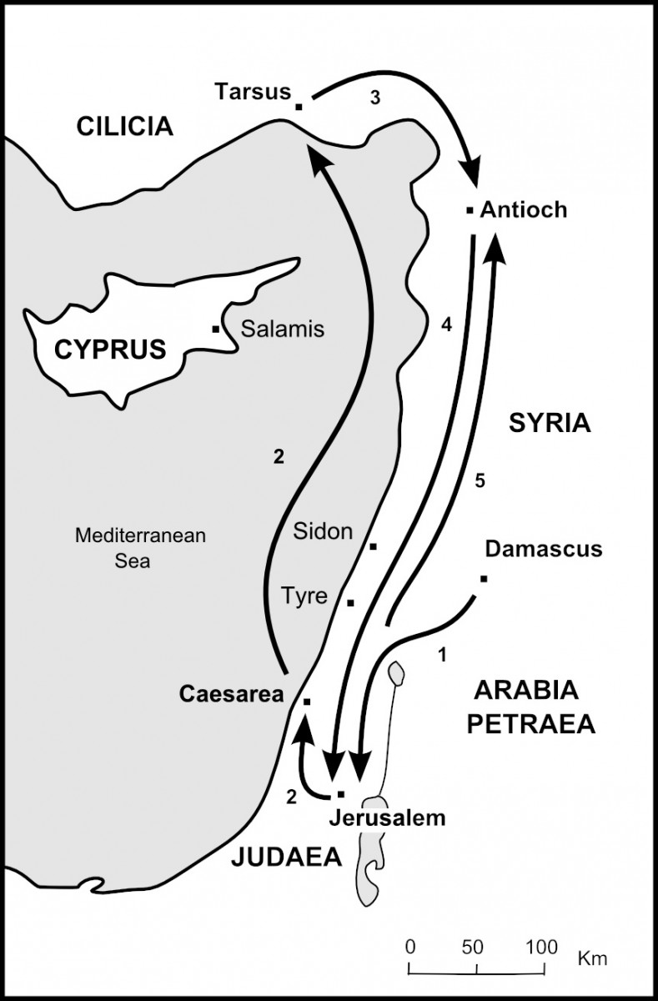
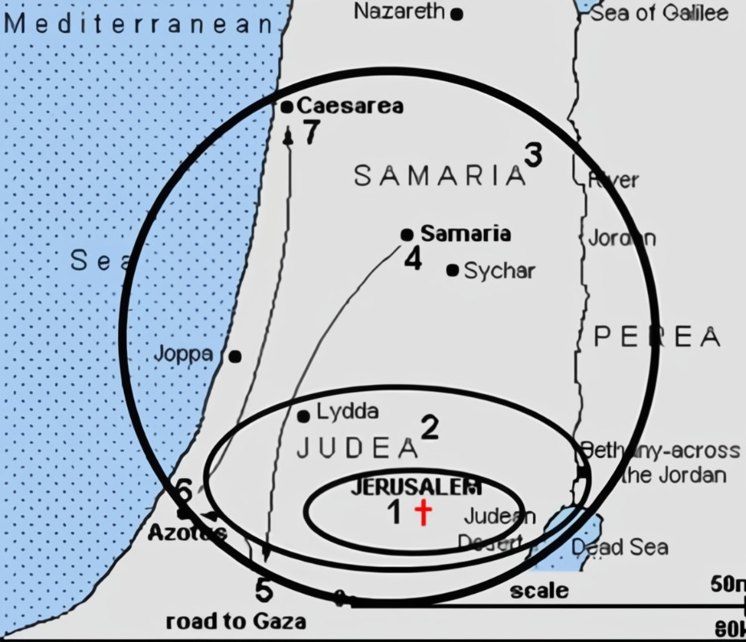
Acts of the Apostle Peter continue
9:32-35 Peter to/at Lydda
(23 miles)
9:36-10:18 Peter to/at Joppa
(10 miles)
Acts 1:8 uttermost part of the earth
The First Gentiles are Saved
10:19-11:1 Peter to/at Caesarea
(30 miles)
Philip at Caesarea 8:40
Philip the evangelist 21:8
11:2 Peter returns to Jerusalem

Slide 4
Acts 10 Pray > Power > Proclaim > Persecute (Inward witness > Outward witness)
10:1-8 Cornelius’ vision – hear Peter (3 pm)
10:9-23 Peter’s vision – go to Cornelius (next day, 12 am)
- “heaven opens” Mt 3:16, Acts 7:56, 10:11, 2 Cor 14:4, Rev 4:1, 11:19, 19:11
10:24-33 Peter & Cornelius share their visions - at Caesarea
10:34-47a Peter preaches Jesus Christ, the first gentiles are saved (Cornelius, his kinsmen, and near friends)
- The Holy Spirit baptizes them as they hear the words of Peter
- They Spoke in tongues and magnified God (Acts 2, a sign, 1 Cor 14:21-22a)
They are baptized with water after baptism in the Holy Spirit
10:47b Peter teaches new believers then returns to Jerusalem

Slide 5
Questions Next Sunday read-ahead/study, Acts 11-12 Title: Preparing for the Apostle Paul’s 1st Missionary Journey Teacher: Brother Bill Heath

