Slide 1
Fellowship Church Sunday School Jan – May 2022, Acts of the Apostles Today – Turn to Acts 11-12 The Jews Embrace the Greeks at Antioch Prayer > Power > Proclaim > Persecute Teacher: Bill Heath

Slide 2
Acts TRANSITIONS IN THE BOOK OF ACTS 33-67 A.D. Apostle Peter (Acts 1-12, 15) / Apostle Paul (Acts 8-9, 13-28) Jerusalem (1-10) / Antioch (11-21) / Rome (22-28) 1:3 Jesus spoke for 40 days about the kingdom of God 1:6-8 Kingdom to Israel (Genesis 12 to Malachi, Matthew to John, Rev 19-20) 1:8 Jerusalem/Judea (2, 3-7), Samaria (8-9), Uttermost (10-28) (19) 2:1 The Church began at Pentecost (Acts 2), the Church ends in (Revelation 3) 6-8 12 Jewish Apostles plus 7 Greek non-apostles (leaders, Stephen and Philip) 10 & 15 from Jew to Gentile, from 1 Nation to All Nations (Galatians & Hebrews) A pattern in Acts: Prayer > Power > Proclaim > Persecution

Slide 3
Greeks saved:
G1 to G3: Acts 11:19-21
S4, (S8-6 yrs.), B3
G3, B2, (B4-S9)
Peter
P1 to P3: Acts 11-12
Barnabas
B1 to B4: Acts 9, 11
(Sister Mary, Nephew Mark)
G2
S1S6
S5
?
Saul (10 years, 36-45 AD)
S1 to S9: Acts 9-12
Gal 1:11-20, 2 Cor 11:32-33
Cyrene, G2
S3, P3, H2
G1, (S2-B1)
S7-P1
H1-P2
Herod Agrippa I (41-44 AD)
H1 and H2: Acts 12
Ethiopia, G2

Slide 4
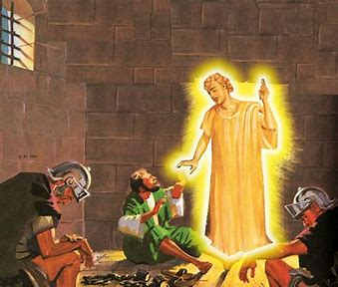
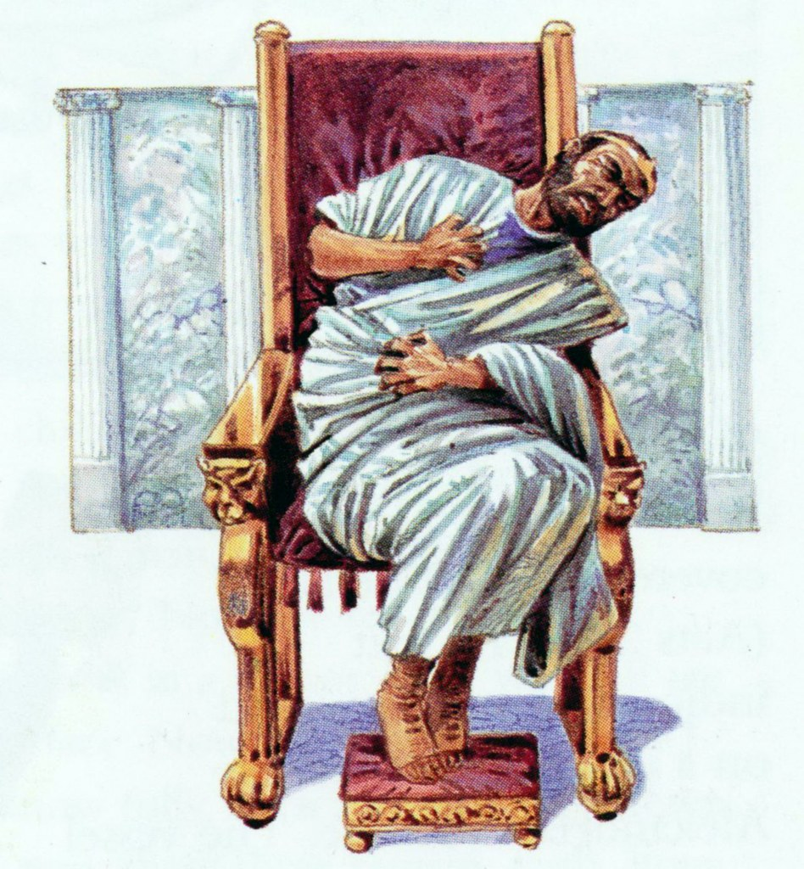
Peter continues from Acts 10 (first gentiles saved)
11:1-18 Peter tells Jerusalem elders his vision
11:19-21 Disciples preach to Jews only – then to Gentiles
11:22-30 Barnabas seeks Saul to teach at Antioch
Herod at Jerusalem (politics)
12:1-5 Herod kills James and imprisons Peter
12:6-19 Peter delivered from prison
12:20-25 Herod worshipped as god – then dies of worms

Slide 5
Questions Next Sunday read-ahead/study, Acts 13 Title: Paul’s First Missionary Trip (Acts 13-14) Teacher: Brother Justin Olsen

