Slide 1
Fellowship Church Sunday School Jan – July 2022, Acts of the Apostles Today – Turn to Acts 15 The Hinge of Acts Prayer > Power > Proclaim > Persecute Teacher: Bill Heath

Slide 2
Acts TRANSITIONS IN THE BOOK OF ACTS 33-67 A.D. Apostle Peter (Acts 1-12, 15) / Apostle Paul (Acts 8-9, 13-28) Jerusalem (1-10) / Antioch (11-21) / Rome (22-28) 1:3 Jesus spoke for 40 days about the kingdom of God 1:6-8 Kingdom to Israel (Genesis 12 to Malachi, Matthew to John, Rev 19-20) 1:8 Jerusalem/Judea (2, 3-7), Samaria (8-9), Uttermost (10-28) (19) 2:1 The Church began at Pentecost (Acts 2), the Church ends in (Revelation 3) 6-8 12 Jewish Apostles plus 7 Greek non-apostles (leaders, Stephen and Philip) 10 & 15 from Jew to Gentile, from 1 Nation to All Nations (Galatians & Hebrews) A pattern in Acts: Prayer > Power > Proclaim > Persecution

Slide 3
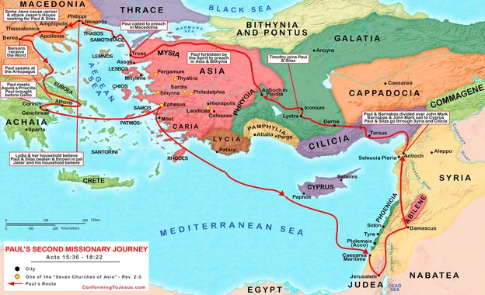
Trip 2
Acts 15:36
to 18:22
Paul &
Silas
Time
2 years
Distance
3050
miles
Stops
14 cities
8 regions
Acts 17:1
Acts 16:1
Acts 18:1
Acts 15:36
Acts 18:22

Slide 4
Acts 15 – The Council at Jerusalem / The Hinge of the book of Acts
PROBLEM (salvation is faith alone, not faith plus works, Romans 7:1-4, Ephesians 2:8-9)
15:1-5 Gentile believers must circumcise and keep the law – decide to go to Jerusalem
- taught error, added to the gospel
15:6-12 Peter and Paul say the Gentiles and Jews have the same salvation experience
- hear and believe, no difference between US and THEM, purifying their hearts by faith
SOLUTION (Amos 9:11-15, Romans 7-8)
15:13-21 James defends Peter with Scripture
- “agree” with the prophets, I will return and build again the “Tabernacle of David”
15:22-35 Paul returns to Antioch with a letter, then teach and preach the word of the Lord
- abstain from food to idols, blood, things strangled / fornication
- apostles, elders, and brethren, … prophets; “seemed good to the Holy Ghost and to us”
Paul’s 2nd Mission Trip begins (Acts 15:36 to 18:22)
15:36-41 Paul separates from Barnabas, then goes with Silas
- “not good” to take Mark , went “confirming“ the churches

Slide 5
Questions Next Sunday read-ahead/study, Acts 16 Title: continue on Paul’s 2nd missions trip Teacher: Brother Phil Verley Acts 17 – Justin, Acts 18 – Phil, Acts 19 - Bill

