Slide 1
Fellowship Church Sunday School Jan – July 2022, Acts of the Apostles Today – Turn to Acts 19 The Last Repeat of an Acts 2 type Pentecost Prayer > Power > Proclaim > Persecute Teacher: Bill Heath
Casting Crowns - Start Right Here ((Single Version) [Official Lyric Video]) - YouTube

Slide 2
Acts TRANSITIONS IN THE BOOK OF ACTS 33-67 A.D. Apostle Peter (Acts 1-12, 15) / Apostle Paul (Acts 8-9, 13-28) Jerusalem (1-10) / Antioch (11-21) / Rome (22-28) 1:3 Jesus spoke for 40 days about the kingdom of God 1:6-8 Kingdom to Israel (Genesis 12 to Malachi, Matthew to John, Rev 19-20) 1:8 Jerusalem/Judea (2, 3-7), Samaria (8-9), Uttermost (10-28) (19) 2:1 The Church began at Pentecost (Acts 2), the Church ends in (Revelation 3) 6-8 12 Jewish Apostles plus 7 Greek non-apostles (leaders, Stephen and Philip) 10 & 15 from Jew to Gentile, from 1 Nation to All Nations (Galatians & Hebrews) A pattern in Acts: Prayer > Power > Proclaim > Persecution

Slide 3
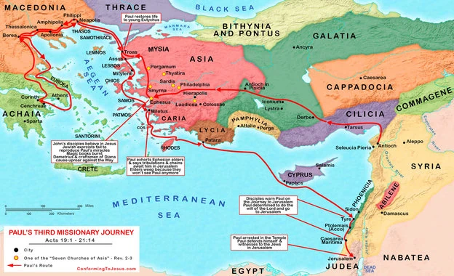
Trip 3
Acts 18:23
to 21:14
Paul &
Timothy,
Apollos
Time
4 years
Distance
3,300
miles
Stops
14 cities
5 regions
Acts 20
Acts 19
Acts 18:23
Apollos
Acts 18:24-28
Acts 21

Slide 4
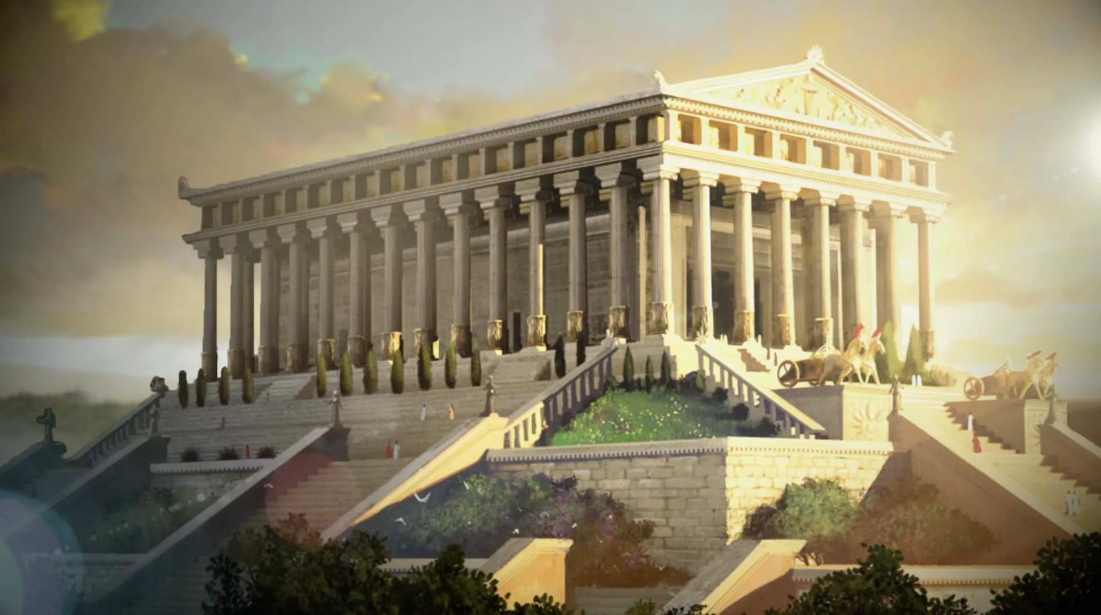
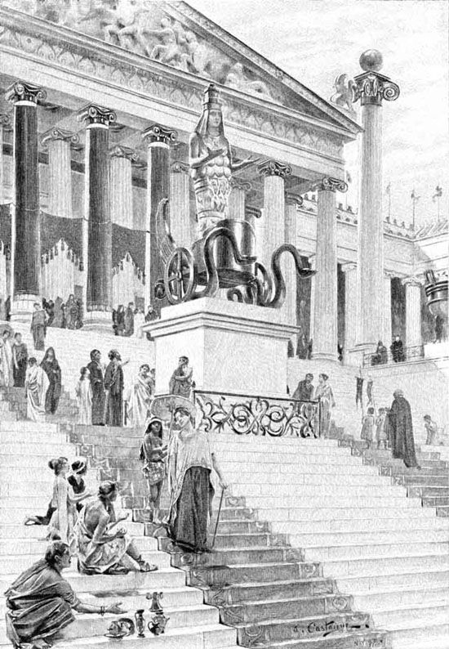
Temple of Diana with the goddess Diana (Greek Artemis)
Temple column today

Slide 5
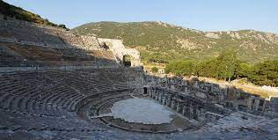
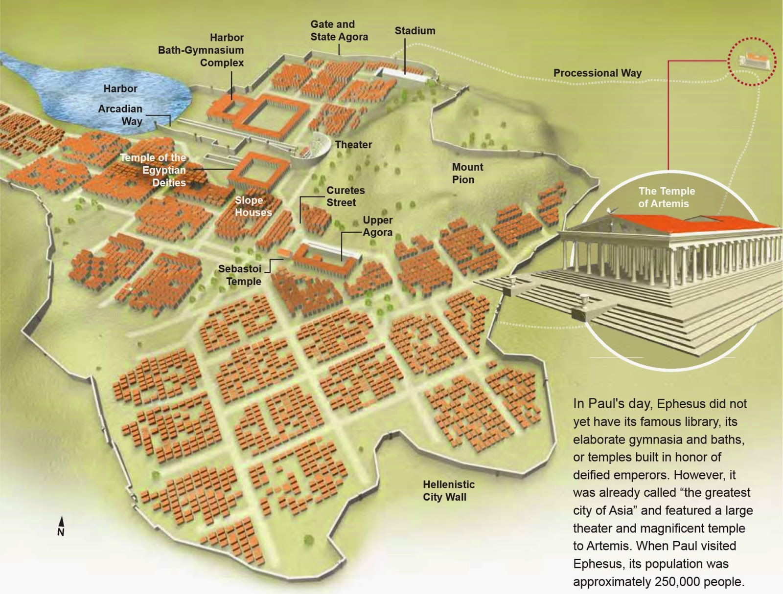

Slide 6
Acts 19 – The Apostle Paul at Ephesus for Three Years
19:1-7 12 disciples of John. 3rd and last time for the “sign” of tongues (1 Cor 14:20-22)
The 12 disciples receive John’s “baptism of repentance,” but never receive the Holy Spirit.
After the 12 hear they (a) “believe on Christ Jesus” and are (b) re-”baptized in the name of the Lord Jesus.”
Paul (c) “lays his hands” on the 12, then (d) “the Holy Spirit came on them.”
Then the 12 men spoke with known-understood-foreign languages and prophesy the “wonderful works of God.”
19:8-22 Paul Proclaims the Kingdom of God and Performs Special Miracles
- Proclaim the gospel then persecution (several Jews from the synagogue spoke evil of “that way”).
All in Asia heard the word of the Lord Jesus.
Handkerchiefs and aprons were used to heal the sick, and evil spirits went out of them.
Evil spirits recognize Jesus and Paul, not Jewish exorcists. “Fear fell on them all-mightily grew the word of God.”
19:23-41 Paul Escapes Persecution from Idol Worshippers at the Temple of Diana
Many believe in the Lord Jesus and depart worship of false Gods (silver statues of Diana).
Idol making craftsmen lose their source of income.
Demetrius stirs up craftsmen and mob to unity in anger and confusion.
Roman political leaders at Ephesus help Paul escape persecution.

Slide 7
Questions Next Sunday read-ahead/study, Acts 20 Title: continue Paul’s 2nd missions trip Challenge: divide into sections and title sections Teacher: Brother Bill Heath Acts 21 & 22 – Brother Wayne

