Slide 1
Fellowship Church Sunday School Jan – May 2022, Acts of the Apostles Today – Turn to Acts 2 “The Father Sends the Holy Spirit” or “The Birth of the Church” Teacher: Bill Heath

Slide 2
2022 – Year of the New Bottle A daily morning choice to Pour New Wine into New Bottles (Job 32:9, Matthew 9:17, Mark 2:22, Luke 5:37-39, Acts 2:13, Eph 5:18)
The Apostle’s Doctrine (Acts 2:42, 2 Timothy 3:10)
Worship God
Scripture
Prayer
Fellowship
Witnessing
Holy Spirit
Salvation
Time Management
Persecution
Good works
Kingdom of God / Kingdom to Israel
Priorities
Church Attendance
Wonderful Works of God
Church Government

Slide 3
Acts TRANSITIONS IN THE BOOK OF ACTS 33-67 A.D. Old Testament (1) to New Testament (2-28) Apostle Peter (Acts 1-12) / Apostle Paul (Acts 13-28) Jerusalem (1-7) / Antioch (8-21) / Rome (22-28) 1:3 Jesus spoke for 40 days about the kingdom of God 1:6-8 Kingdom to Israel (Genesis 12 to Malachi, Matthew to John, Rev 19-20) 1:8 Jerusalem/Judea (2-3), Samaria (8, 8-9), Uttermost (10, 10-12), (19, 13-28) 2:1 Church began at Pentecost (Acts 2), Church ends in (Revelation 3) 10 & 15 from Jew to Gentile, from 1 Nation to All Nations, Galatians & Hebrews Pattern: Prayer – Power – Proclaim - Persecution – More Prayer

Slide 4
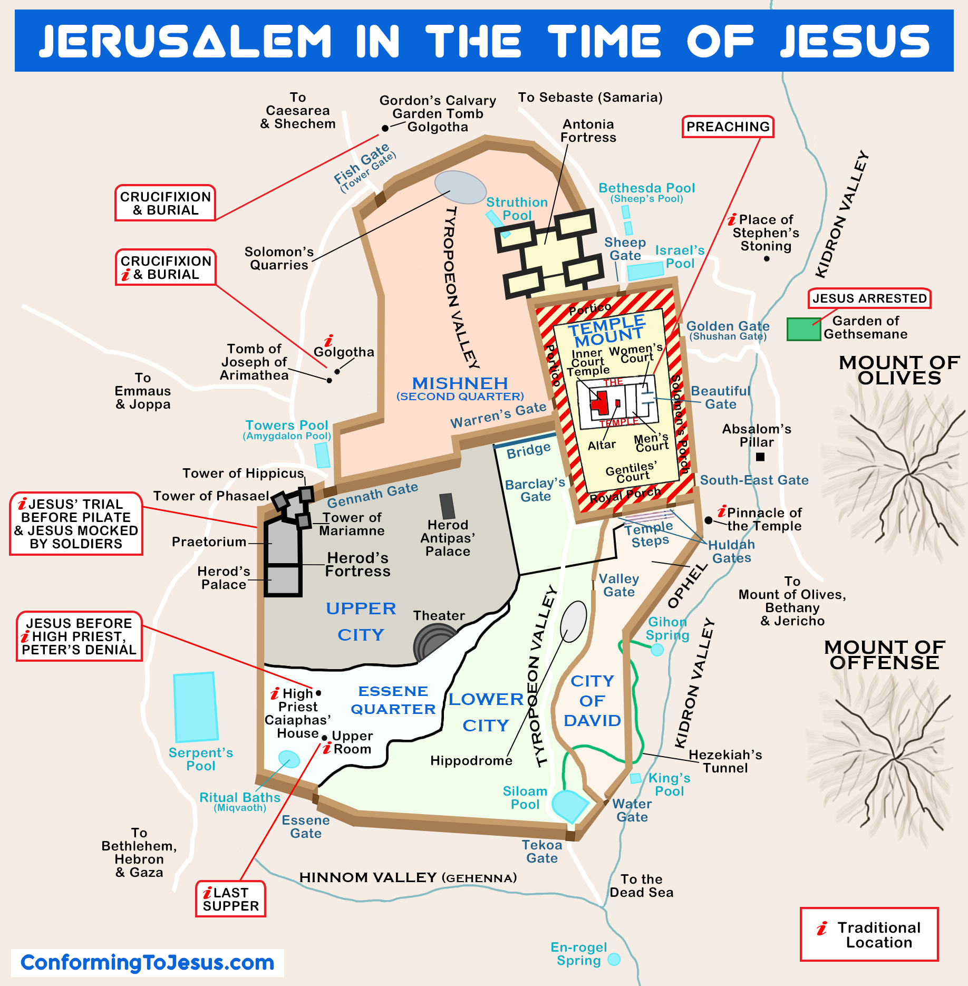
Acts 2 33 A.D. Summer (7 sabbaths = 49 + 1 = 50 days after the Sabbath, Leviticus 23:15-16, Acts 2:1 is the feast of Pentecost. Begin-end with Sunday) House (2:1-13, 12 or 12+ or 120 speak) Temple (2:14-21, 3,000)

Slide 5
Acts 2 – The Father sends the Holy Spirit to the Church
2:1-13 The Holy Spirit Arrives and they speak the “wonderful works
of God” (a one-time event, beginning the Church age)
2:14-36 Peter’s 10-point message on the “wonderful works of God”
2:37-41 3,000 Jews repent, are baptized in the name of Jesus for
the remission of sins, then receive the gift of the Holy Spirit
2:42-47 They continue in the Apostles doctrine, fellowship, breaking
of bread, and prayers

Slide 6
Acts 2:42-47 – 16 Manifestations of the Holy Spirit
42 continue in the Apostles doctrine, fellowship, breaking of bread,
and prayers (cause - still applies today)
43a fear came upon every soul (effect - still applies today, in revival)
43b-45 many wonders and signs through the Apostles
together, all things common, sold possessions, divided goods
(circumstantial - does not apply the same,today or always)
46-47a continued daily with one accord in the temple,
breaking bread in houses, ate with gladness and single heart,
praising God (effect - still applies today, in revival)
47b favor with all the people, Lord added saved daily to the church
(circumstantial - does not apply the same always)

Slide 7
Questions Next Sunday read-ahead/study Acts 3:1 to 4:4 (Lame man healed and Peter’s 2nd Message - 5,000 saved) Teacher: Phil Verley

