Slide 1
Fellowship Church Sunday School Jan – July 2022, Acts of the Apostles Today – Turn to Acts 23 Persecution, Protection & Providence Teacher: Bill Heath

Slide 2
Acts TRANSITIONS IN THE BOOK OF ACTS 33-67 A.D. Apostle Peter (Acts 1-12, 15 (James too)) / Apostle Paul (Acts 8-9, 13-28) Jerusalem (1-10) / Antioch (11-21) / Rome (22-28) 1:3 Jesus spoke for 40 days about the kingdom of God 1:6-8 Kingdom to Israel (Genesis 12 to Malachi, Matthew to John, Rev 19-20) 1:8 Jerusalem/Judea (2, 3-7), Samaria (8-9), Uttermost (10-28) (19) 2:1 The Church began at Pentecost (Acts 2), and the Church ends in (Revelation 3) 6-8 12 Jewish Apostles plus 7 Greek non-apostles (leaders, Stephen and Philip) 10 & 15 from Jew to Gentile, from 1 Nation to All Nations (Galatians & Hebrews) A pattern in Acts: Prayer > Power > Proclaim > Persecution

Slide 3
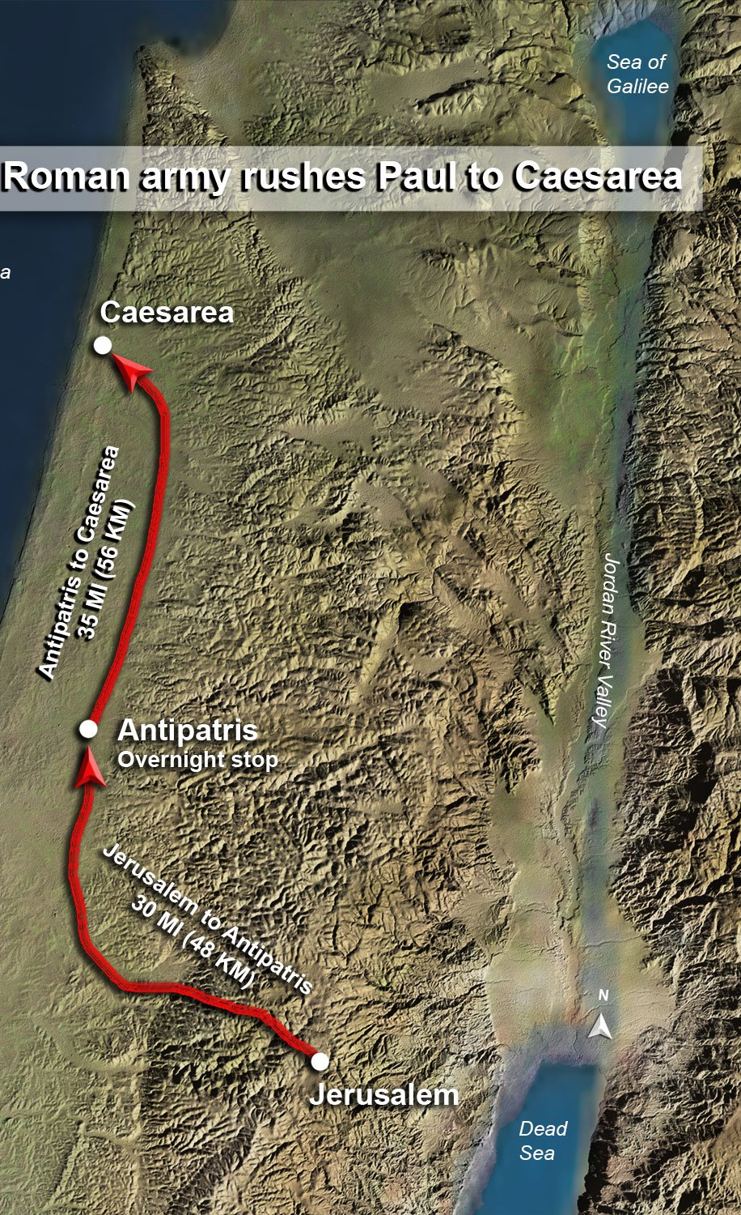
Acts 21:15-26:32, Paul’s Testimony
Acts At Jerusalem (12 days)
21:15-26 Vow at the Temple & false witness
1st 22:1-29 Testimony to angry mob & soldiers rescue
2nd 22:30-23:35 Testimony to the Council & soldiers rescue
At Caeserea (2 years)
3rd 24:1-27 Testimony to Governor Felix
4th 25:1-12 Testimony to Governor Festus
5th 25:13-26:32 Testimony to King Agrippa
27-28 Trip to Rome (1st known in Acts 19:21)

Slide 4
Acts 22:30-23:35, Paul’s Testimony to the Council at Jerusalem (2nd witness, 3 days)
22:30-23:11 PERSECUTION by the High Priest and the Council
- On the next day after the Council persecutes Paul
Pharisees’ and Sadducees’ unity is divided by doctrine
The night following the Lord Jesus encourages Paul
23:12-22 A Vow, a Young Man, and a Soldier PROTECTION & PROVIDENCE
A vow of over 40 Jewish men to kill Paul the next day (23:12-15)
A secret between Paul, a young man, and the Chief Captain (23:16-22)
23:23-35 Captain Writes a Letter and Escorts Paul to Felix the Governor of Caesarea
Plan to keep Paul safe by departing Jerusalem at 9 pm on the same day
200 foot soldiers, 70 horsemen, and 200 spearmen
Letter to the most excellent governor Felix
70 horsemen arrive in Caesarea
Questions? Next Sunday, Acts 24 with Raymund Remo

