Slide 1
Fellowship Church Sunday School Jan – July 2022, Acts of the Apostles Today – Turn to Acts 25 Persecution & Faith Teacher: Bill Heath

Slide 2
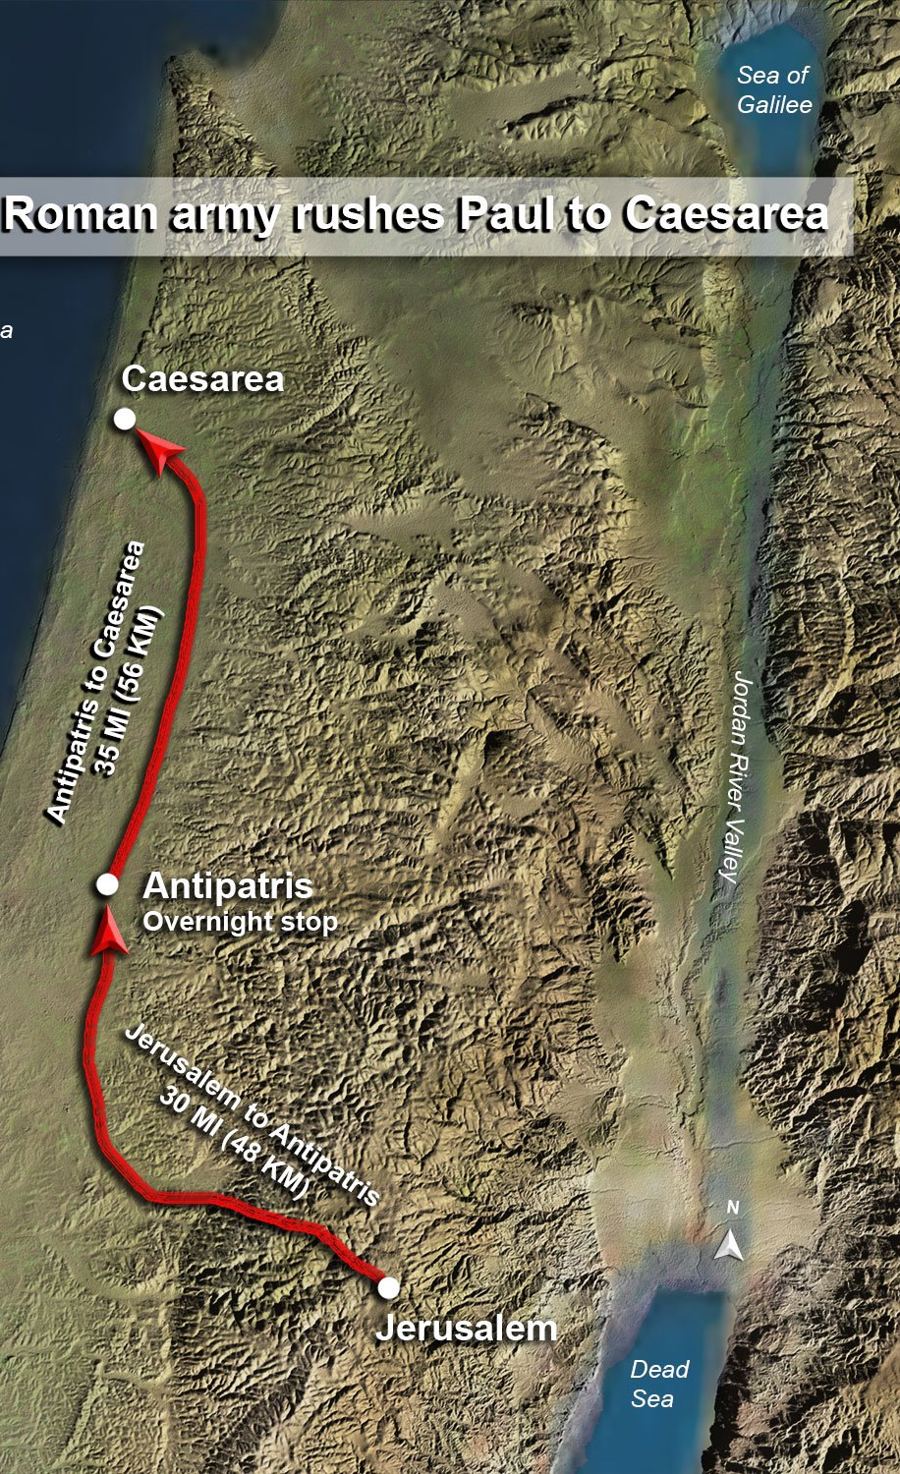
Acts 21:15-26:32, Paul’s 5 Trials
Acts At Jerusalem (12 days)
21:15-26 Vow at the Temple & false witness
1st 22:1-29 Testimony to angry mob & soldiers rescue
2nd 22:30-23:35 Witness to the Council & soldiers rescue
At Caeserea (>2 years)
3rd 24:1-27 Witness to Governor Felix (> 2 years)
4th 25:1-12 Witness to Governor Festus (> 14 days)
5th 25:13-26:32 Testimony to King Agrippa (near 30 days)
27-28 Trip to Rome (1st known in Acts 19:21)

Slide 3
Laws of the Land and Laws of God (Acts 24:25)
Last week’s examples:
Supreme Court Opinions
S. Maryland Counties
McLean Bible Church
Fellowship Church

Slide 4
The Herodian Dynasty 103 years
(37 BC – 66 AD)
1st Herod the Great
Murdered Babies
2nd Herod Antipas
Murdered John
Trial 5 – Jesus
3rd Herod Agrippa I
Murdered James
4th Herod Agrippa II
Trial 5 - Paul
Descendants of Esau?
1 Tim 1:4, Titus 3:9

Slide 5
Acts 25, Paul’s 4th and 5th Trials (Offense, Accuse, Defense, Judge, Appeal, Hearing, Evidence)
24:25-27 Paul’s Witness to Felix (25). Money & Time – Felix turnovers to Festus (26-27).
25:1-12 Paul Before Governor Festus – Trial 4 PERSECUTION and FAITH
(1-5) Religious leaders ACCUSE Paul (they want to kill him)
(6-7) At the JUDGMENT SEAT the Jews ACCUSE Paul with no proof
(8-11) Paul’s DEFENSE & request for Caesar’s JUDGMENT SEAT
(12) Roman JURY approves APPEAL to Caesar.
25:13-27 Paul Before King Agrippa II - Trial 5 (part 1)
(13-16) After many days Festus tells Agrippa about the Jew’s JUDGMENT AGAINST Paul
(17-21) The next day JUDGMENT SEAT – accusations only religious superstition
(22-23) The next day HEARING Paul face to face (Acts 26)
(24-27) Nothing to write, no CRIME AGAINST Paul
Questions?
Next Sunday: Acts 26 - Trial 5 (part 2) Paul’s Testimony Teacher: Bill Heath

